Slide 1
Understanding Nature-based Solutions’ Role in Flood Mitigation, Environmental Uplift, and Community Enhancement
EAC 4th Quarter Meeting– July 18, 2025
Mikel Wilkins, PE - Senior Engineer

Slide 2
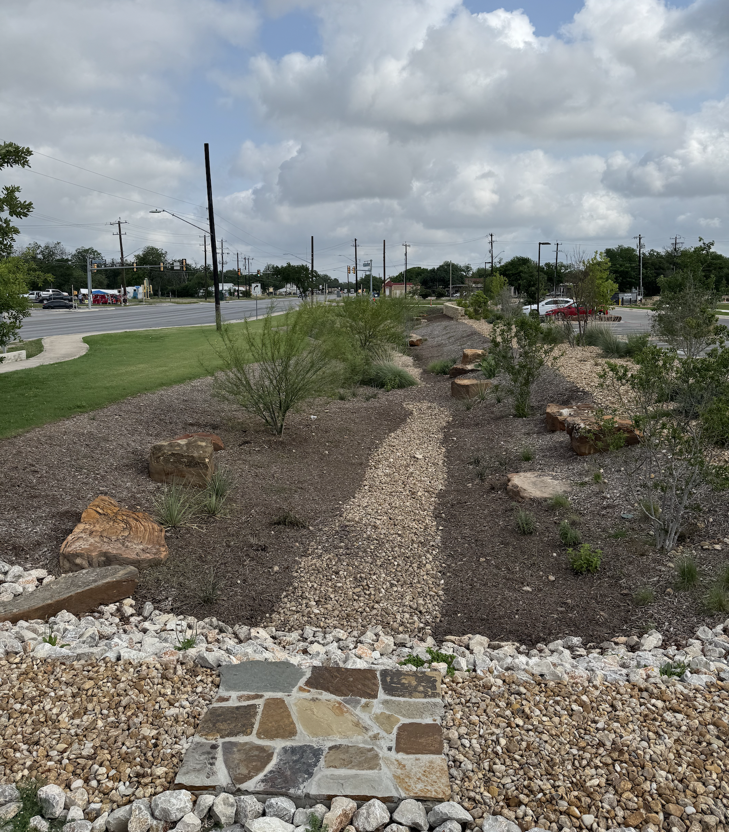
Nature-based Solutions
NbS, an "umbrella concept"
Green Infrastructure, Low Impact Development, Natural, and Nature-based features, Stormwater BMPs
Imitate or preserve natural features and/or processes to increase environmental sustainability & resilience
Hybrid engineered systems or preserved natural systems
Provides co-benefits

Slide 3
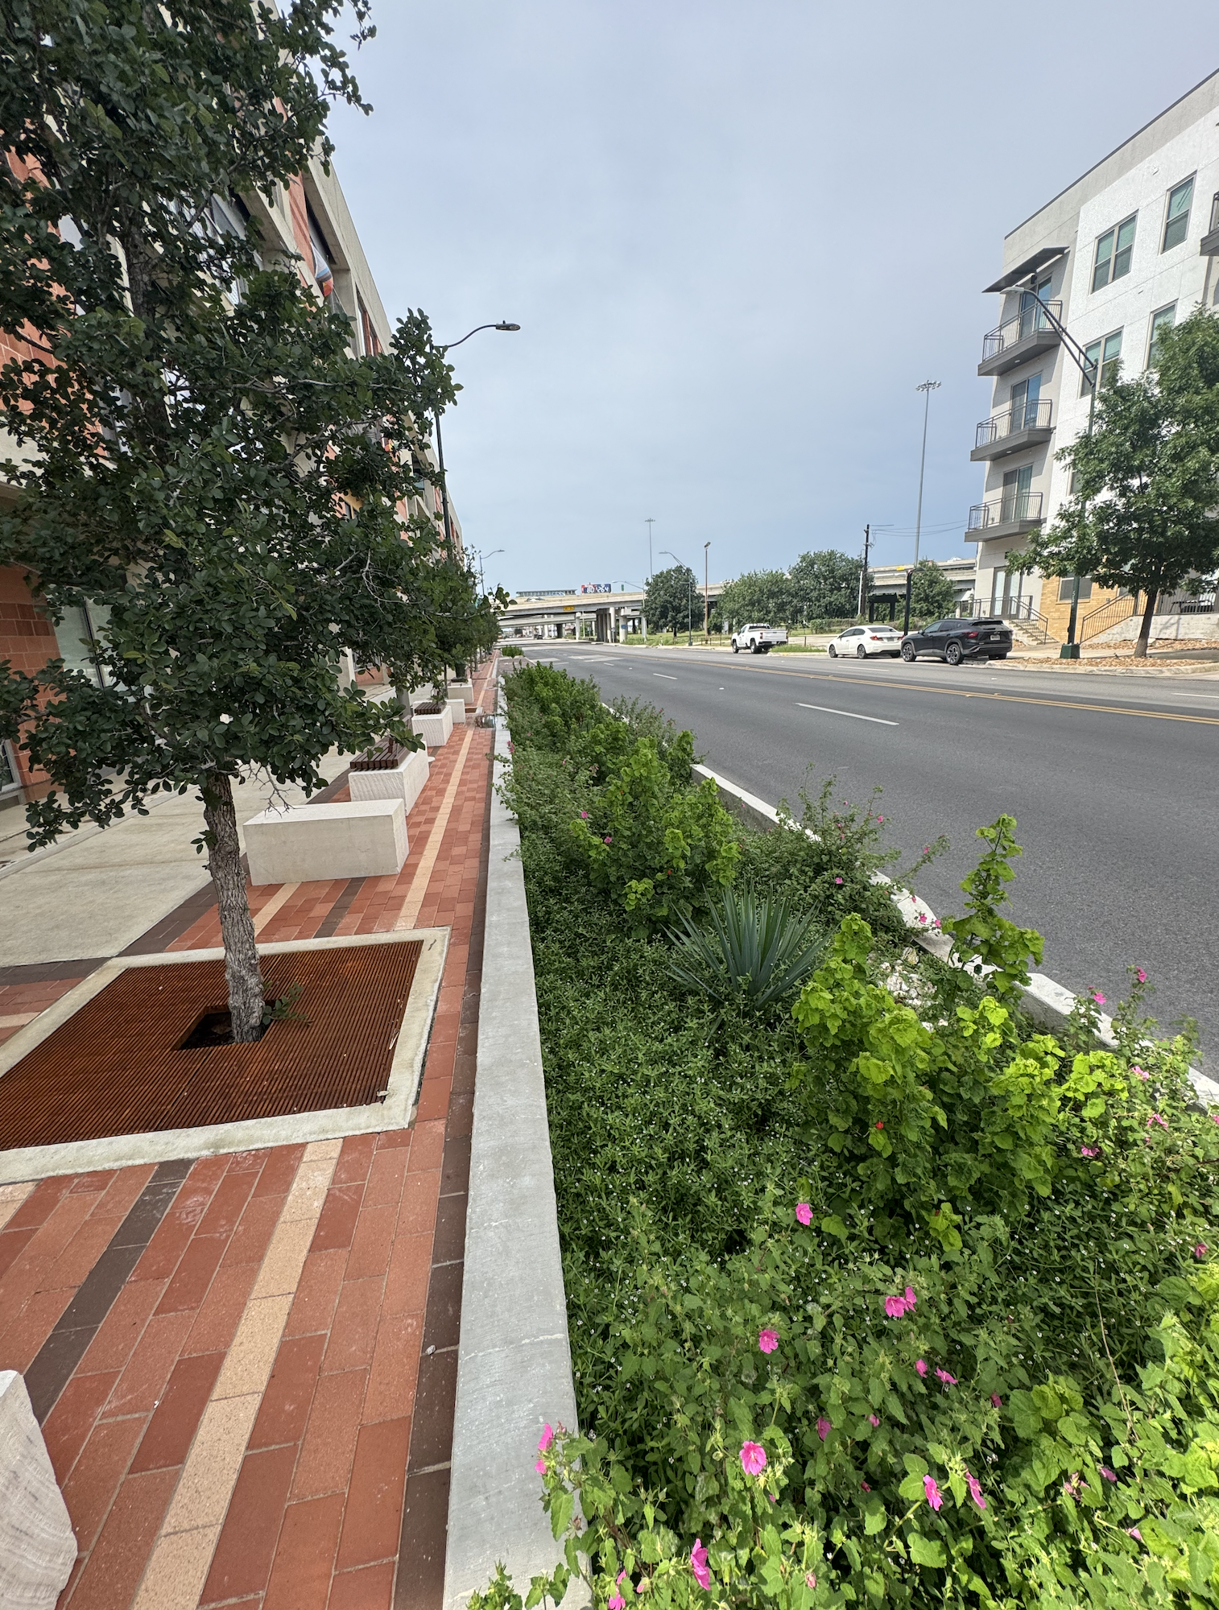
Nature-based Solutions
Co-benefits
Water Quality improvements
Bacteria, TSS, Oil/Grease, Metals, Nutrients, and Heat
Infiltration & Peak Runoff reduction
Habitat & Biodiversity
Reduced Heat Island Effect
Beautification, Recreation

Slide 4
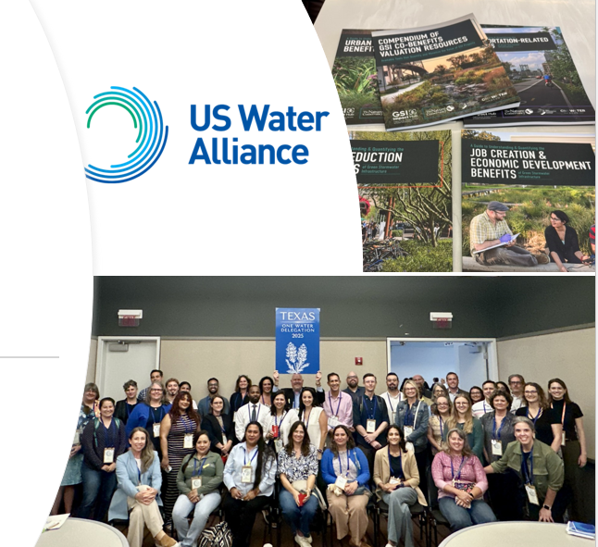
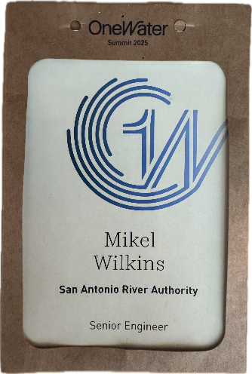
Nature-based Solutions
Technical Leadership: Continuously improve planning, design, construction, and O&M guidance
NBS Master Planning
NBS for Flood Mitigation Projects
Support for Community Planning Efforts
Innovation and National Collaboration
Notes:
Our LID Manual is the Code standard for voluntary and mandatory low impact development in San Antonio, and it is widely used as a resource across our four county jurisdiction.
We are leveraging in-house expertise for the majority of our project design, which helps us better execute our responsibilities as technical leaders.
Sharp in-house experts help drive the value of our training courses, and increases our effectiveness as technical reviewers for development in the RIO Districts and West Side Creek water quality protection areas.
Through our program we can continue to generate useful recommendations and guidance to our agency partners on how to bring these approaches into policy.

Slide 5
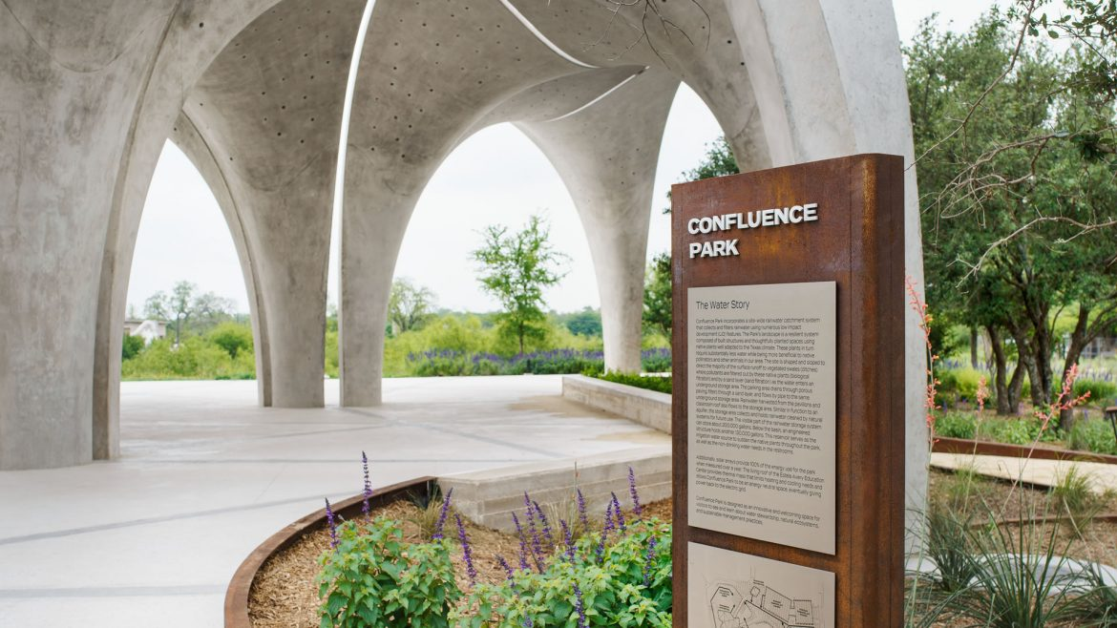
How do we plan for and prioritize nature-based solutions?
Notes:
Now Mikel is going to share our latest work identifying and prioritizing nature-based infrastructure for implementation in San Antonio and beyond in our Southern basin.

Slide 6
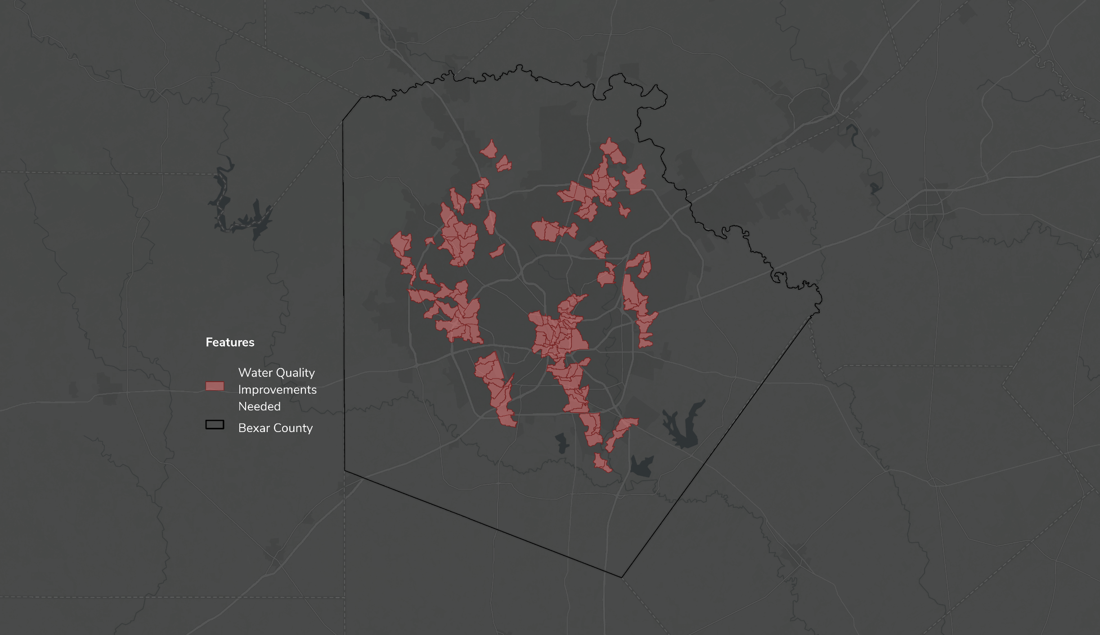
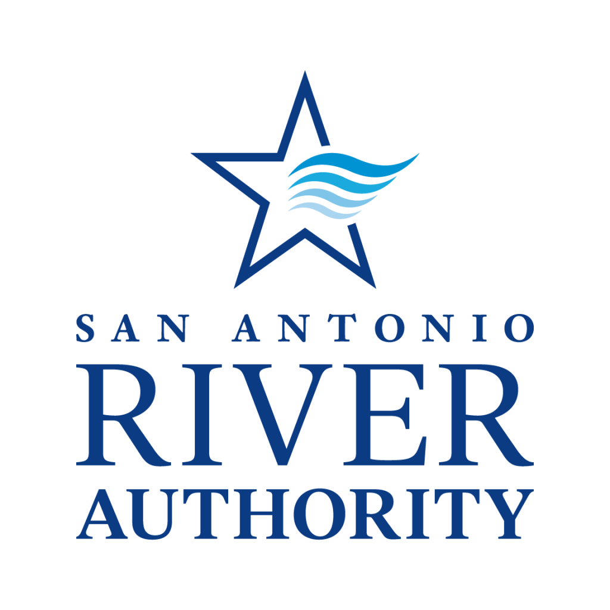
NbS Priority Areas

Slide 7
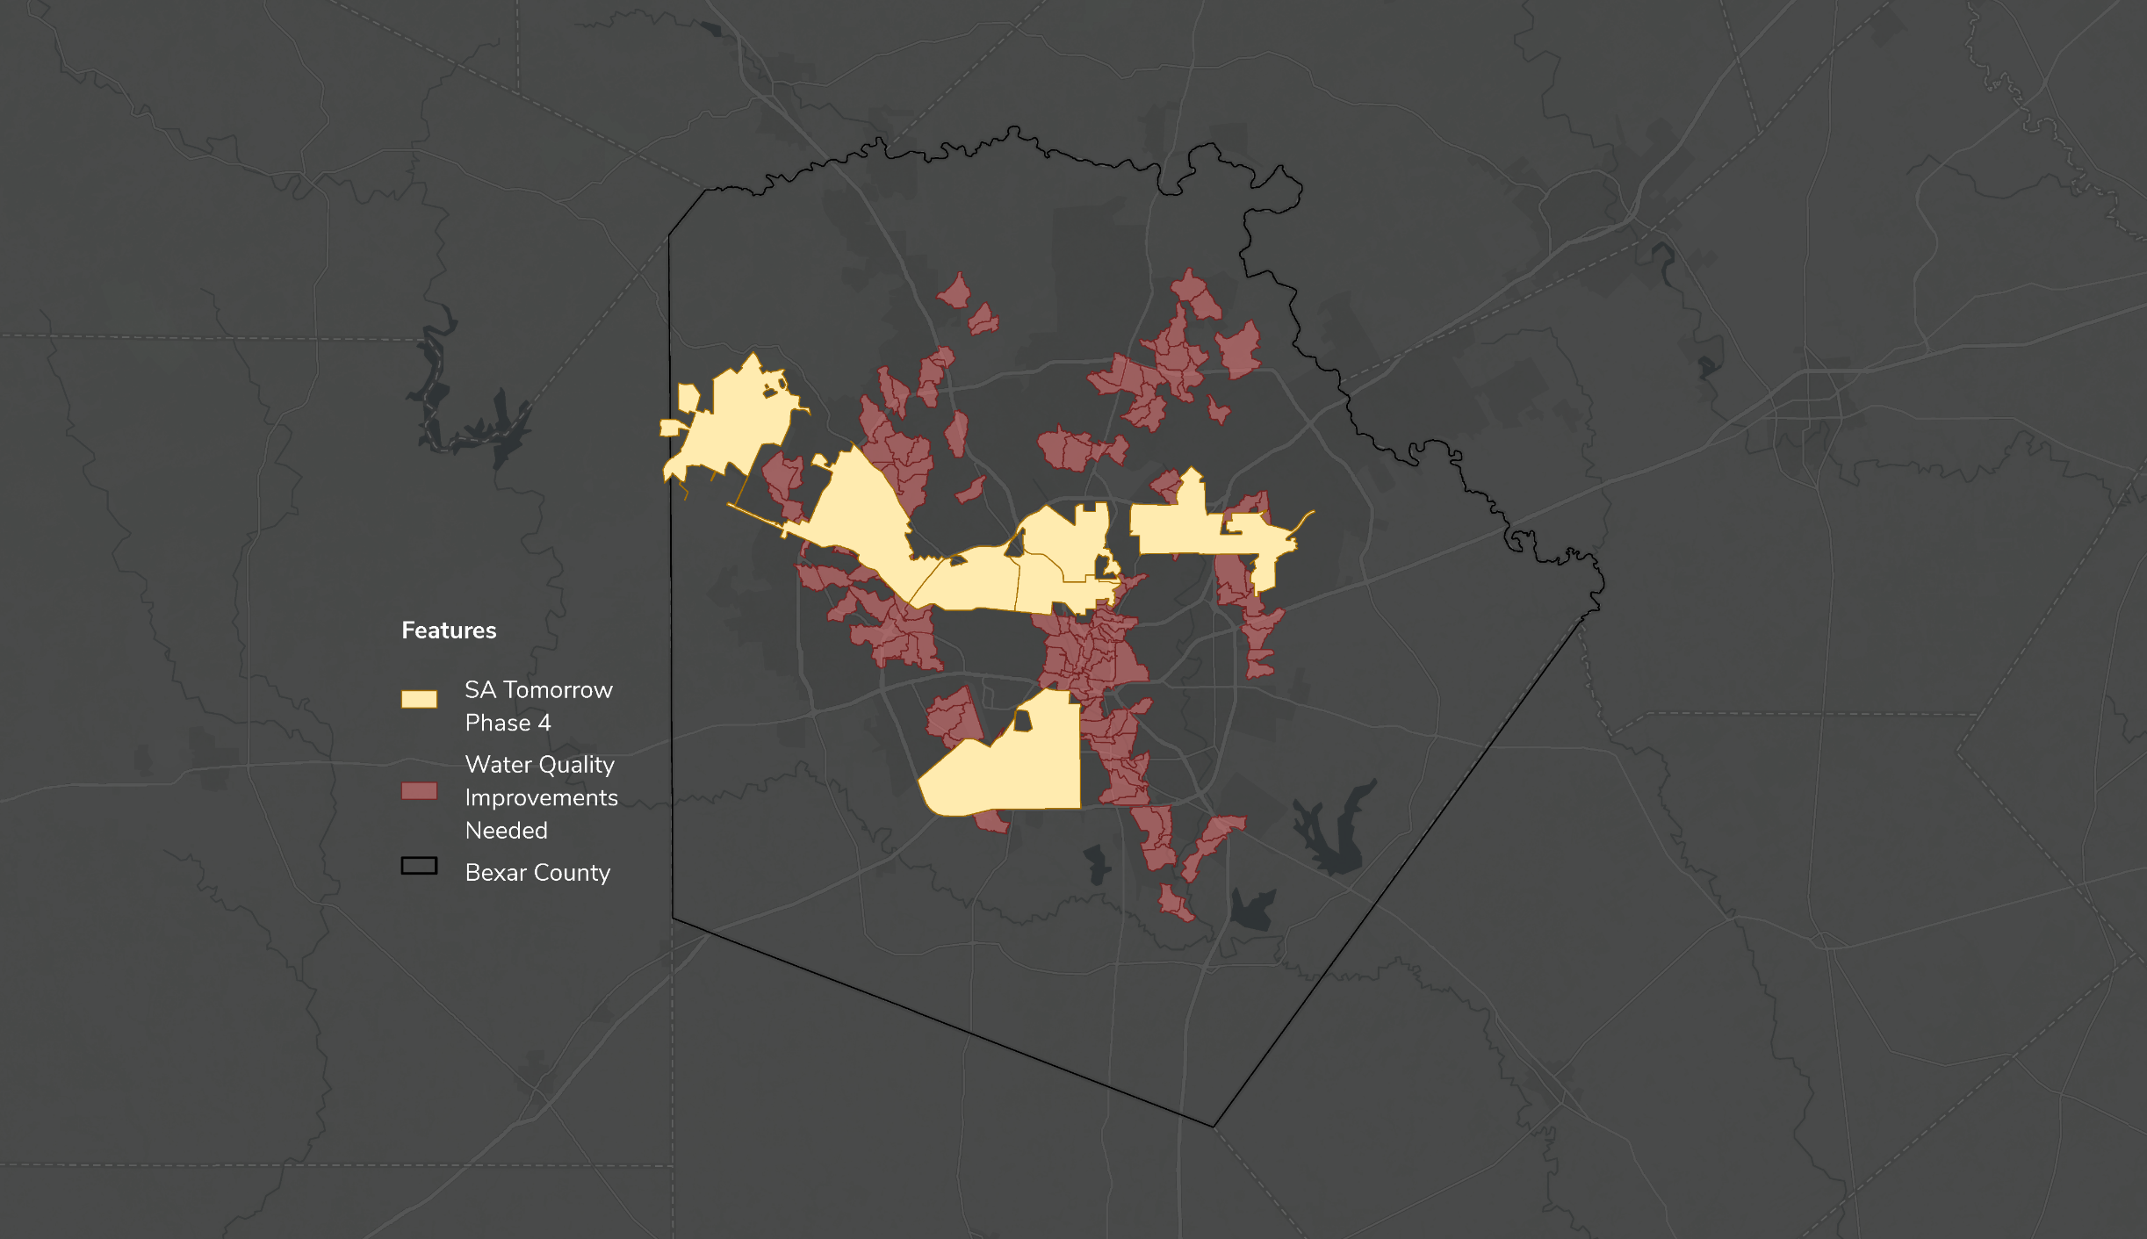
NbS Priority Areas

Slide 8
NbS Priority Areas

Slide 10
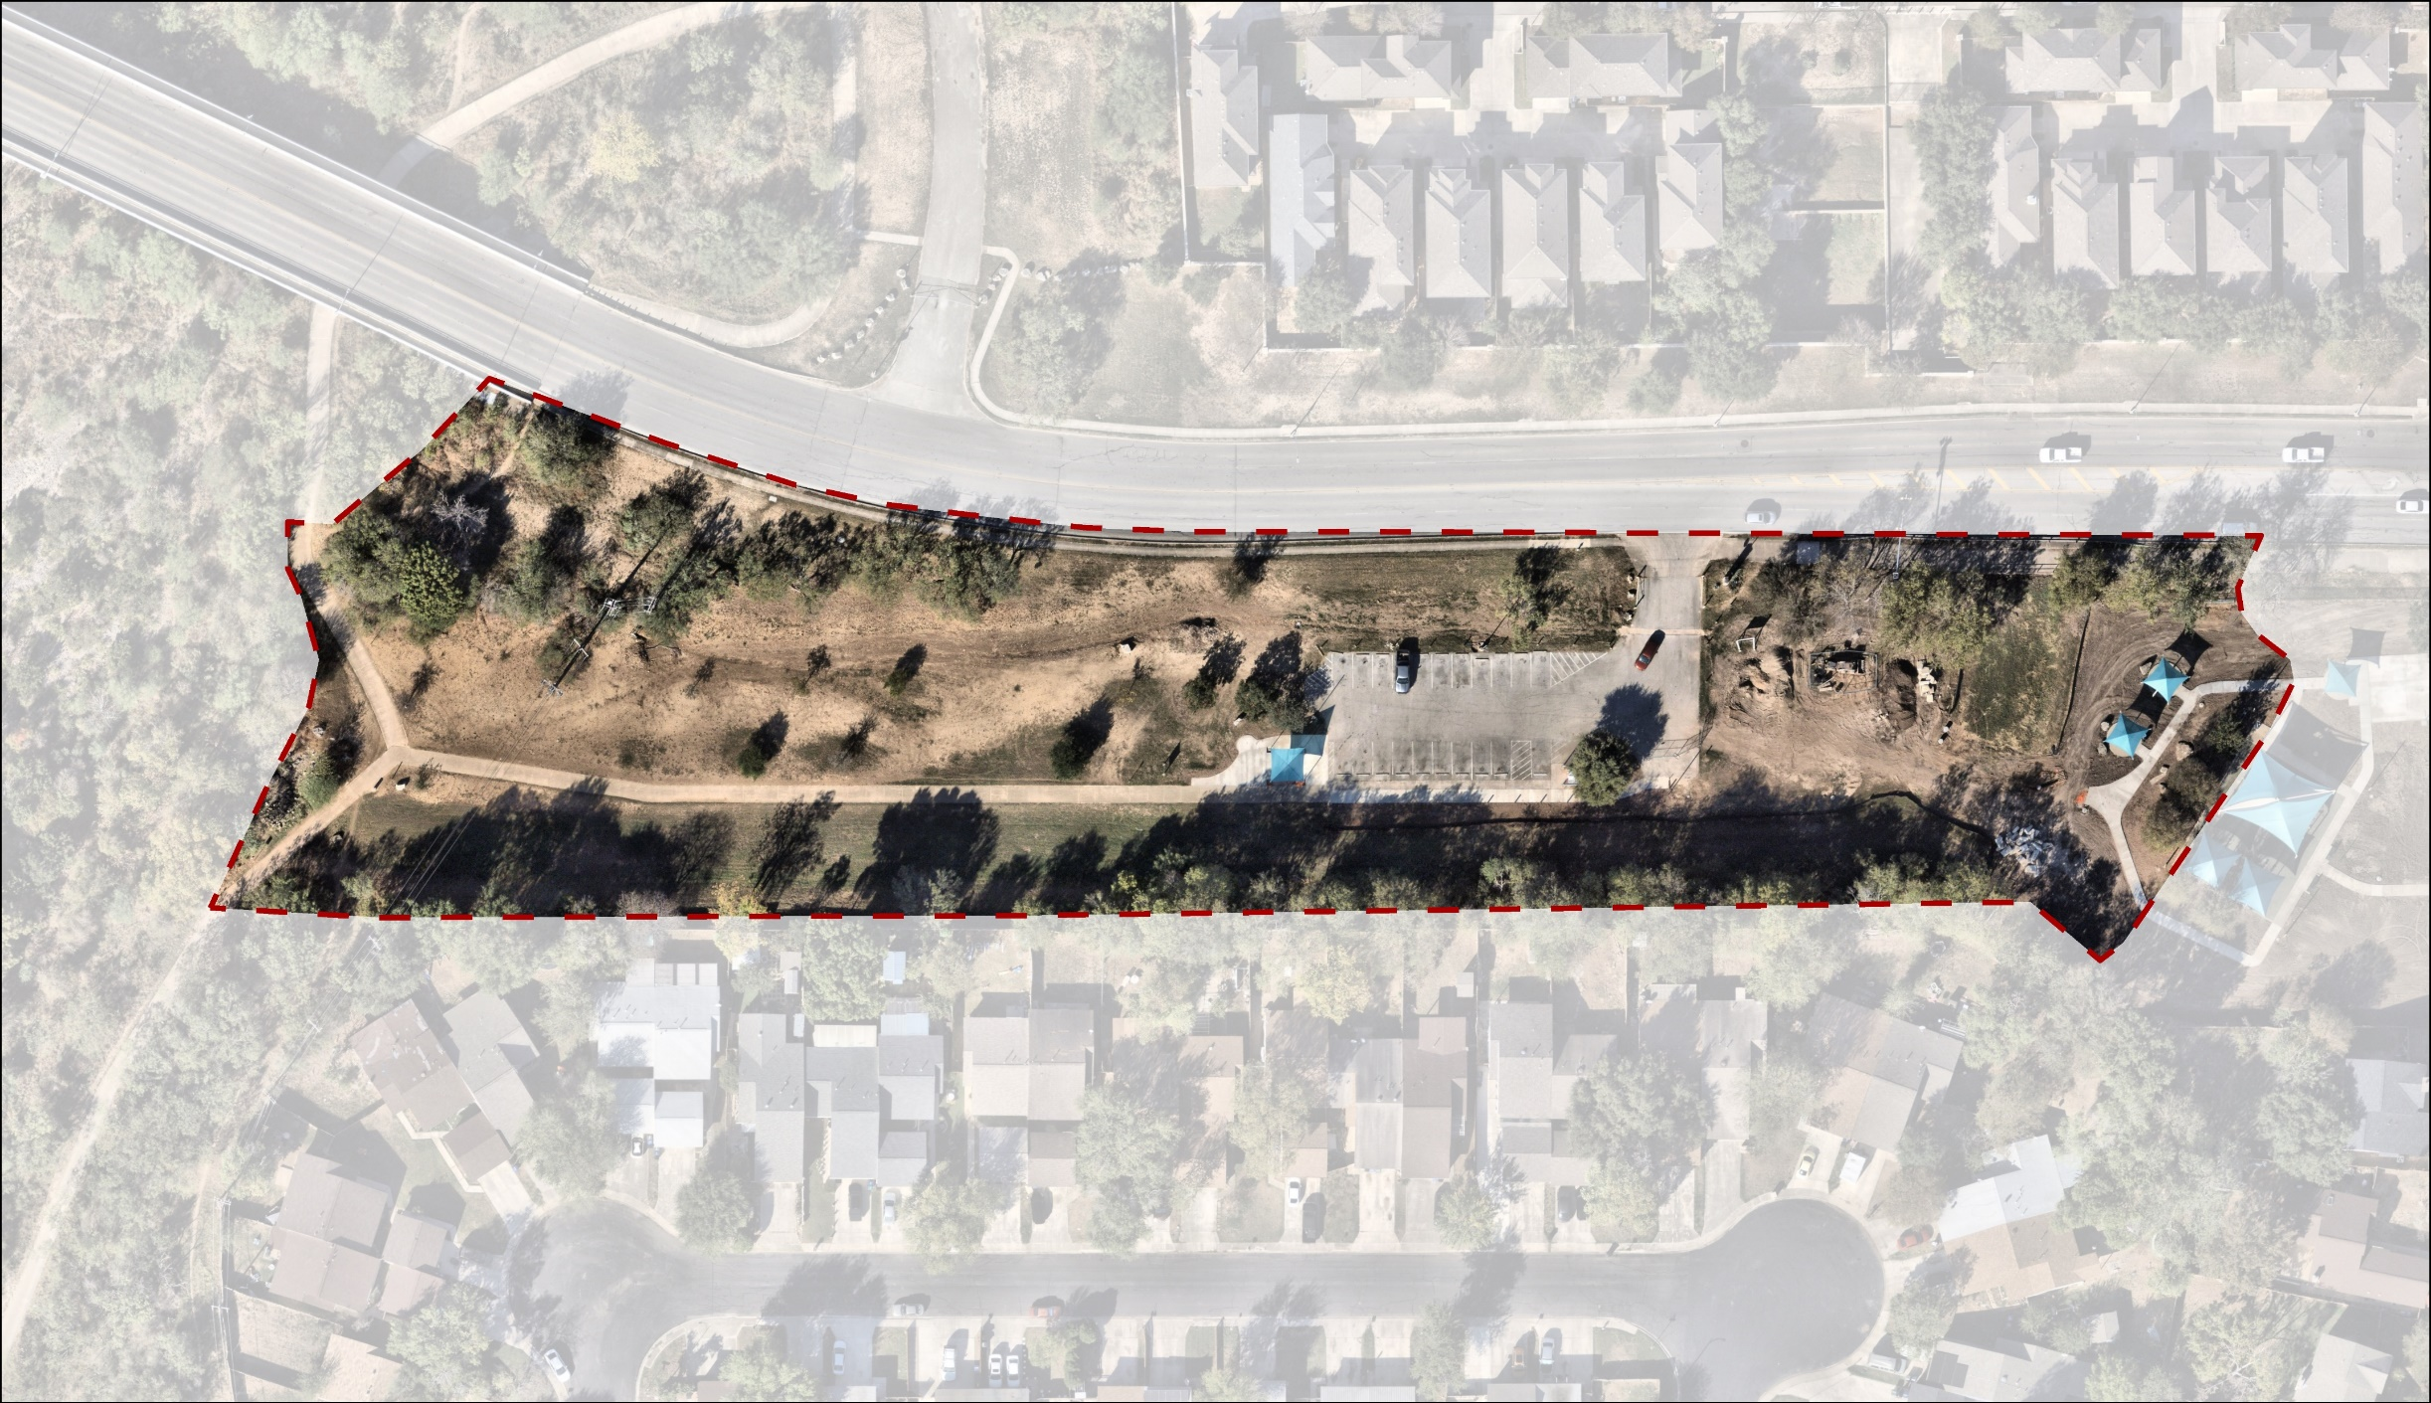
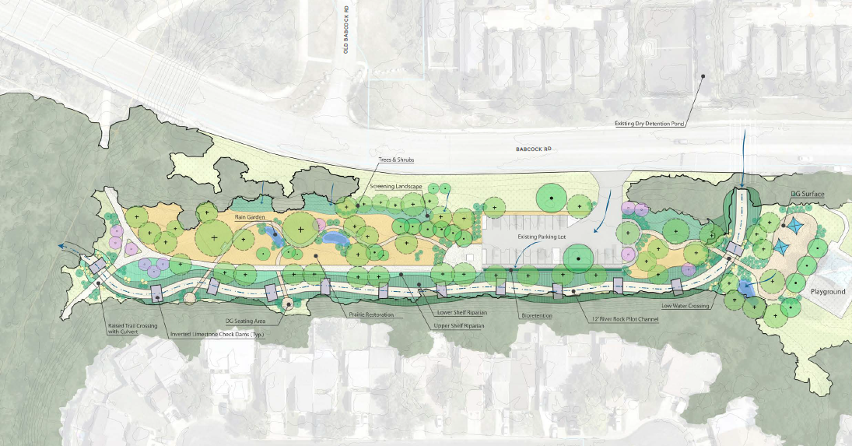
Implementation

Slide 11
Implementation

Slide 12
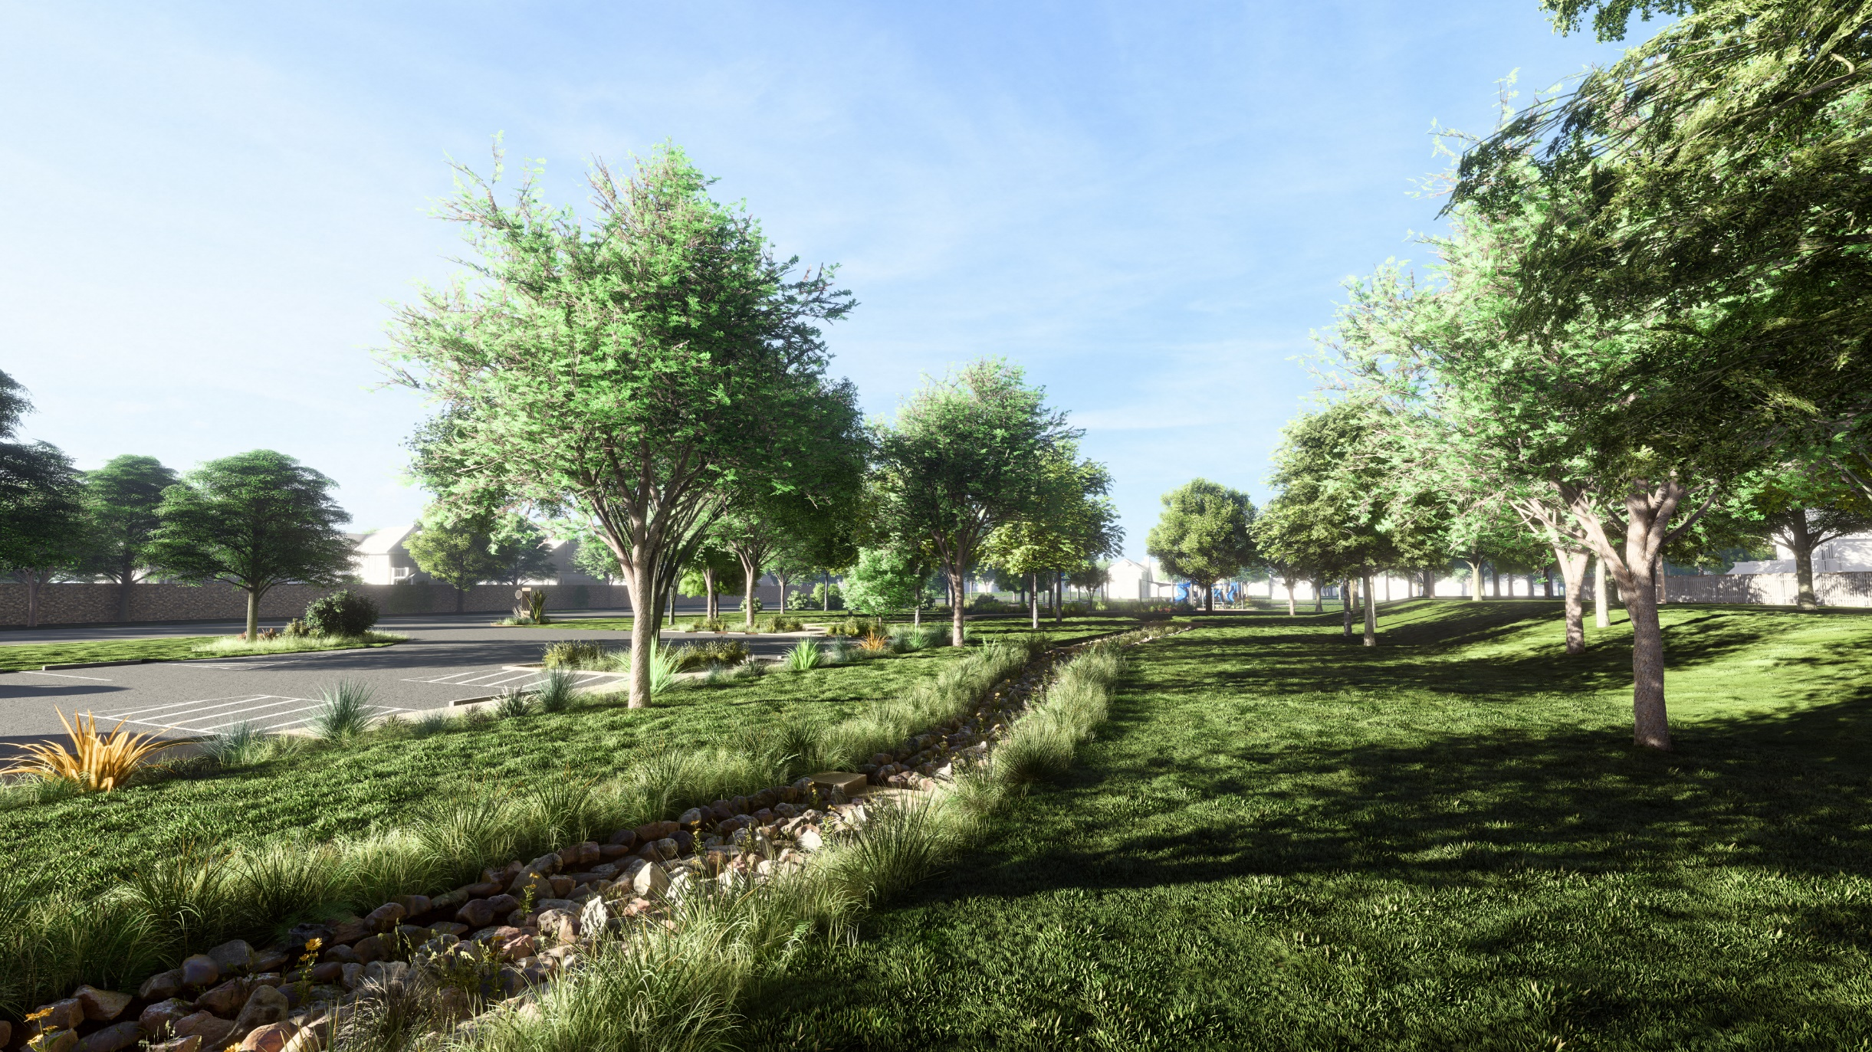

Slide 13
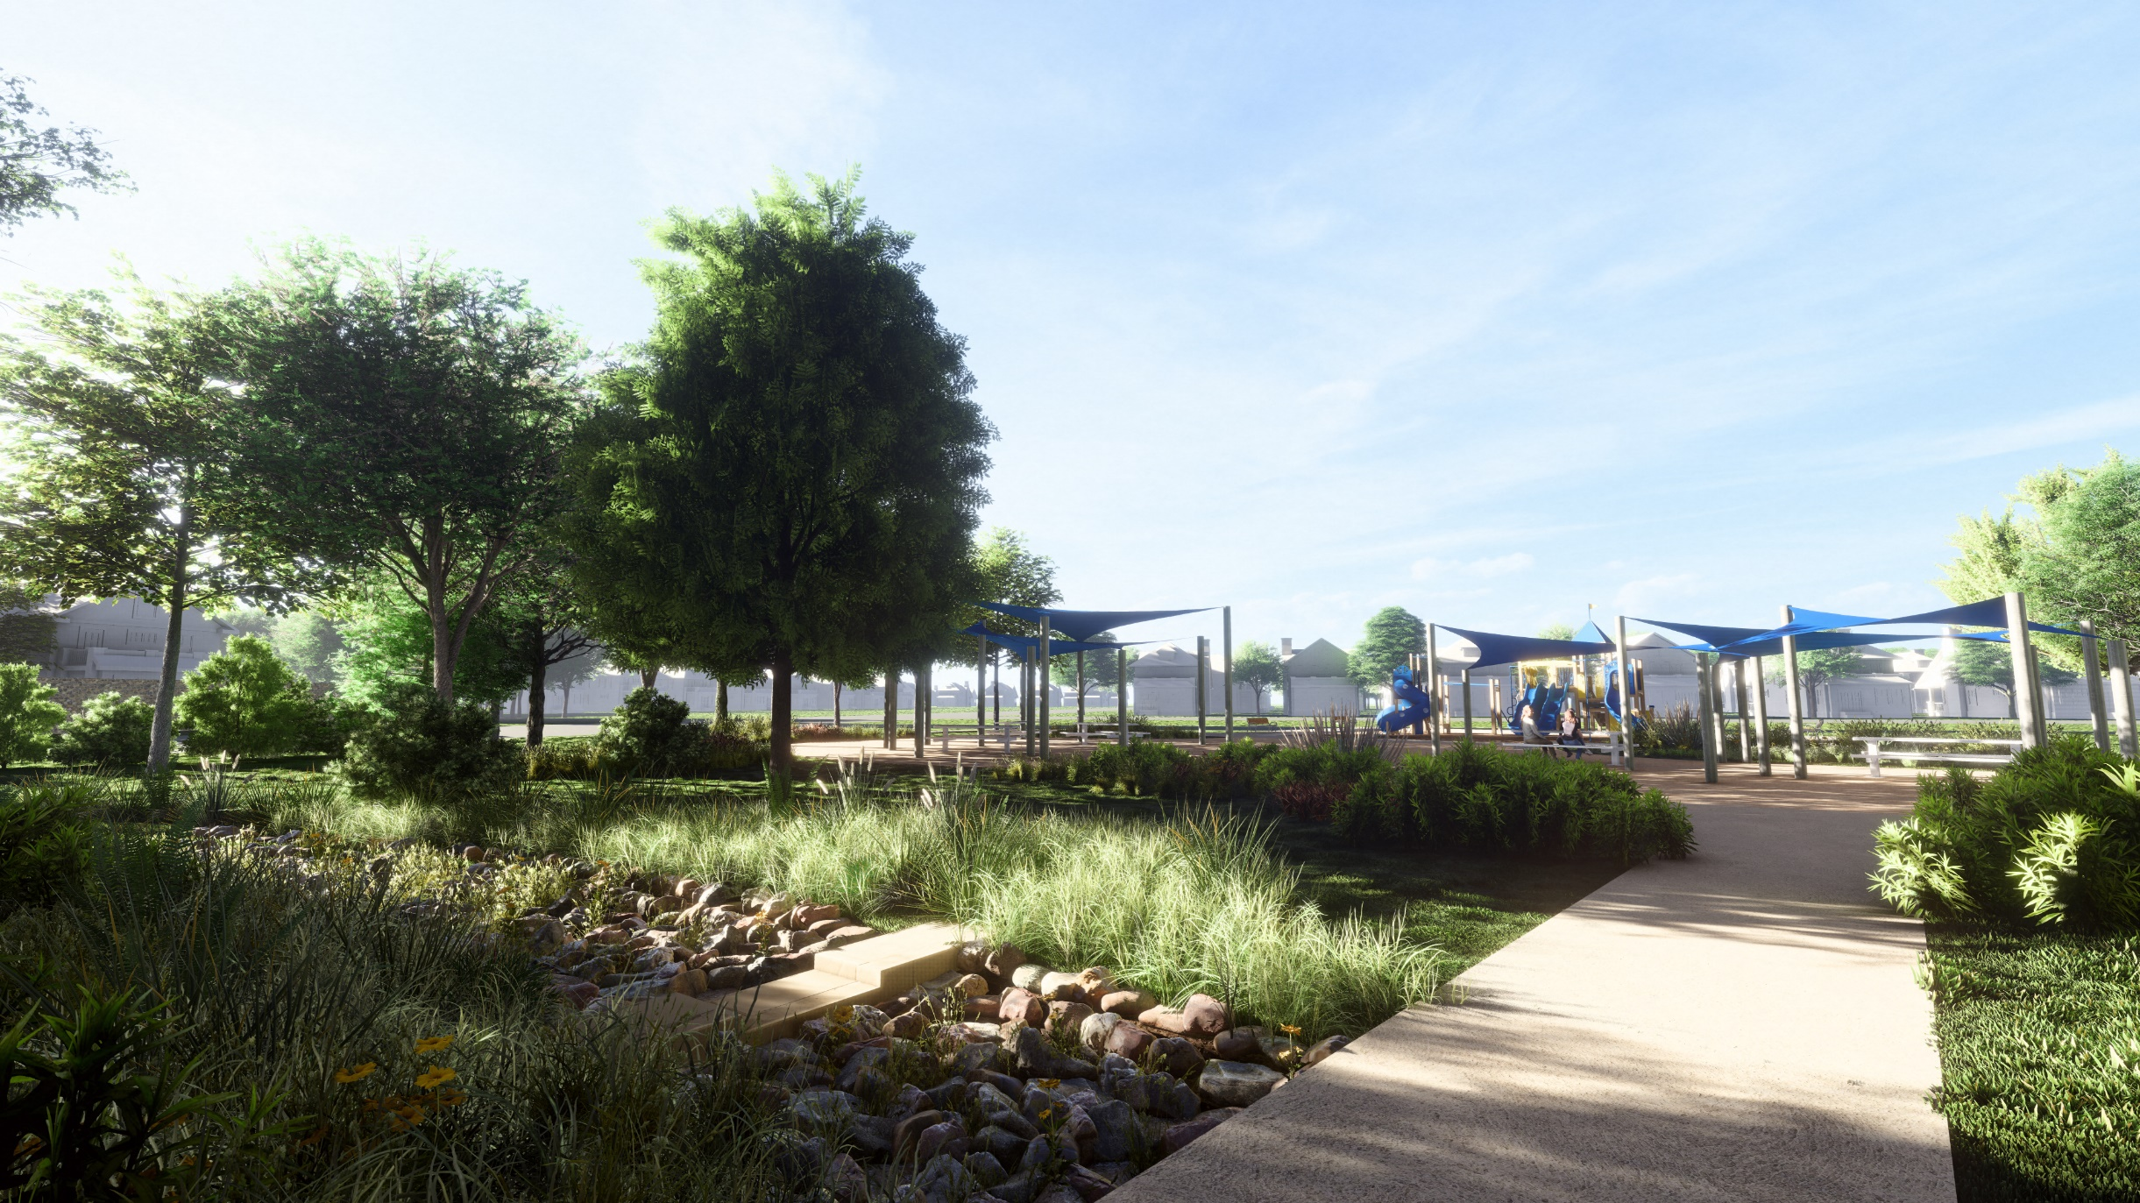

Slide 14
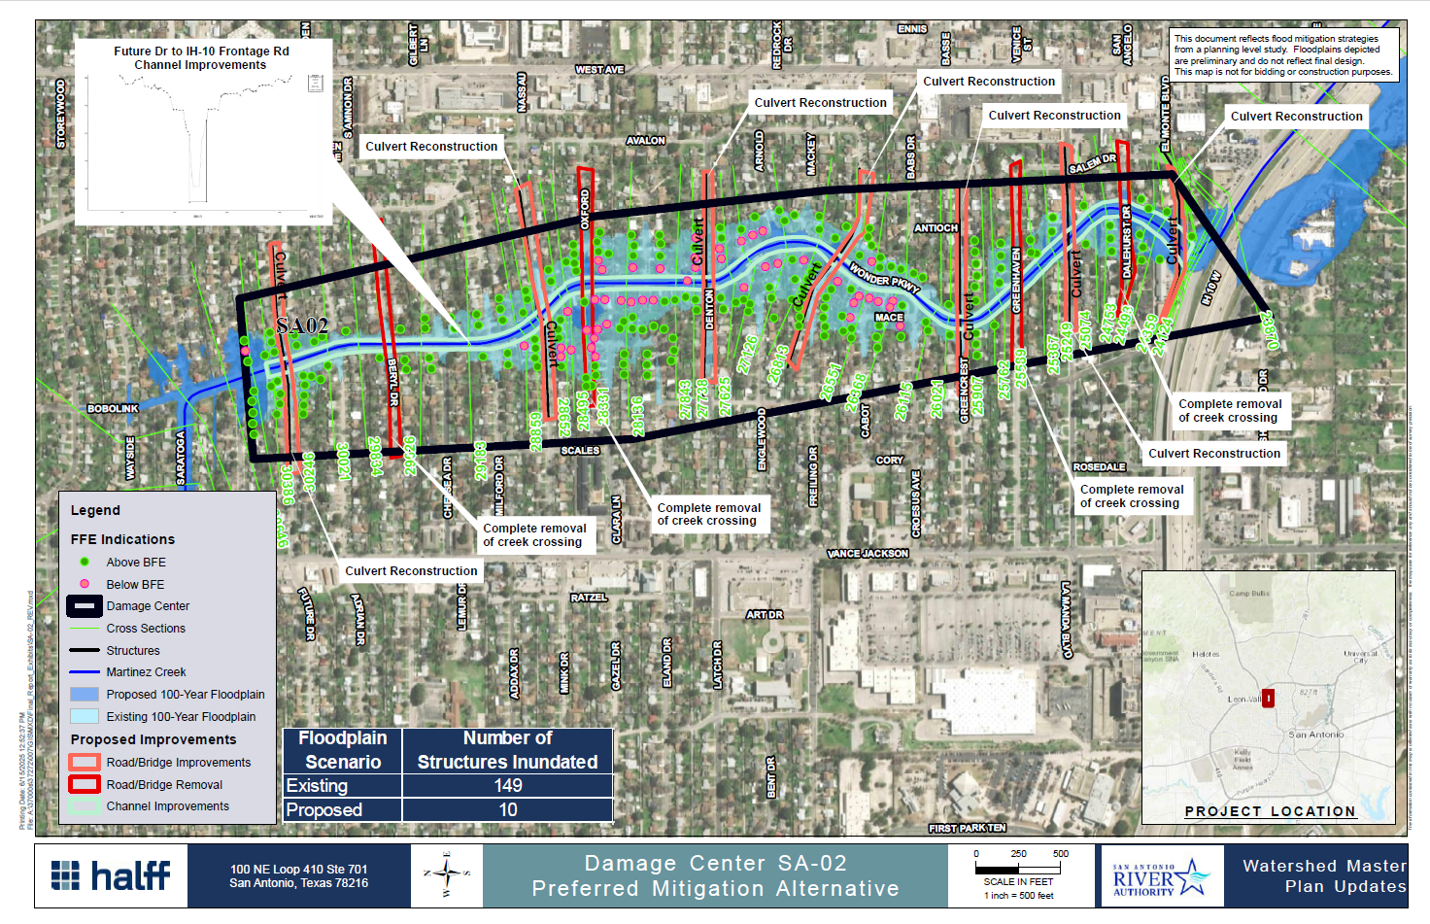
Notes:
Starting around the same time as the River Improvement Project's completion was an effort to bring Low Impact Development to San Antonio as a way to mitigate our City's number #1 water quality pollutant, stormwater runoff. To do that, the River Authority worked with stakeholders to create the SARB LID Technical Design Manual in 2013. Three years later, in 2016, the Manual and LID were incorporated into the City's UDC as a voluntary use pattern.

Slide 15
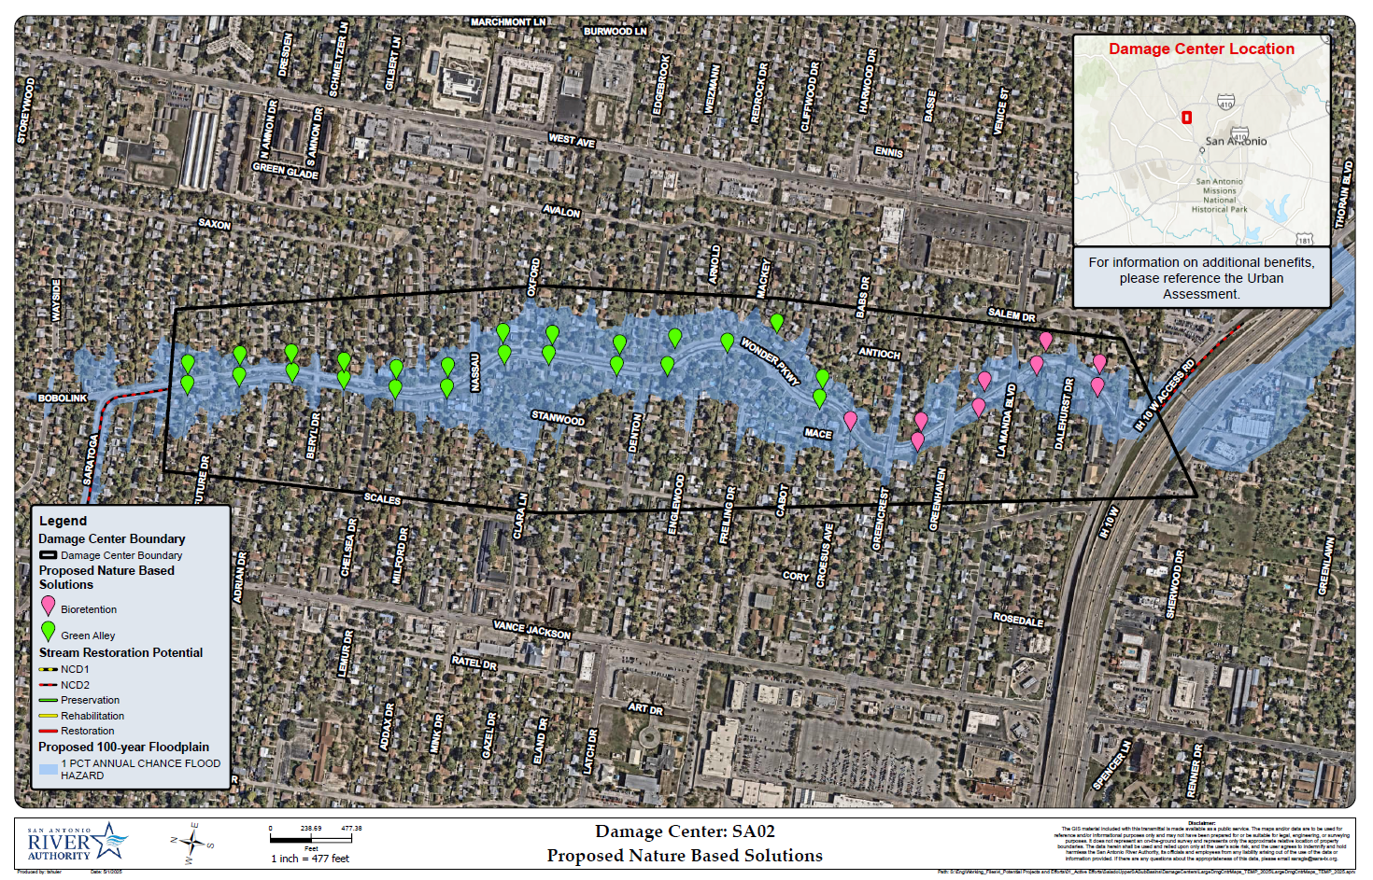
Notes:
6,140 lf of channel mods, adjust/replace 7 bridges, remove 4 bridges, concrete channel lining
9 bioretentions at outfalls (450,000 to 675,000)
Green Alley Retrofits ($3 to $6 million)
$38 million. NBS: $3.5 to $6.7 million.

Slide 16
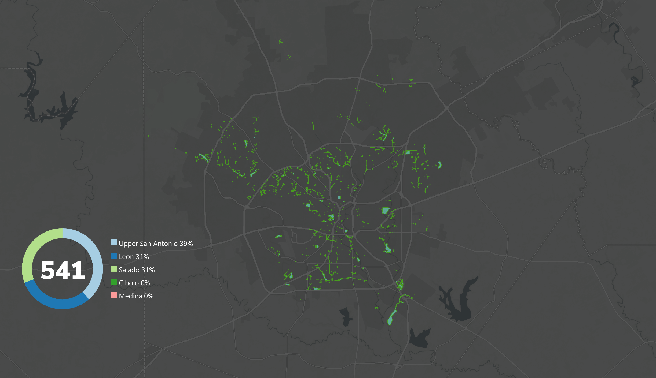
Phase 1

Slide 17
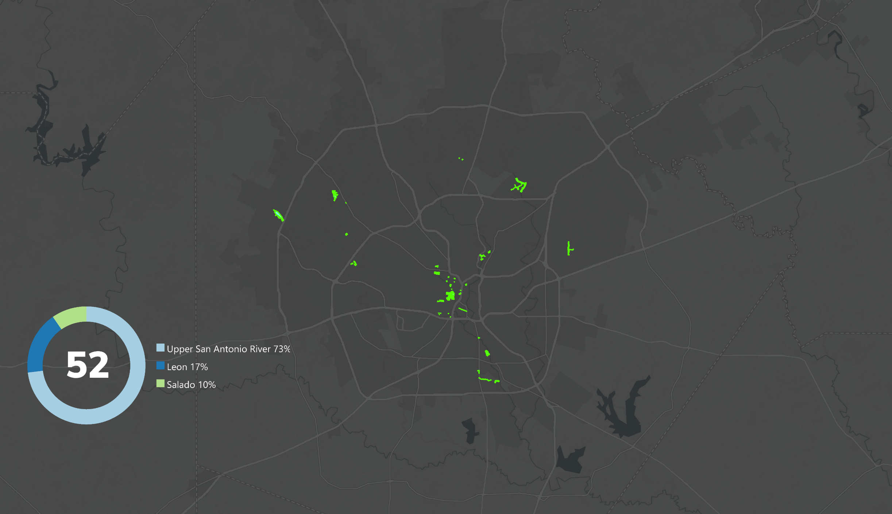
Phase 2

Slide 18
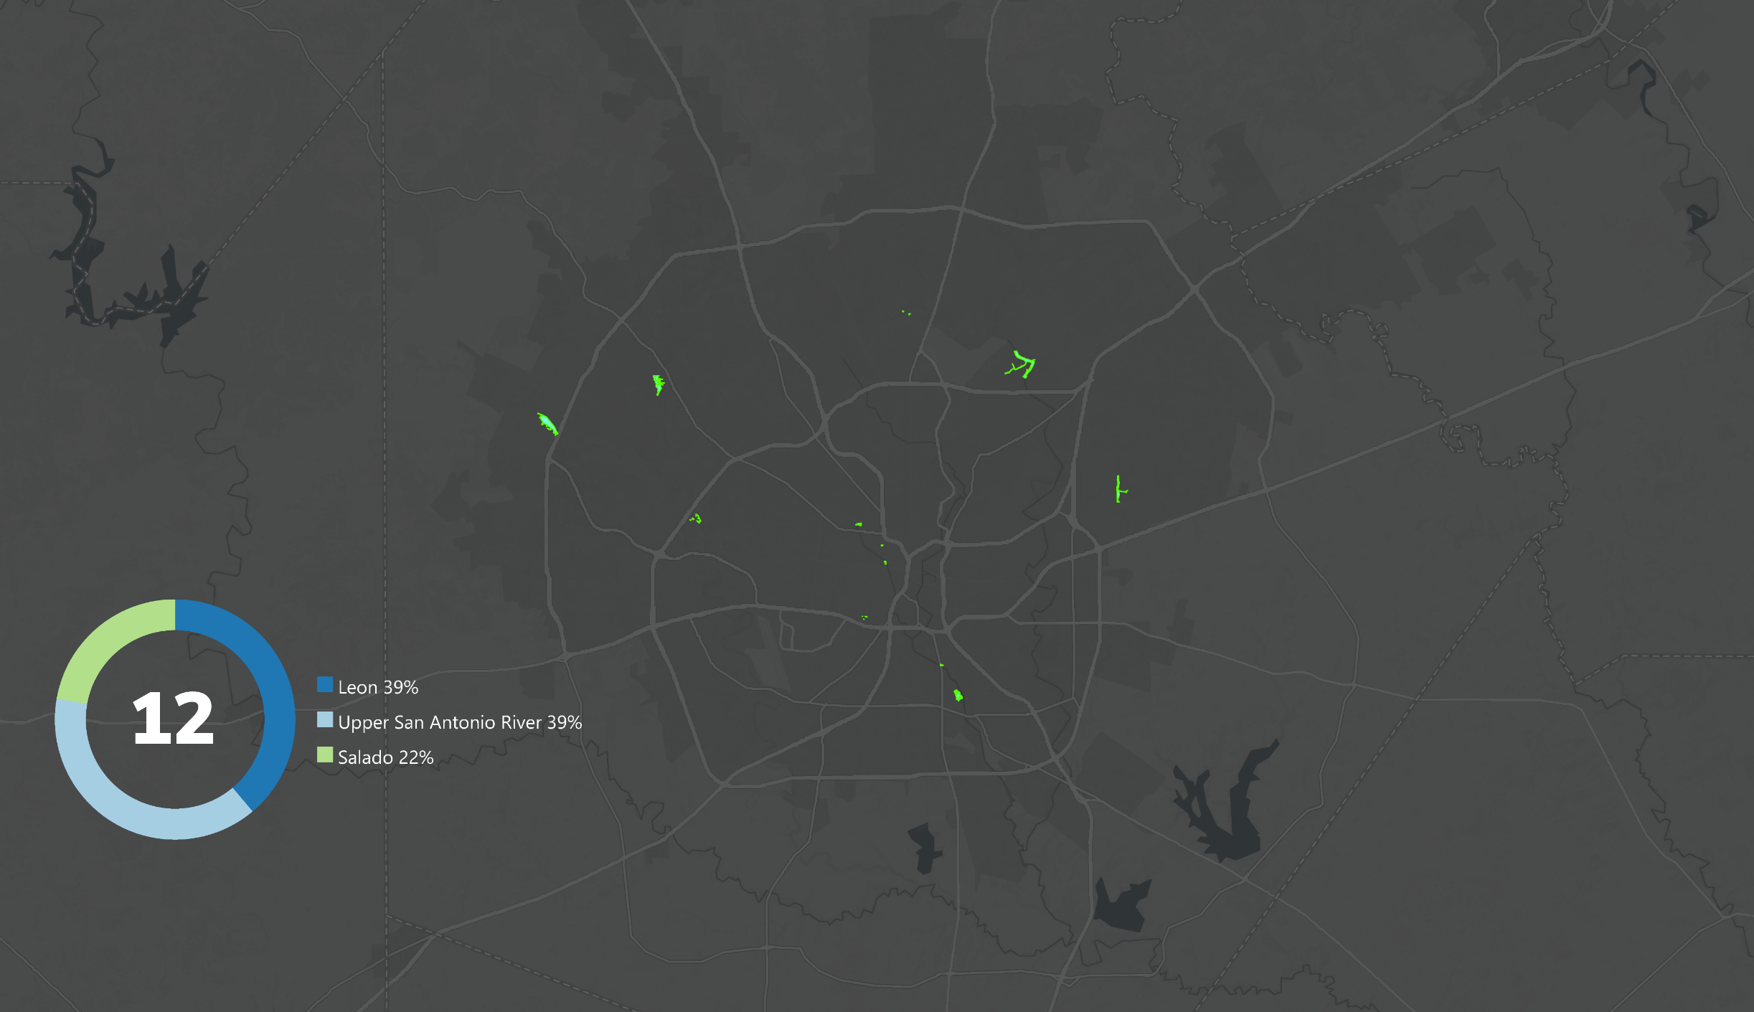
Phase 3

Slide 19
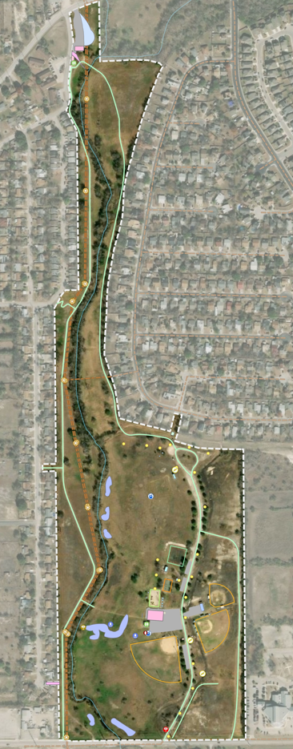
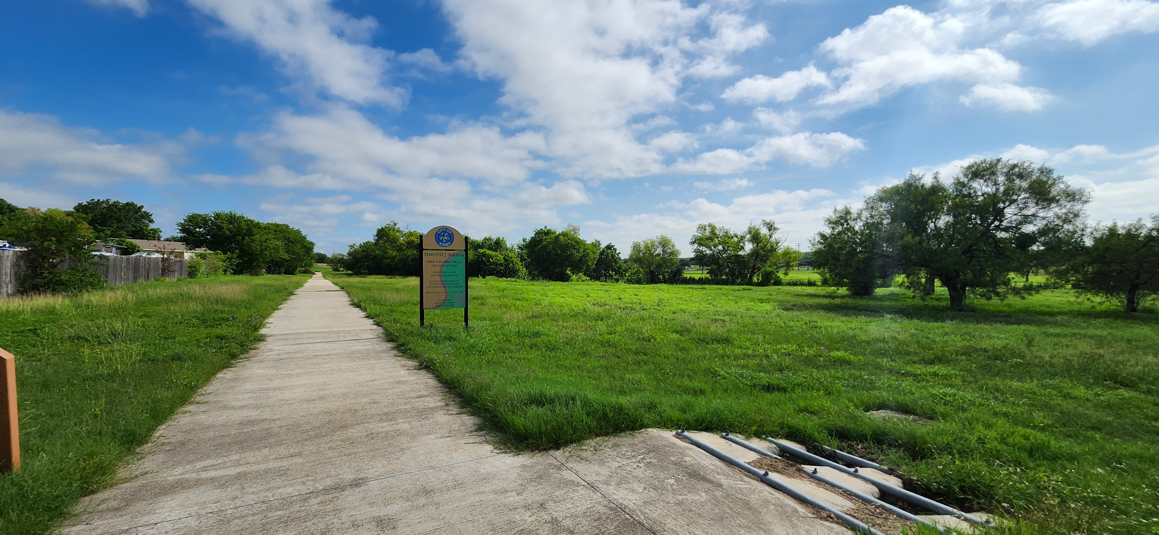
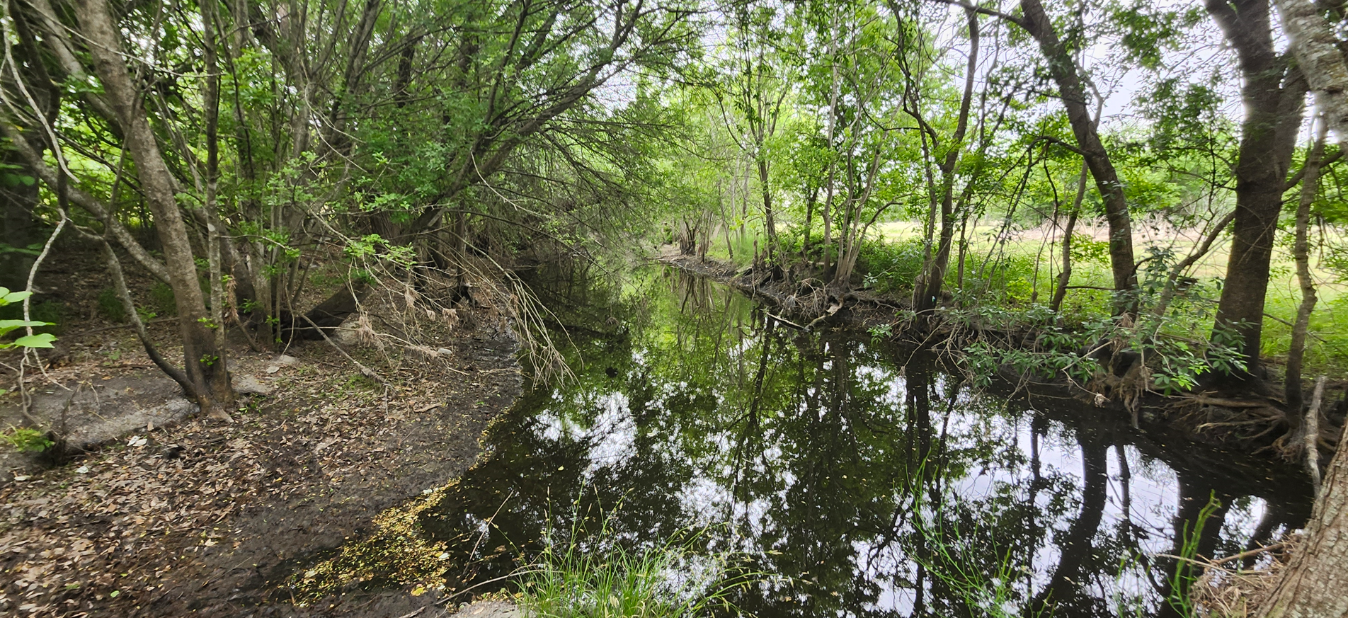

Slide 20
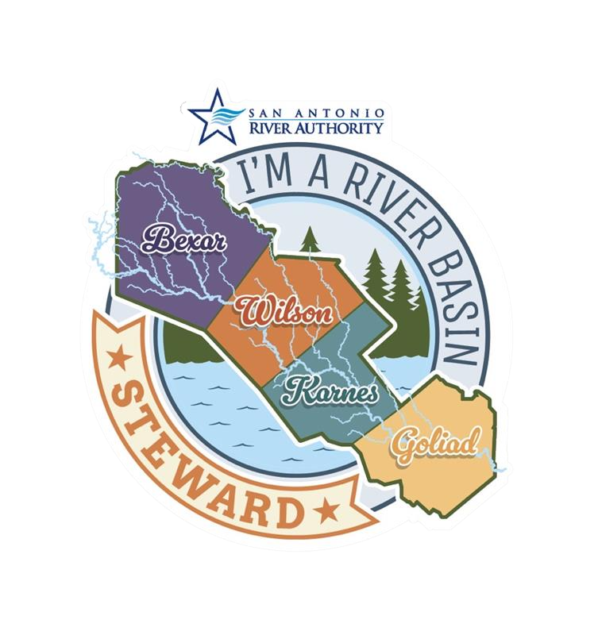
Mikel Wilkins mwilkins@sariverauthority.org www.sariverauthority.org

