Slide 1
Tools for Stormwater Quality Management
July 18, 2025
Sheeba M Thomas Dominguez, PE, PhD – Lead Technical Engineer

Slide 2
Agenda
Background
Approach
Models and Analysis
Results
WQ Improvement Implementation

Slide 3
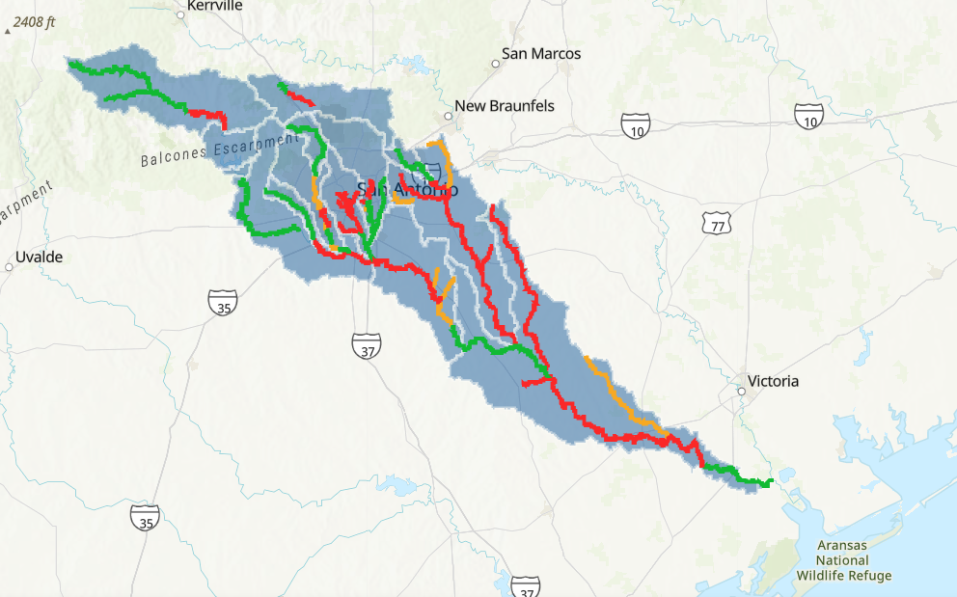
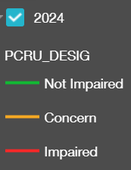
Impaired Waterbodies for Primary Contact Recreation

Slide 4
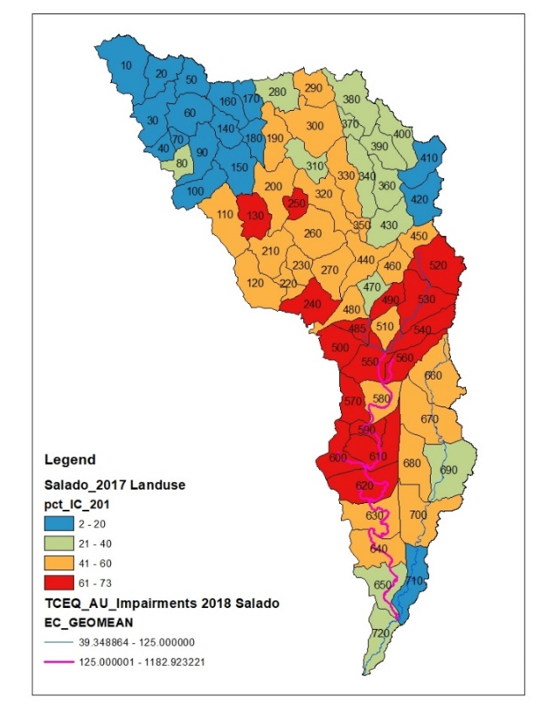
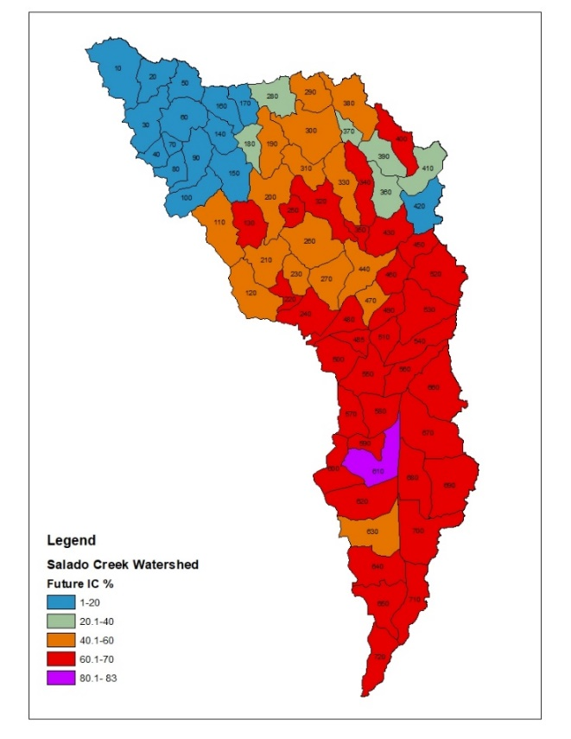
Salado Creek Watershed
IC%~35%
IC%~41%
IC%~53%
Δ IC Area~14.5 mi²
Δ IC Area~26 mi²
2005 Impervious Cover
2017 Impervious Cover
2040 Impervious Cover

Slide 5
Our Approach
Baseline
Model
(HSPF Models)
Quantify
Mitigation
(Models and WQ Tools)
Informed
Planning
Quantify
WQ Issues
(Models and WQ Tools)

Slide 6
SARA Project Team
Sheeba Thomas, PhD, P.E., PMP
Yu-Chun Su, PhD, PE,CPESC, CPSWQ
Paul Duda
RESPEC (formerly Aqua Terra)

Slide 7
SARA Suite of WQ Modeling Tools
Approach and Tools to allow quantitative WQ planning:
SARA WQ modeling standards
WQ model development and calibration
HSPF
Timeseries Utility Tool
Load Reduction Tool
SARA Enhanced BMP Tool
BMP Database

Slide 8
SARA WQ Modeling Standards

Slide 9
Data Needed for WQ Modeling
DFIRM
Subbasin delineation
Stream shapefile
HEC-HMS
HEC-RAS
Topography
DEM
Contours
Channel XS
Dams/reservoirs
Aerial images
SSURGO soil data
Major development centers
Met data (NOAA)
Rainfall
NOAA
EAA (gage, NEXRAD)
SARA
USGS
Diversion
USGS flow data
Groundwater recharge & spring flow
Latest 303(d)
CRP Screening levels
Landuse & IC%
Water Quality
SWQM
USGS
Wastewater data
SSO
OSSF (estimates)
QUAL-TX models
Atmospheric deposition
Edwards Aquifer Infiltration Data
Rural watershed data
Agricultural data
SELECT or EC loading estimates

Slide 10
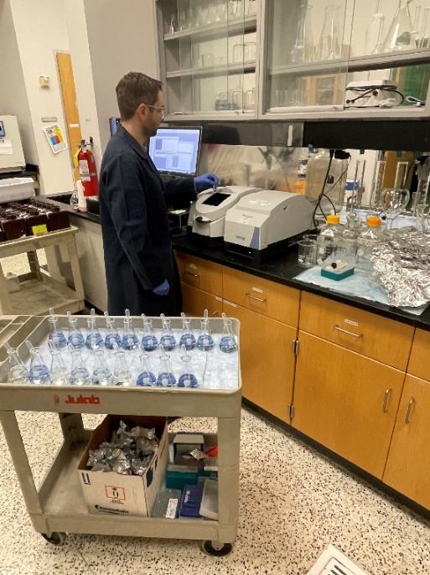
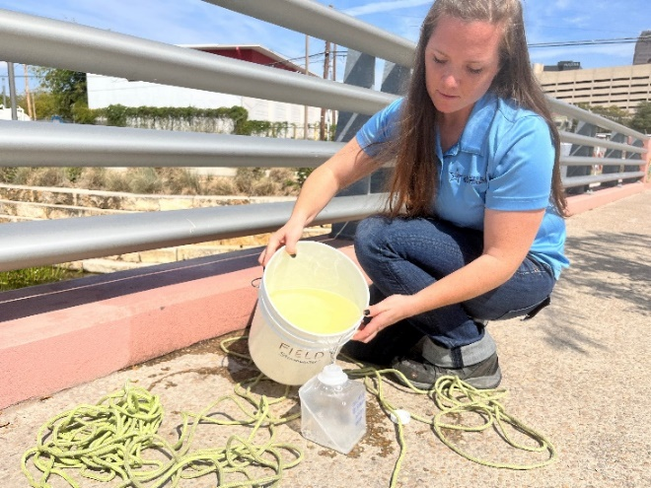
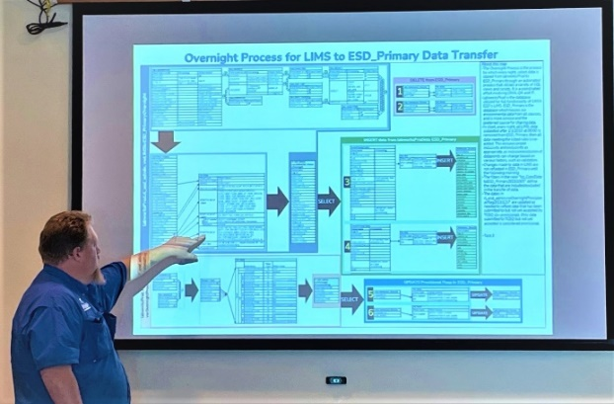
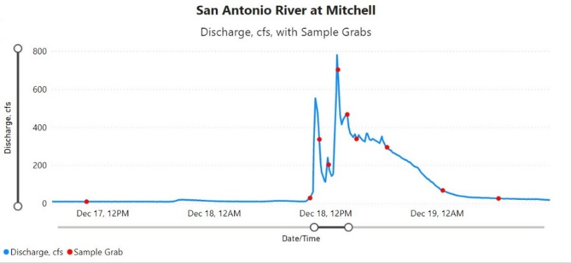
Water Quality Data
Environmental Services Department Superstars!

Slide 11
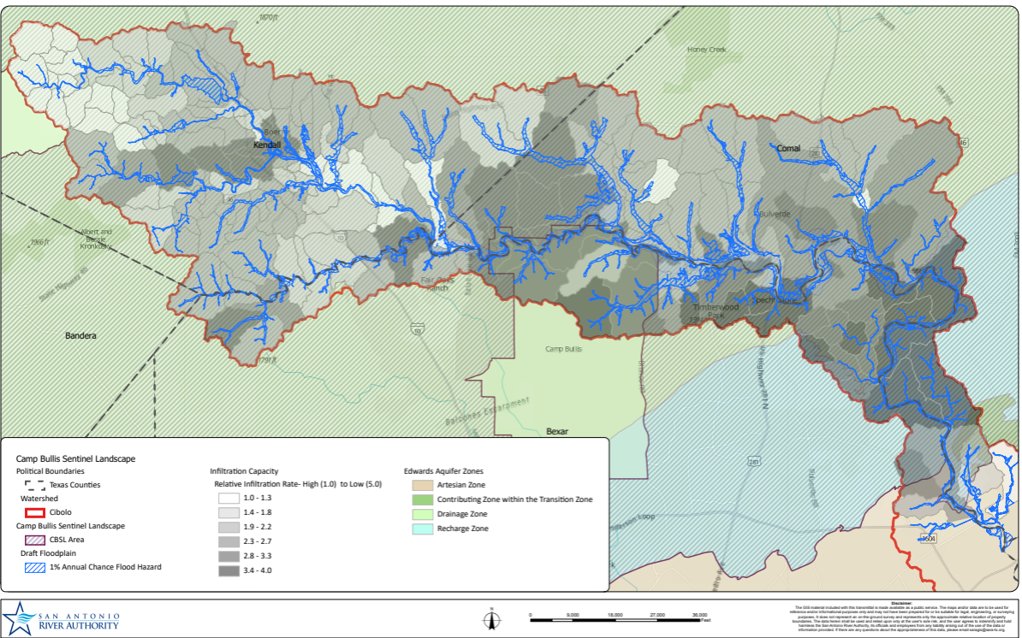
EAA’s Relative Infiltration Data

Slide 12
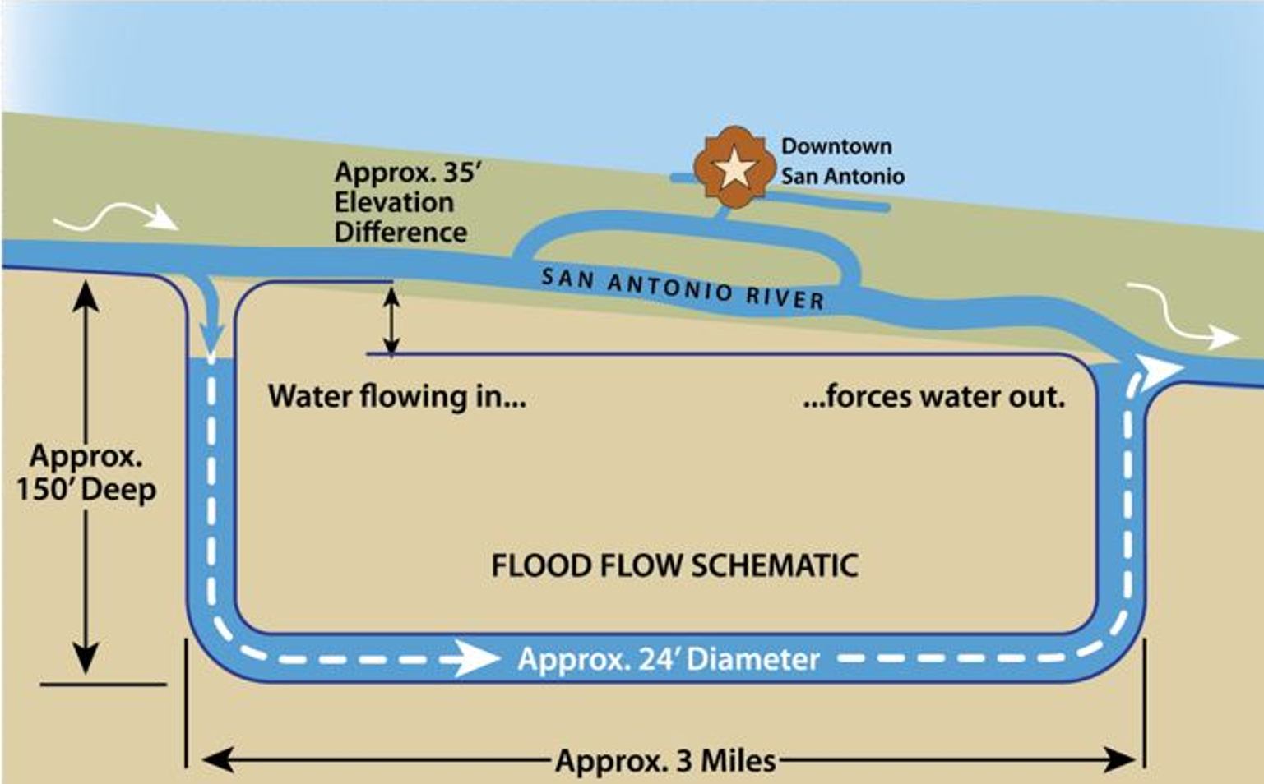
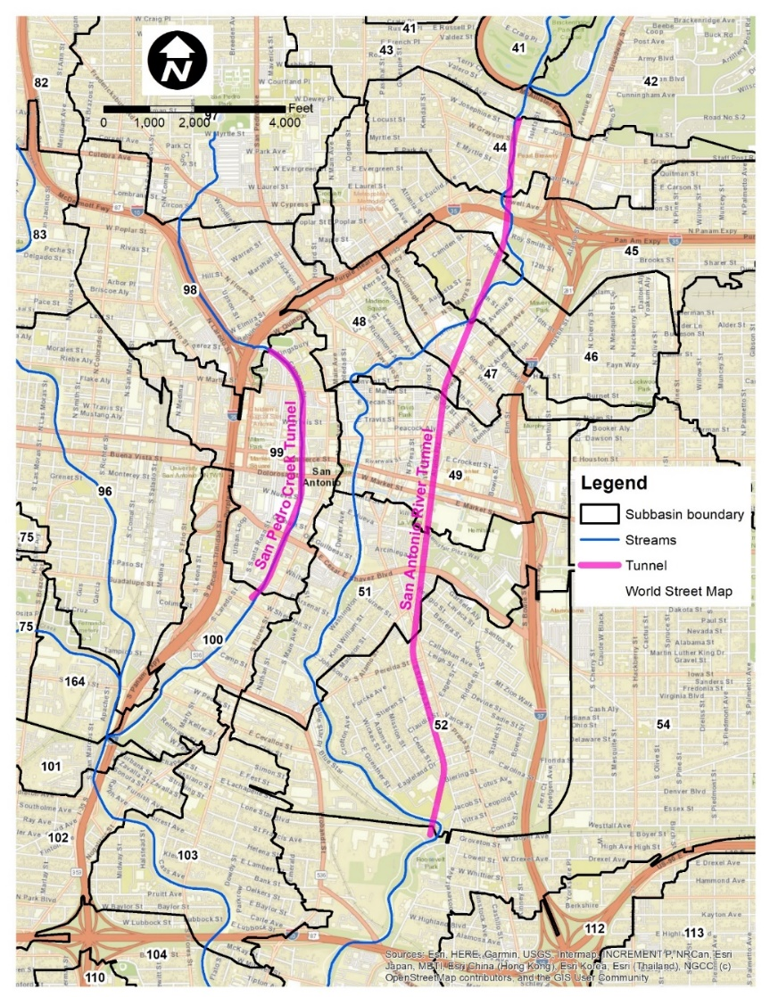
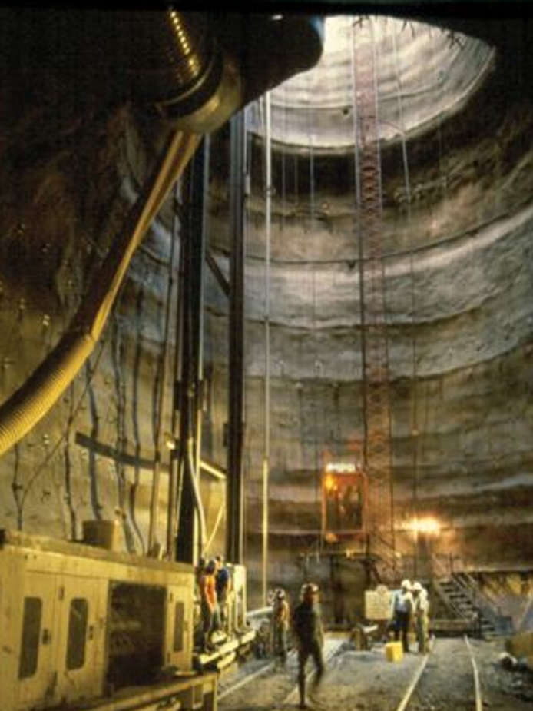
Modeling Challenge Flood Control Tunnels

Slide 13
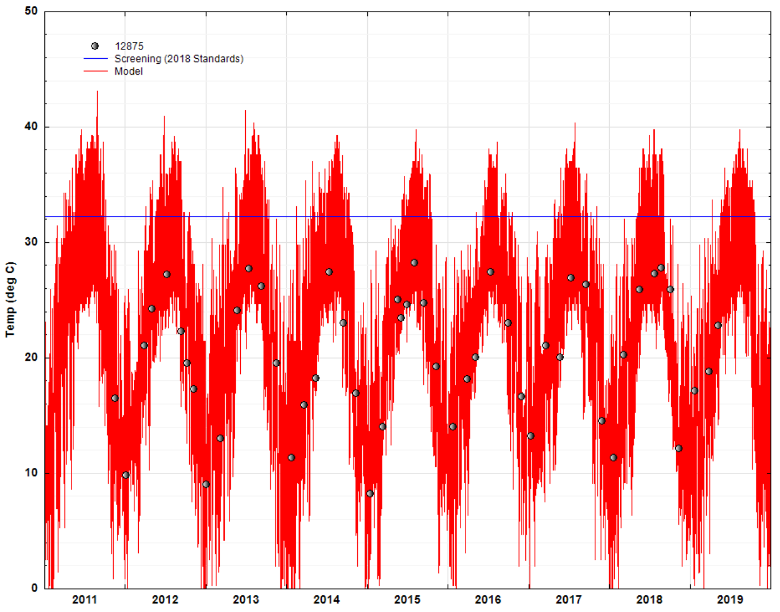
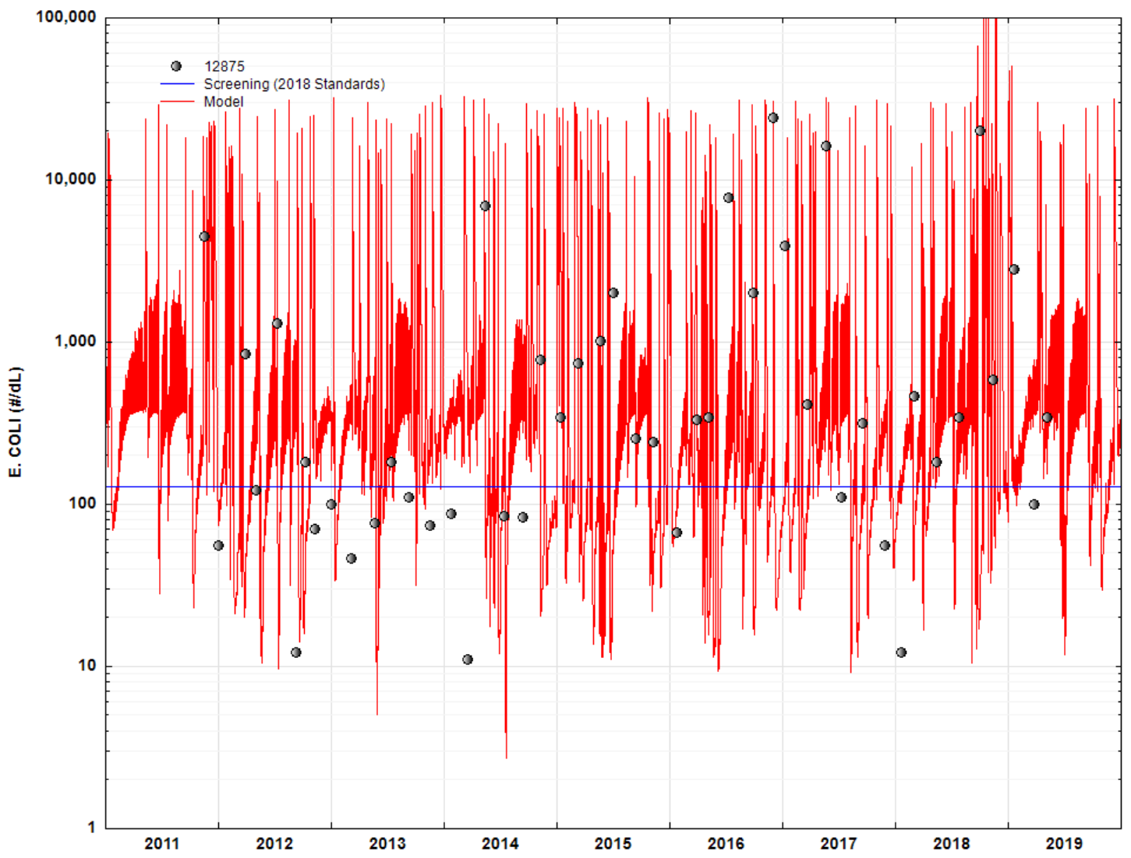
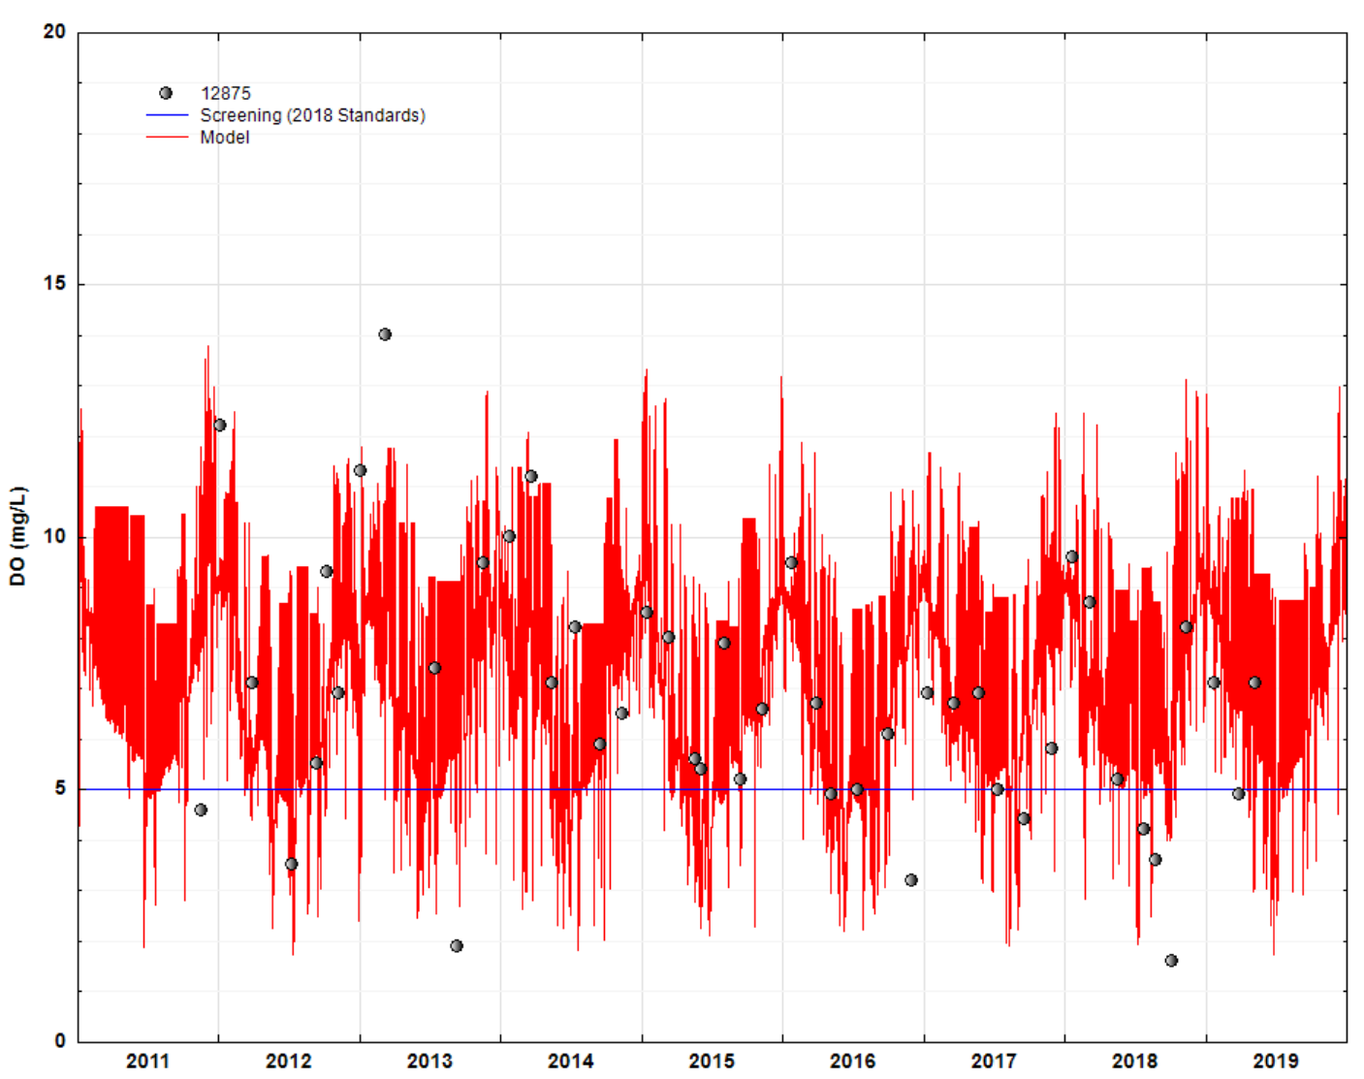
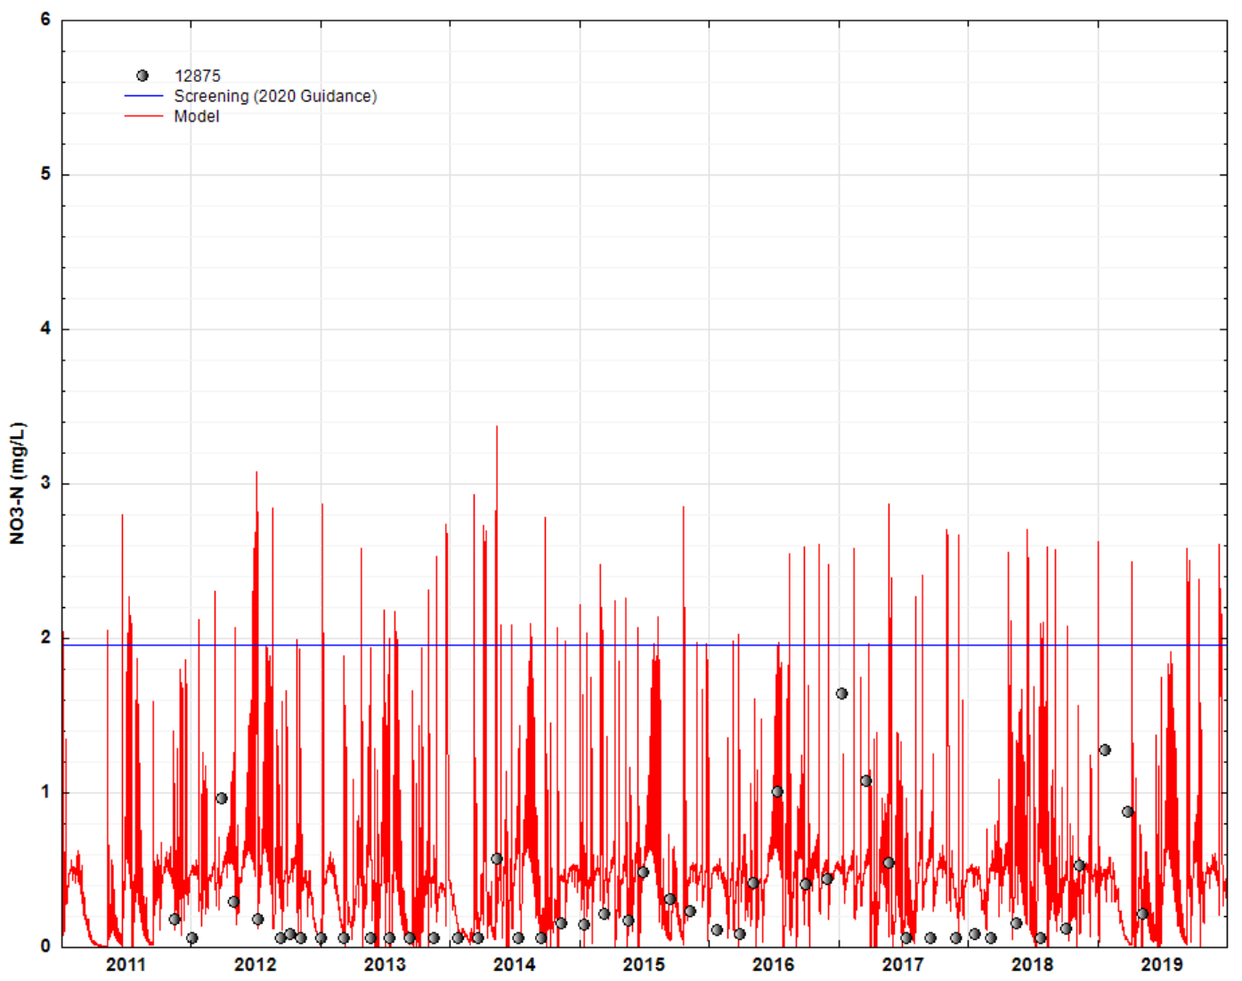
HSPF Calibration – Continued Simulation Thru Wet/Dry
Salado Creek

Slide 14
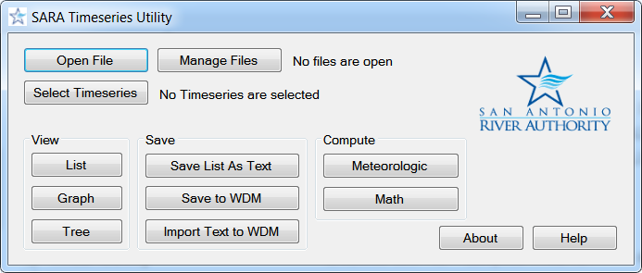
SARA Timeseries Utility Tool
Enhanced efficiency in reading large timeseries records (e.g. HSPF binary output).
Developed, tested, and released to public through EPA BASINS user community on 10/24/2013.
Replaced WDMUtil

Slide 15
SARA Load Reduction Tool
Calibrated HSPF model UCI
Uses load reduction factors in HSPF BMP Module.
Automates tedious process for large watershed models.
Compared to manual processes.
Developed, tested, and released to public through EPA BASINS user community on 5/09/2014.
User Specification
Target Subbasins/Landuses for BMP
Target constituents
Concentration threshold
Reduction Tolerance
Maximum removal
Target point source
Automatic Load Reduction
From upstream to downstream subbasins
Generate detailed report

Slide 16
SARA Enhanced BMP Tool
Identify LID/BMPs to achieve needed load reductions.
Use LRT results or any calibrated HSPF models.
Combines robust land surface representation from HSPF with EPA SUSTAIN’s BMP capabilities.
Avoids ArcGIS version issue inherent in SUSTAIN by using non-GIS component (SUSTAINOPT)

Slide 17
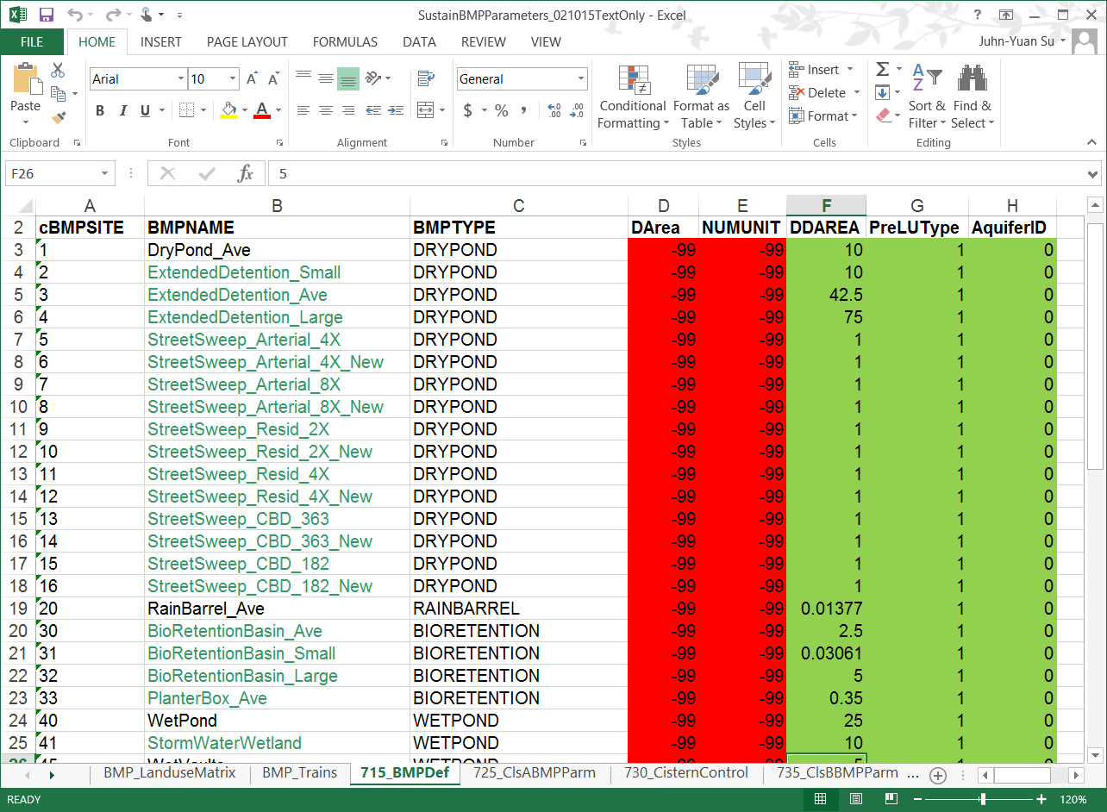
SARA BMP Tool Database

Slide 18
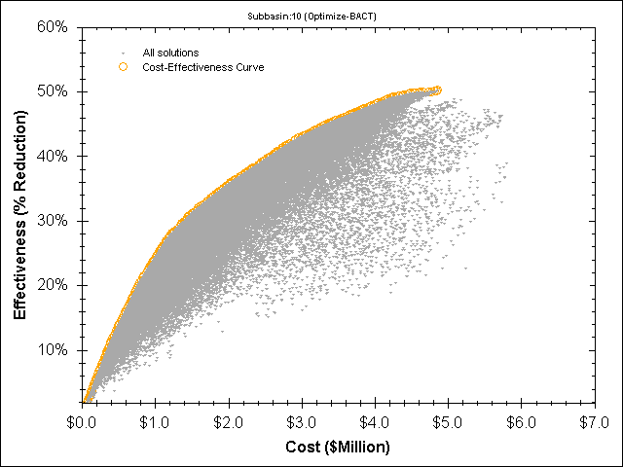
Cost Saving with Optimization
Load Reduction > 50% not possible with BMPs
Target: 40% Load Reduction
Optimal BMPs: $2.5 MM
Non-Optimal BMP Combinations: can be > $5MM
Cost Saving: can be $2.5 MM or 100%
Avoid building first then discover it won’t work or too costly

Slide 19
SARA WQ Modeling Tools Download Website

Slide 20
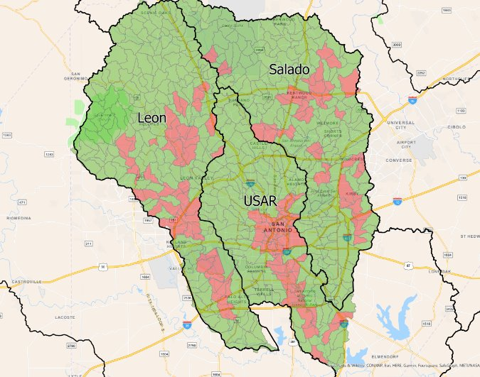
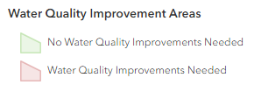
Water Quality Improvement Areas

Slide 21
Implementation of WQ Improvement and Collaboration
Models and analysis provide information on where improvement strategies need to be implemented
City of San Antonio
MS4
Bond Projects
EAA is partly providing funding for the Cibolo Creek Watershed
Team pursuing collaboration with other agencies for WQ improvement

Slide 22
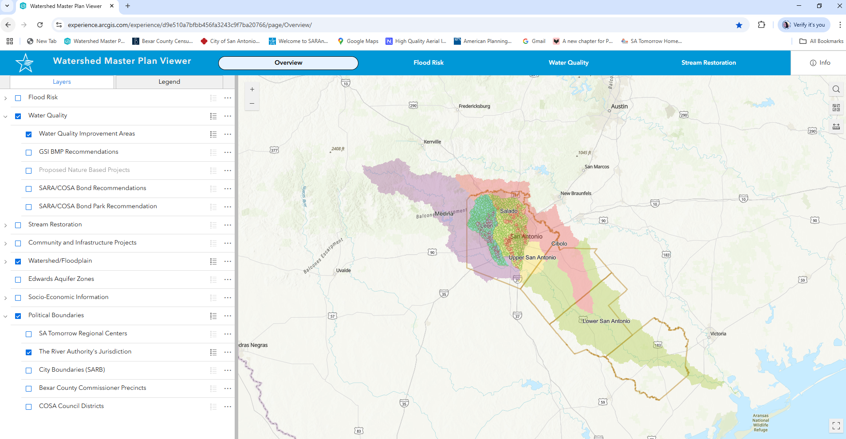
Watershed Master Plan Viewer

Slide 23
Thank you!
Sheeba M Thomas Dominguez, PhD, PE, PMP
sthomas@sariverauthority.org

