Slide 1

Stormwater Sampling in the San Antonio River Basin
July 18, 2025

Slide 2
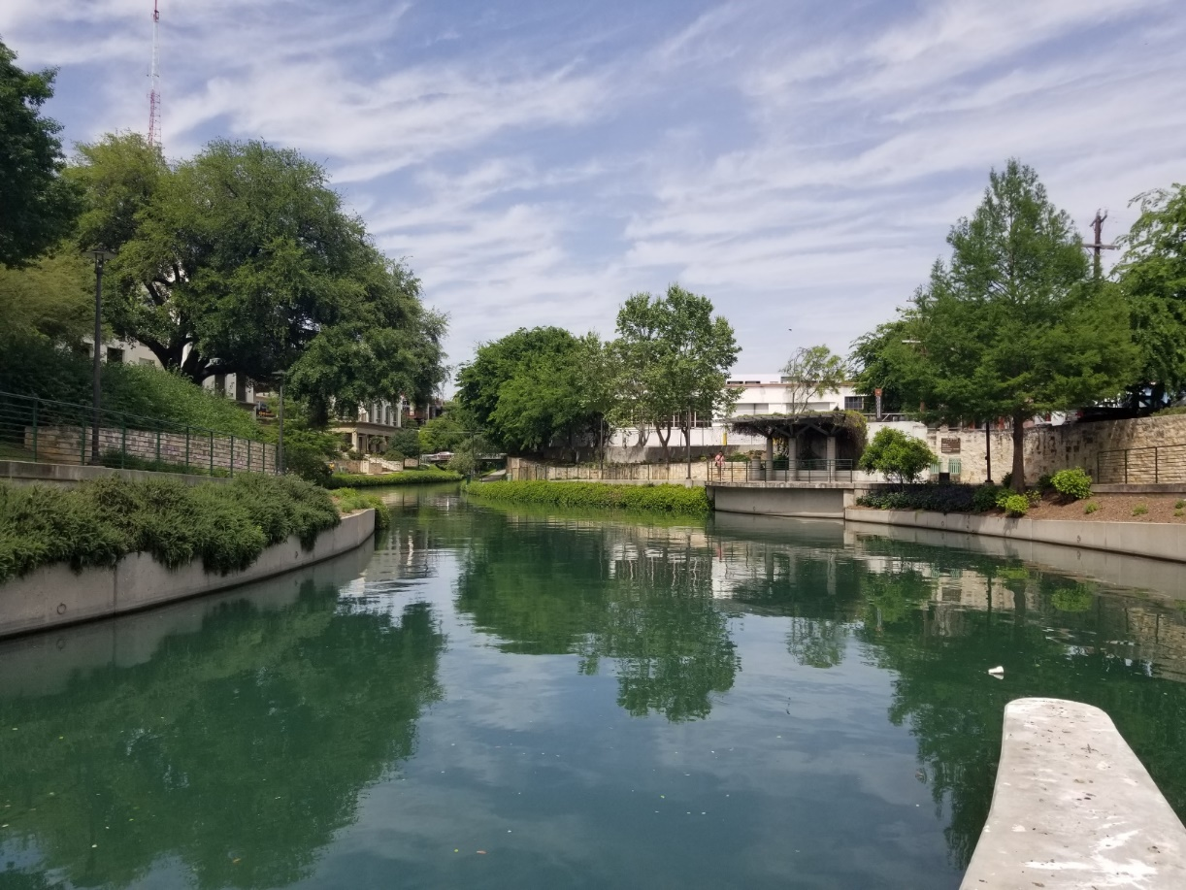
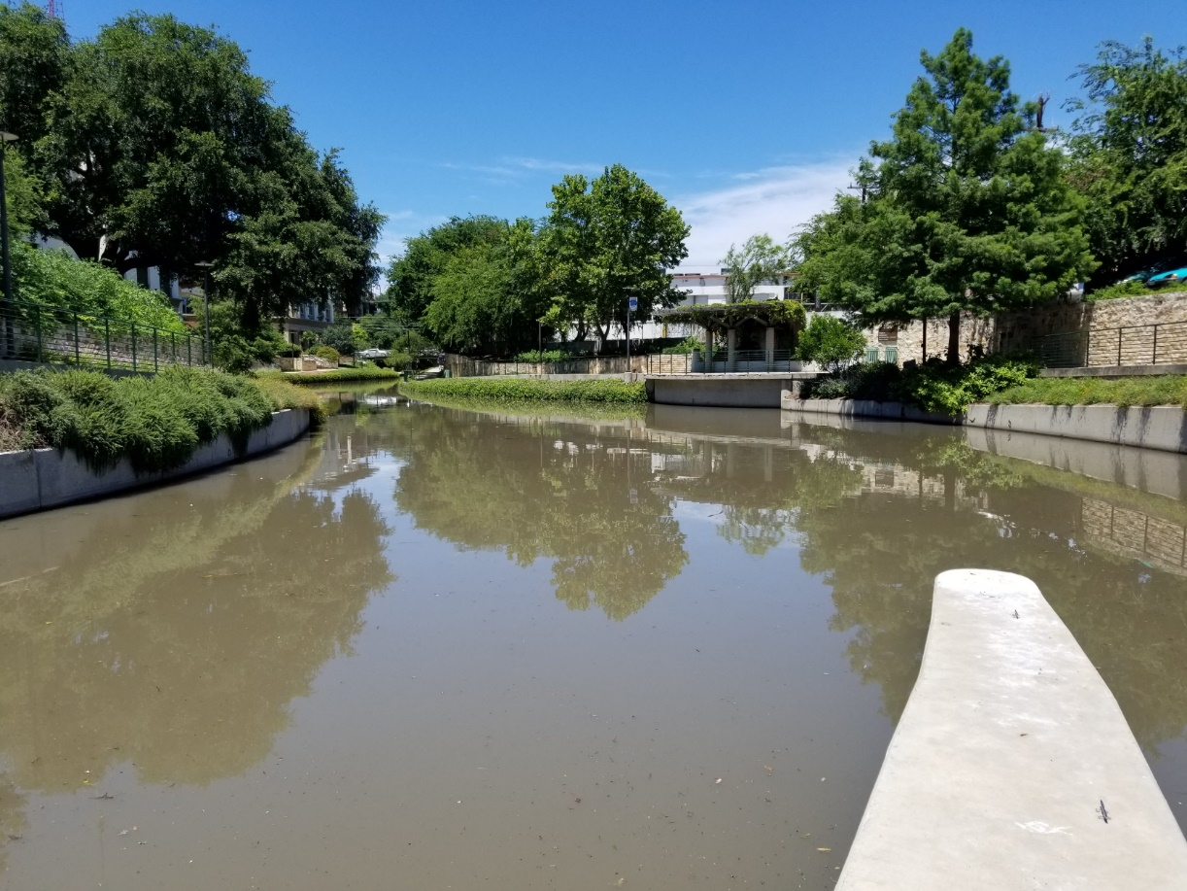

Slide 3
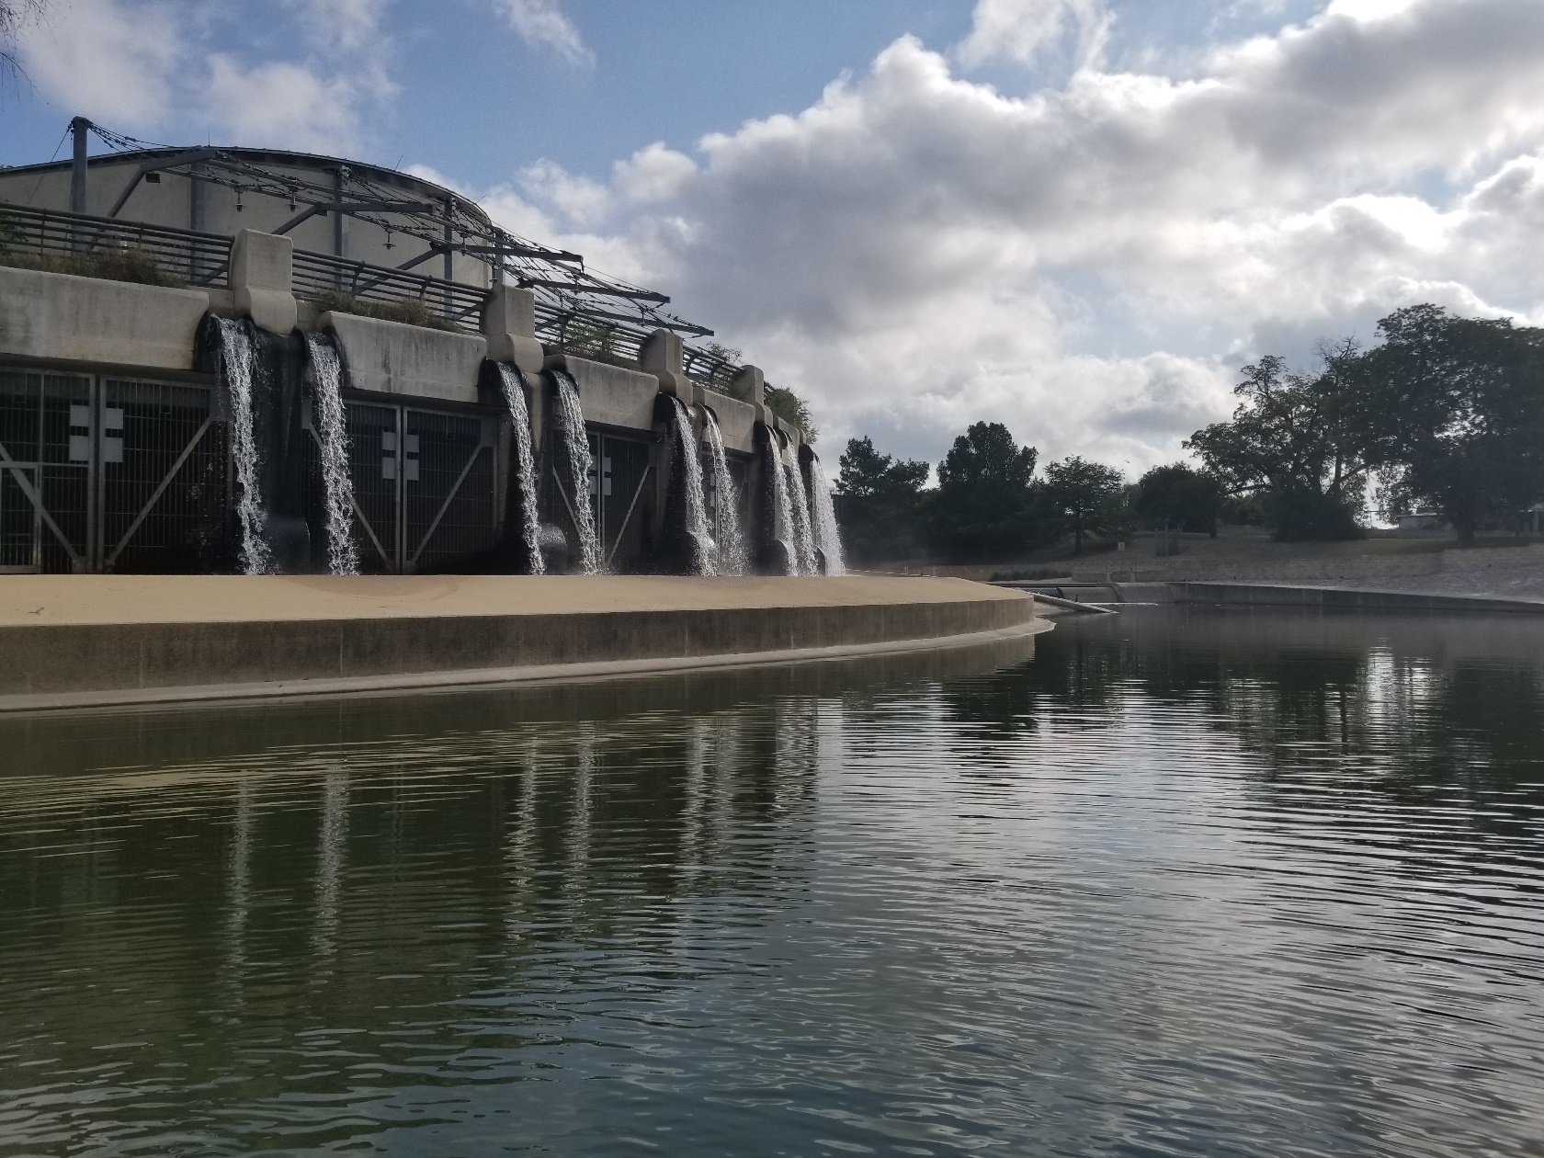

Slide 4
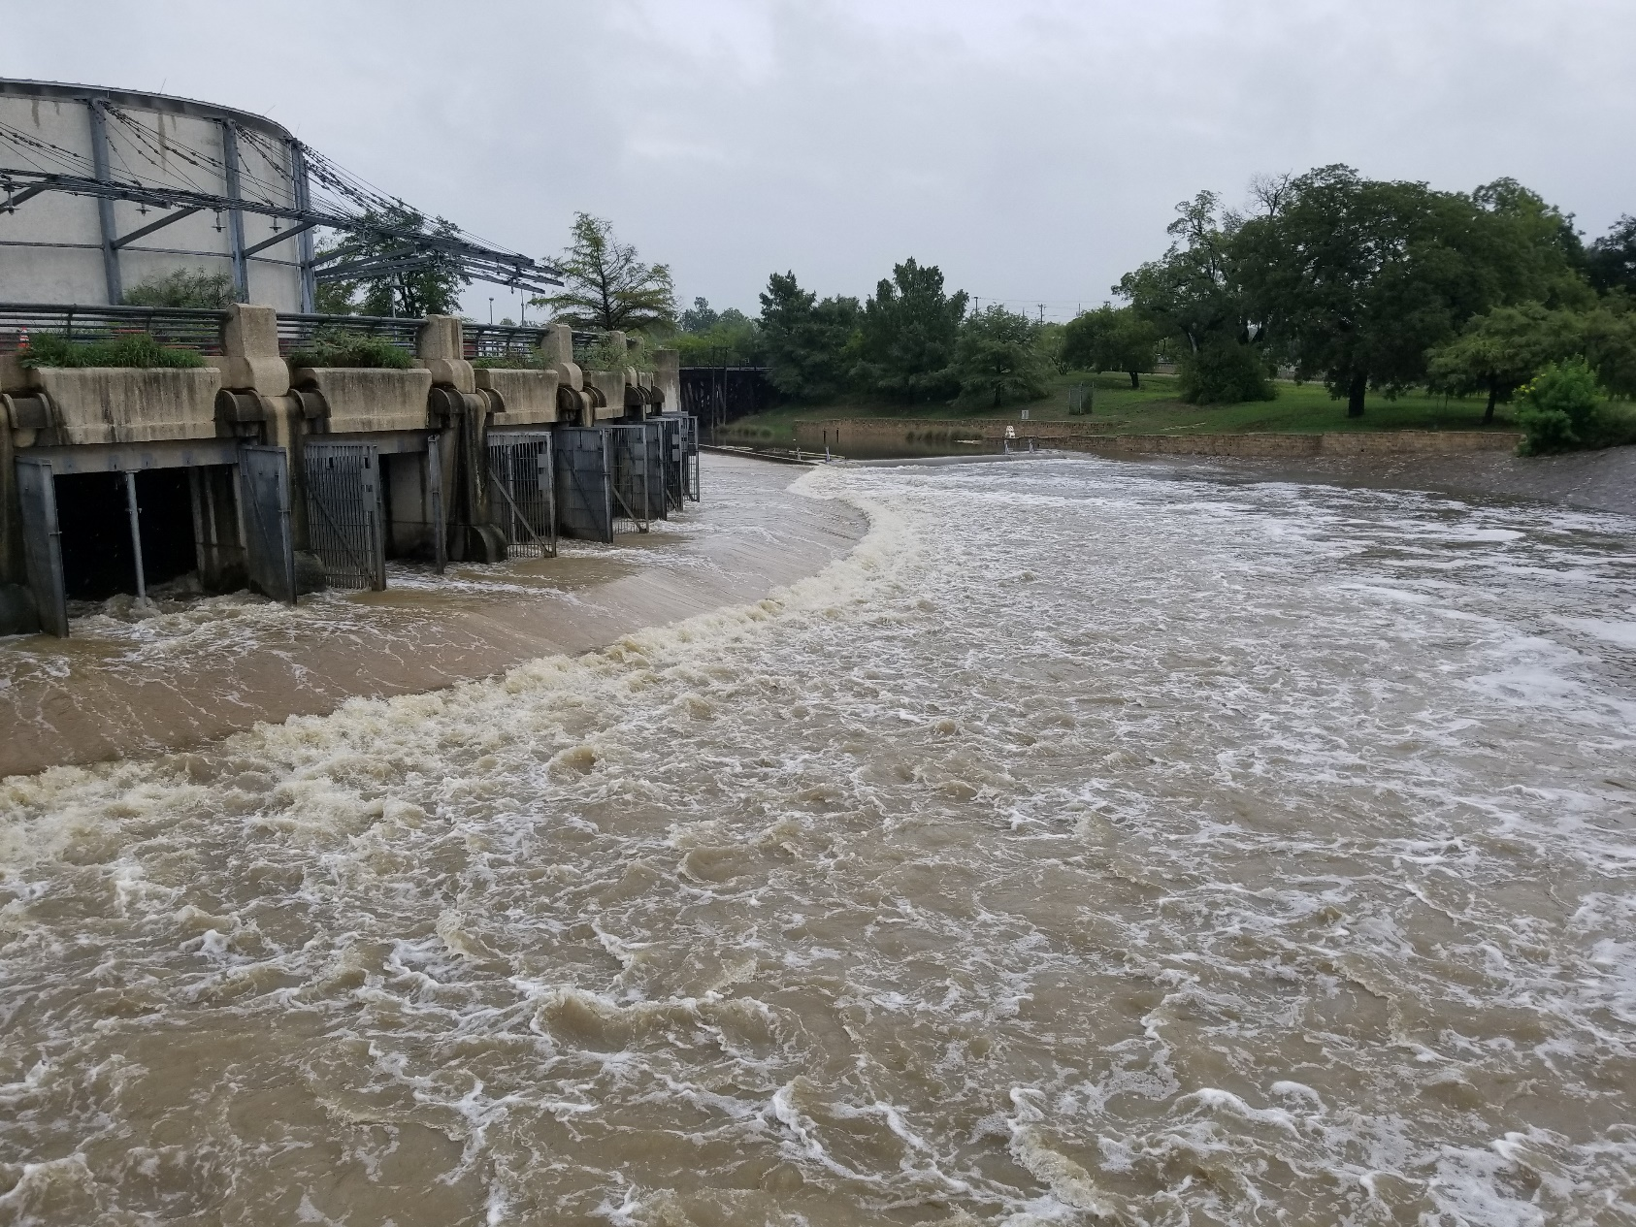

Slide 5
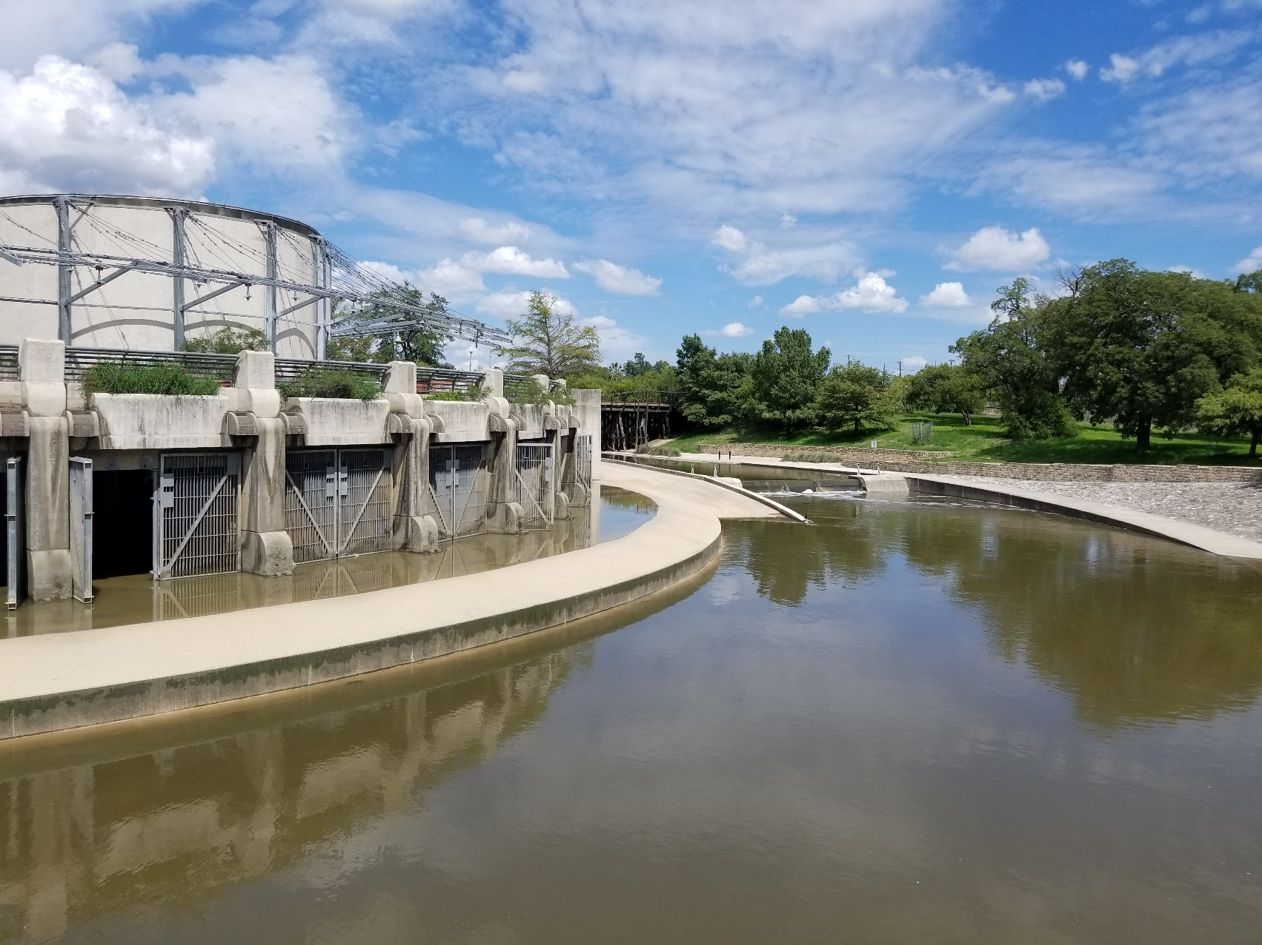

Slide 6
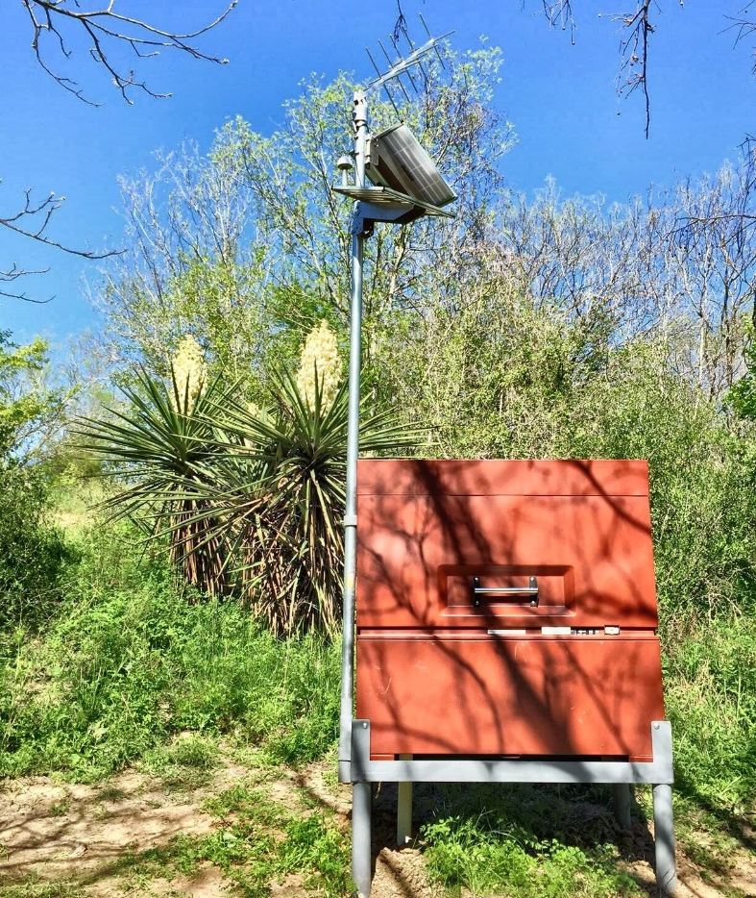
Monitoring Station Types
Instream Stormwater Sampling
Continuous Instream Monitoring
BMP Stormwater Sampling (Best Management Practice -Low-Impact Development)

Slide 7
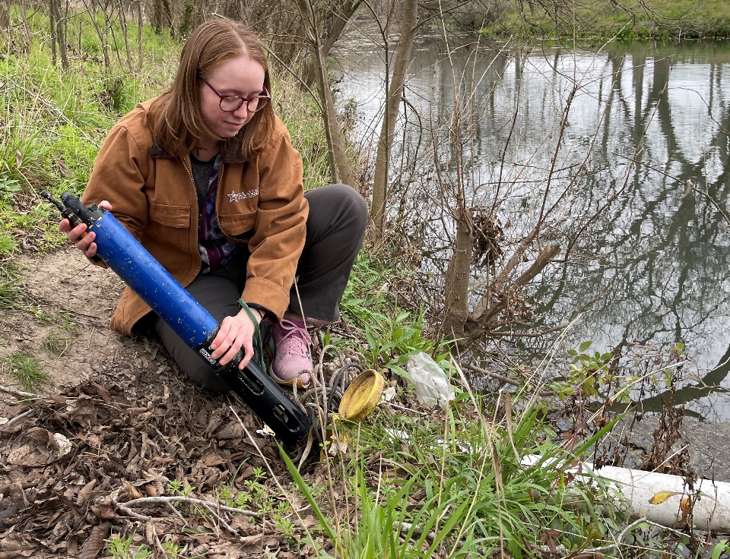
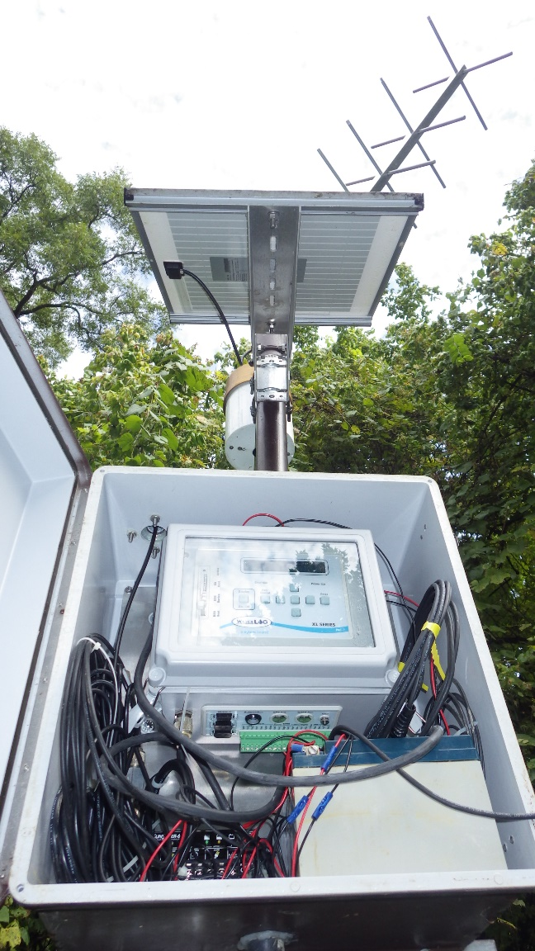
What’s in a Station?
Continuous Instream Monitoring
  Multiparameter Sonde: temperature, pH, specific conductance, dissolved oxygen
  Data Logger/ Transmitter
  Rain Gauge

Slide 8
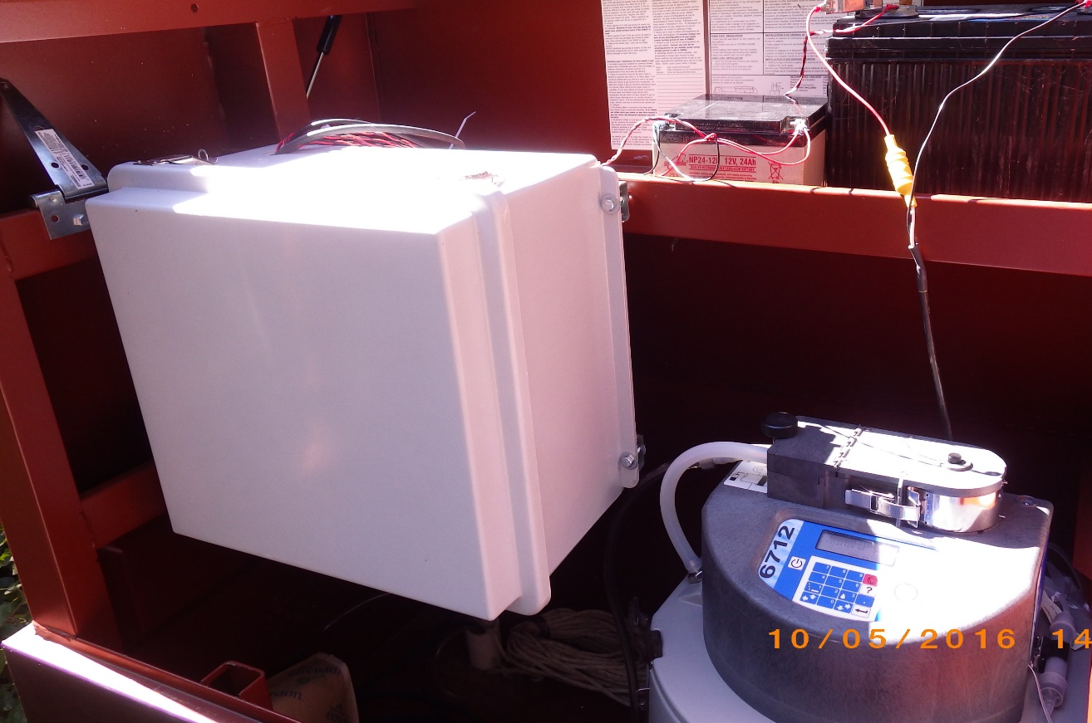
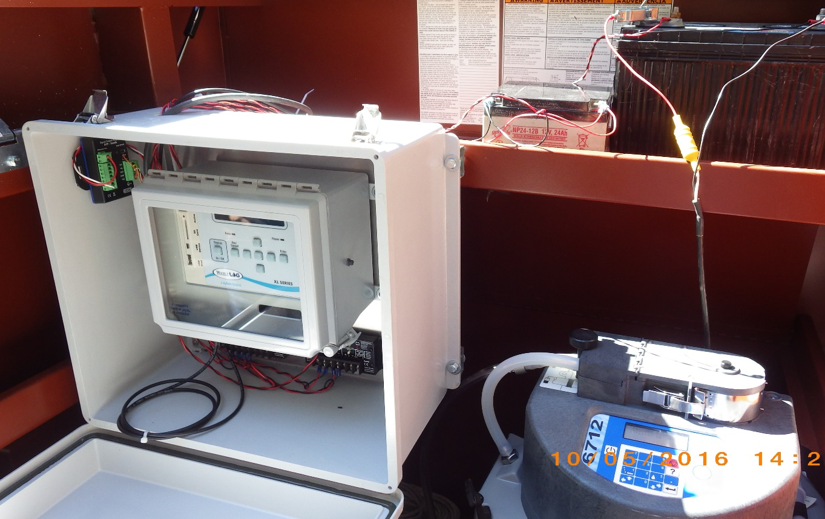
What’s in a Station?
Instream Stormwater Sampling
  Automated Sampler
  Multiparameter Sonde (field parameters)
  Data Logger/ Transmitter
  Rain Gauge

Slide 9
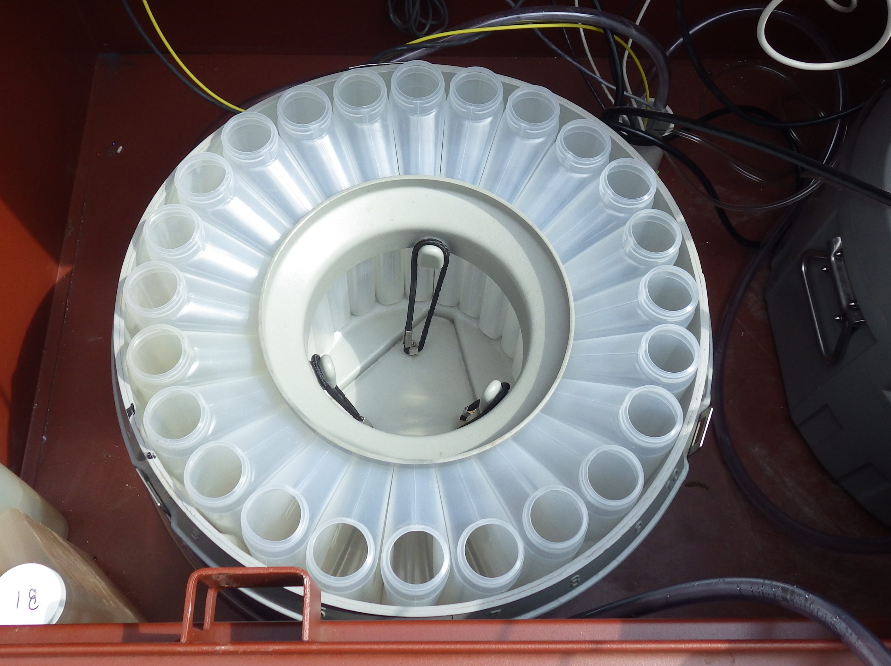
Stormwater Sampling Station

Slide 10
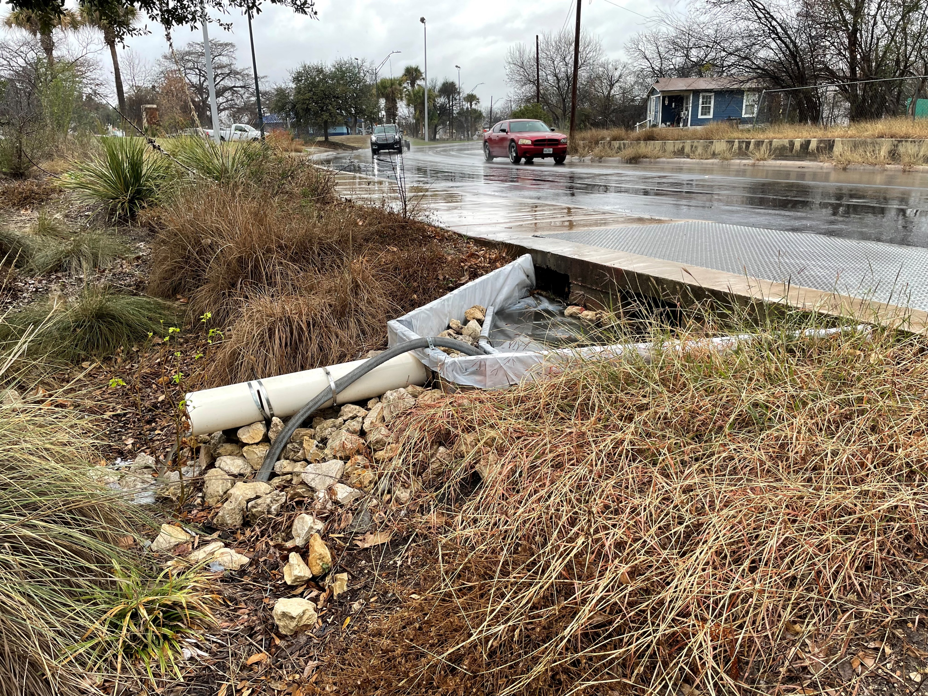
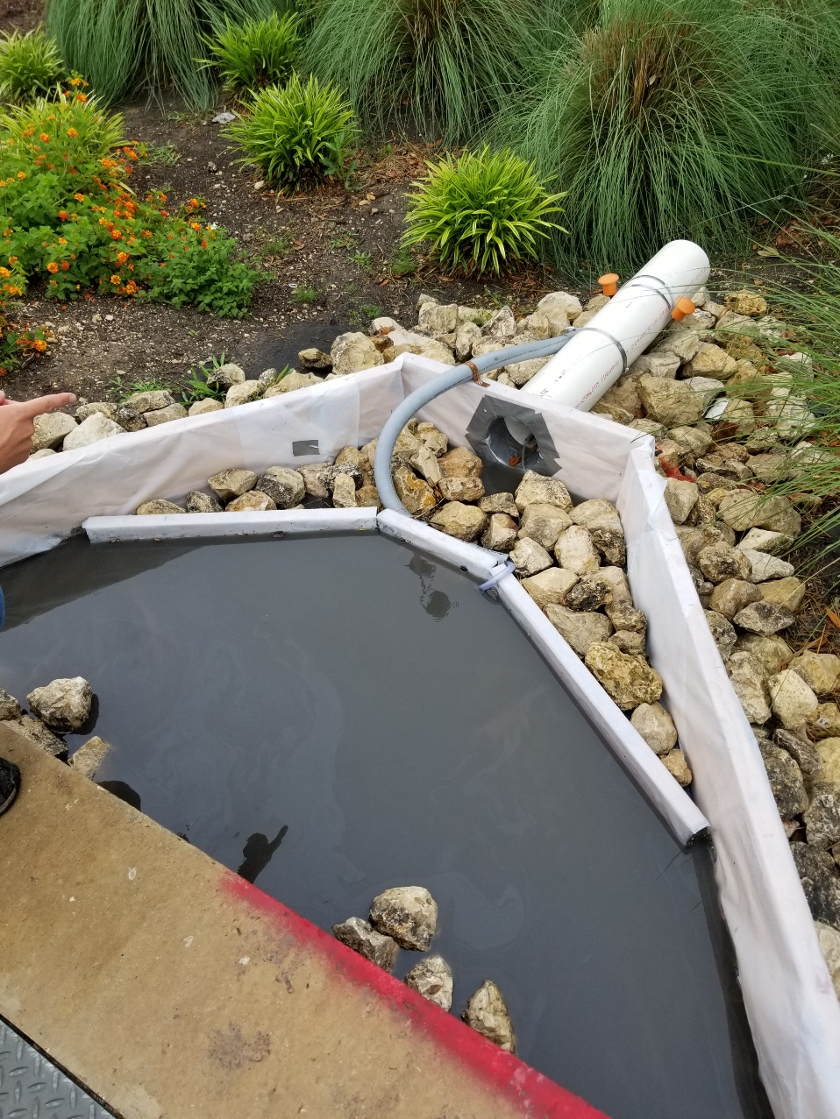
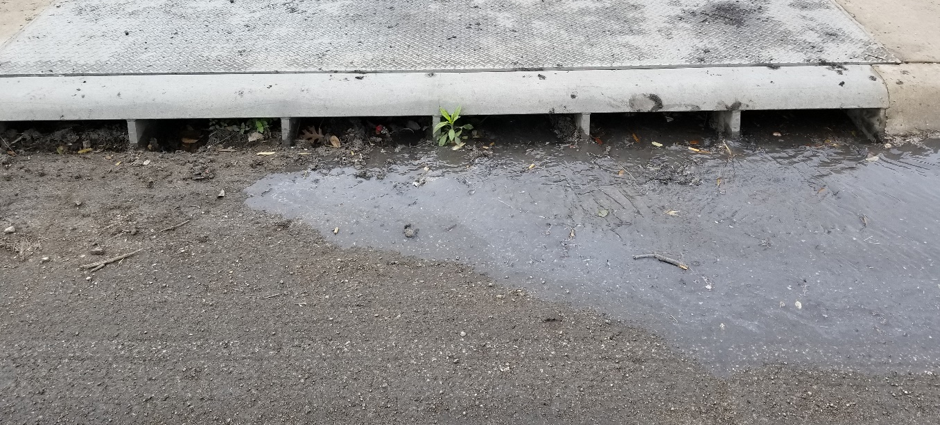

Slide 11
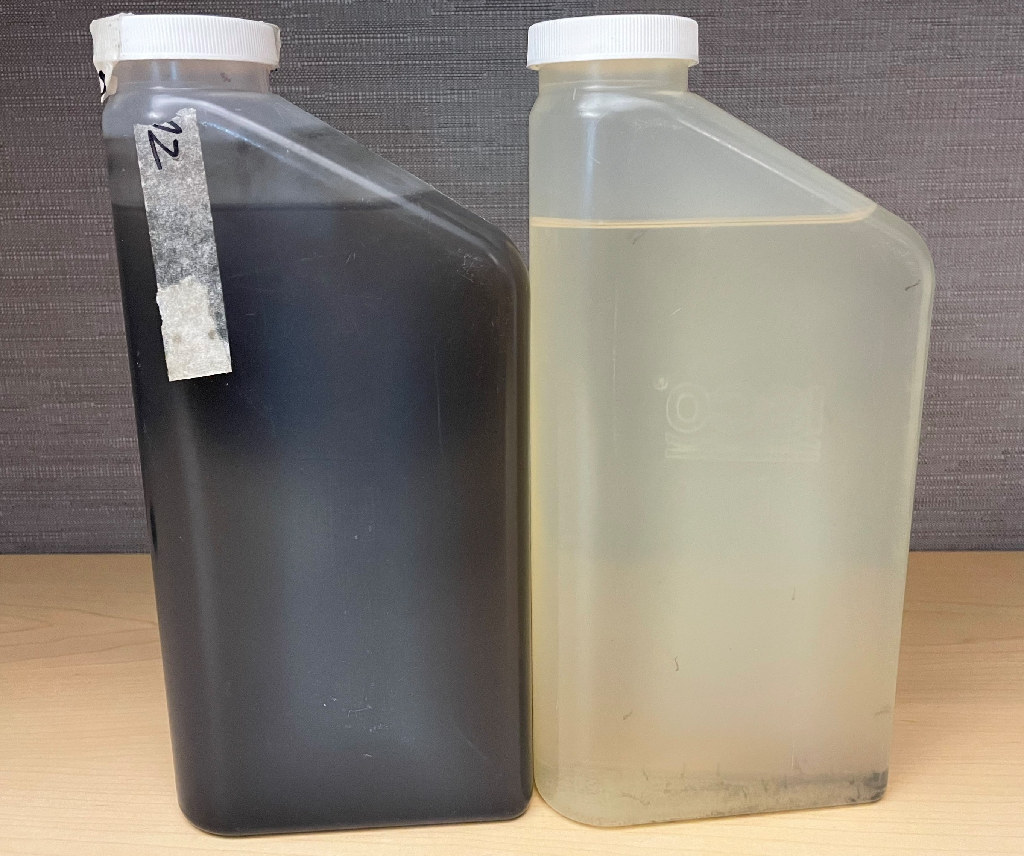
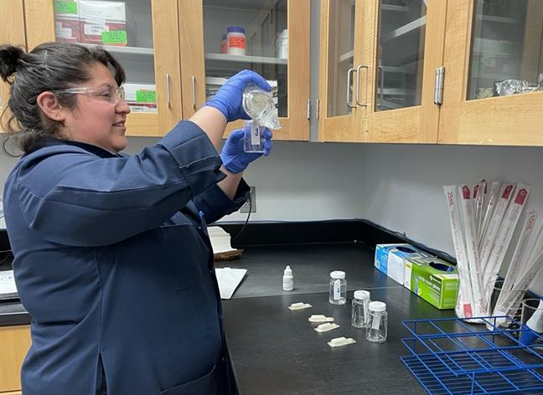

Lab Analyses
Non-Potable Water
Chemistry: 17
Micro: 1
Metals: 22
BMP: IN
BMP: OUT

Slide 12
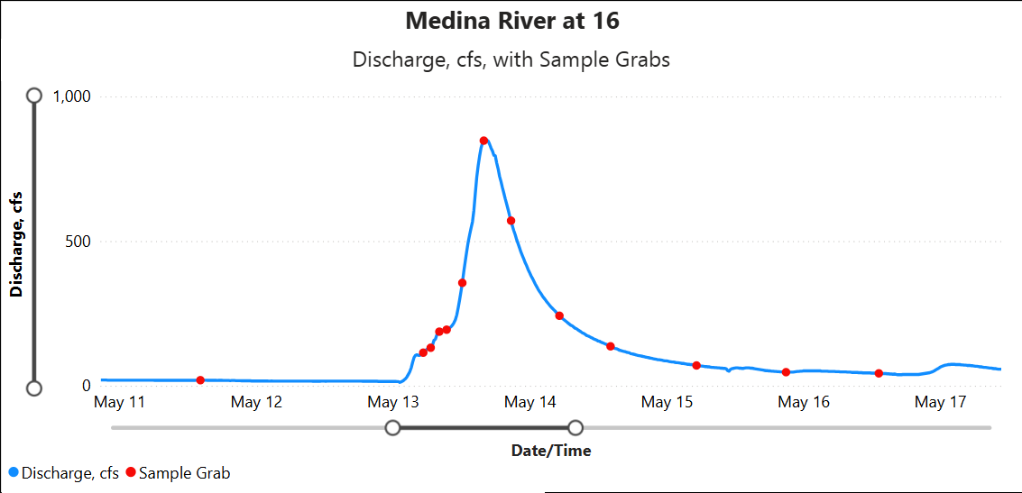
Hydrographs
Sample | Flow (CFS)
Baseline | 19
Day 1 (First) | 114
Peak | 847
Day 4 (Last) | 43
Notes:
E. Coli values range from 88 at baseline,

Slide 13
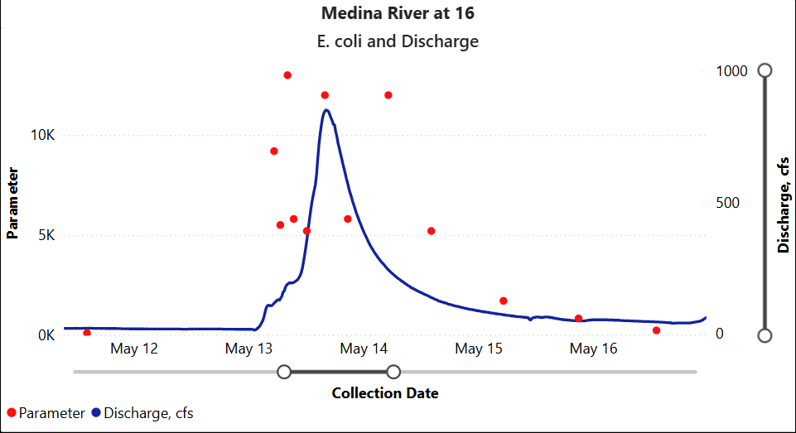
Hydrographs
Sample | Flow (CFS) | MPN
Baseline | 19 | 88
Day 1 (First) | 114 | 9,200
Peak* | 847* | 13,000*
Day 4 (Last) | 43 | 220
Recreation Standard | Geometric Mean
Primary Contact 1 (i.e. swimming) | 126 MPN
Secondary Contact 1 (i.e. kayaking) | 630 MPN
Notes:
E. Coli values range from 88 at baseline, over 5k rising, 13k peak, down below 1k on 15th (day 3). Last sample 220 MPN (flow: 42.8 cfs// vs baseline flow 10.6 CFS; 88 MPN)
Peak MPN: 5/13 08:11=13,000 (flow: 187) // Peak Flow: 5/13 15:59 847 (mpn 12,000) ---- peak MPN value roughly 8 hours before peak in flow (ONE example)

Slide 14
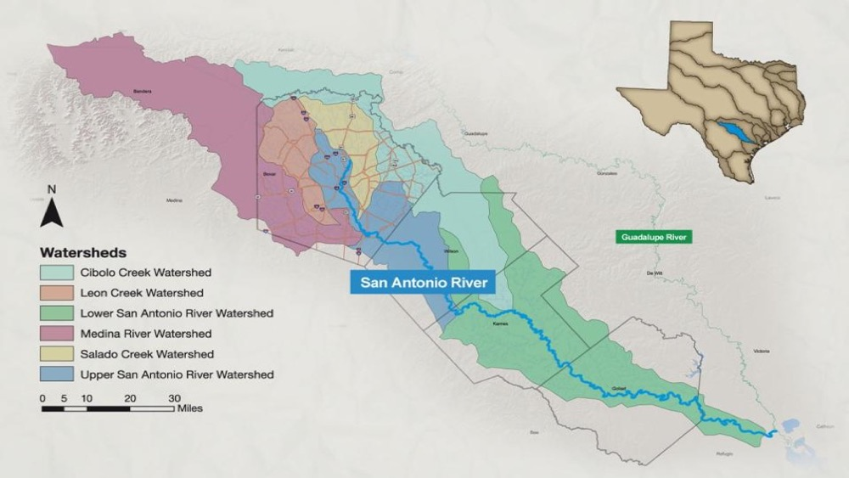

Slide 15
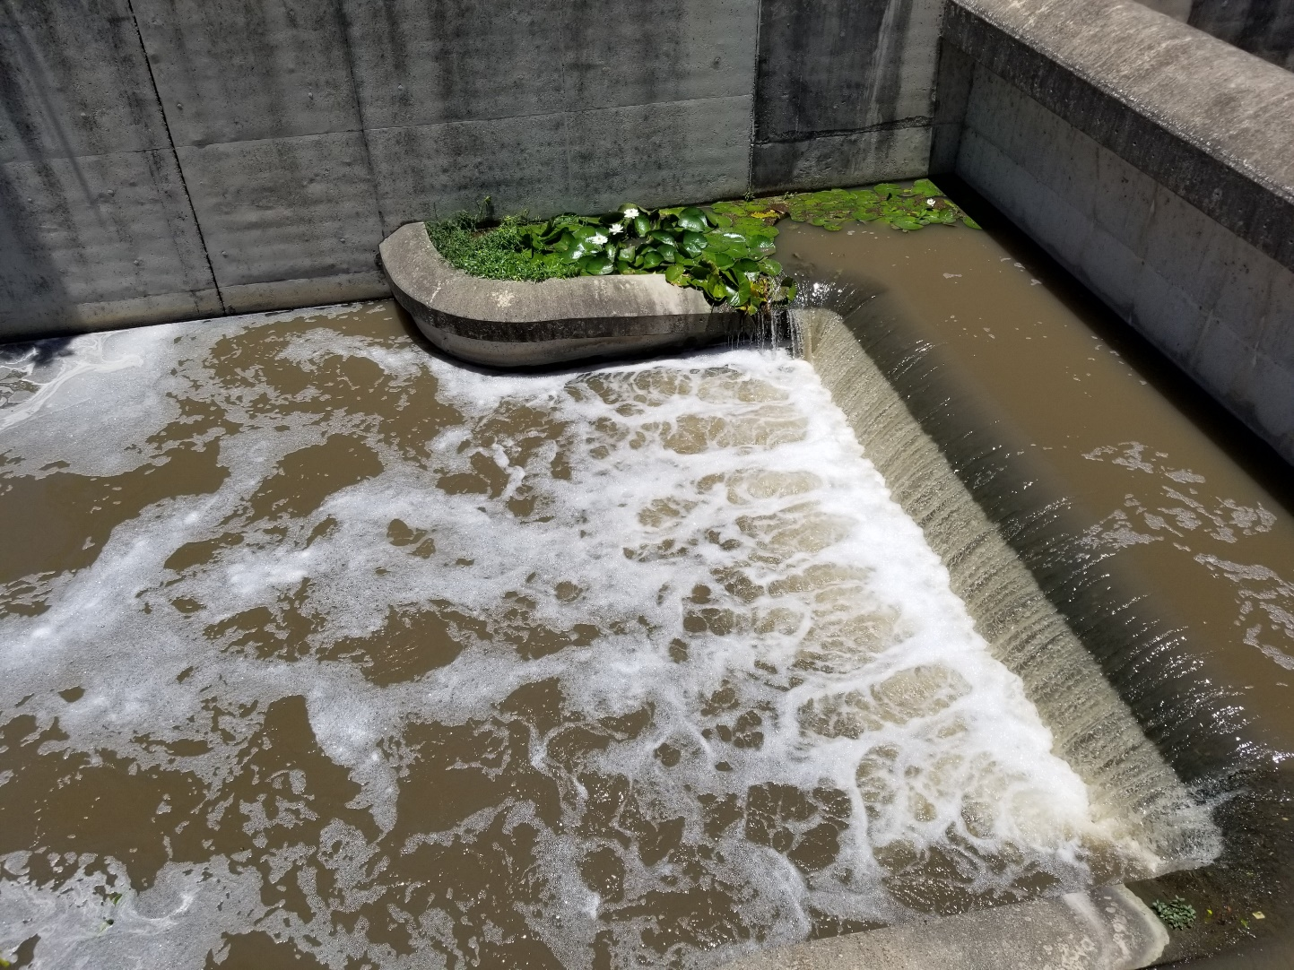
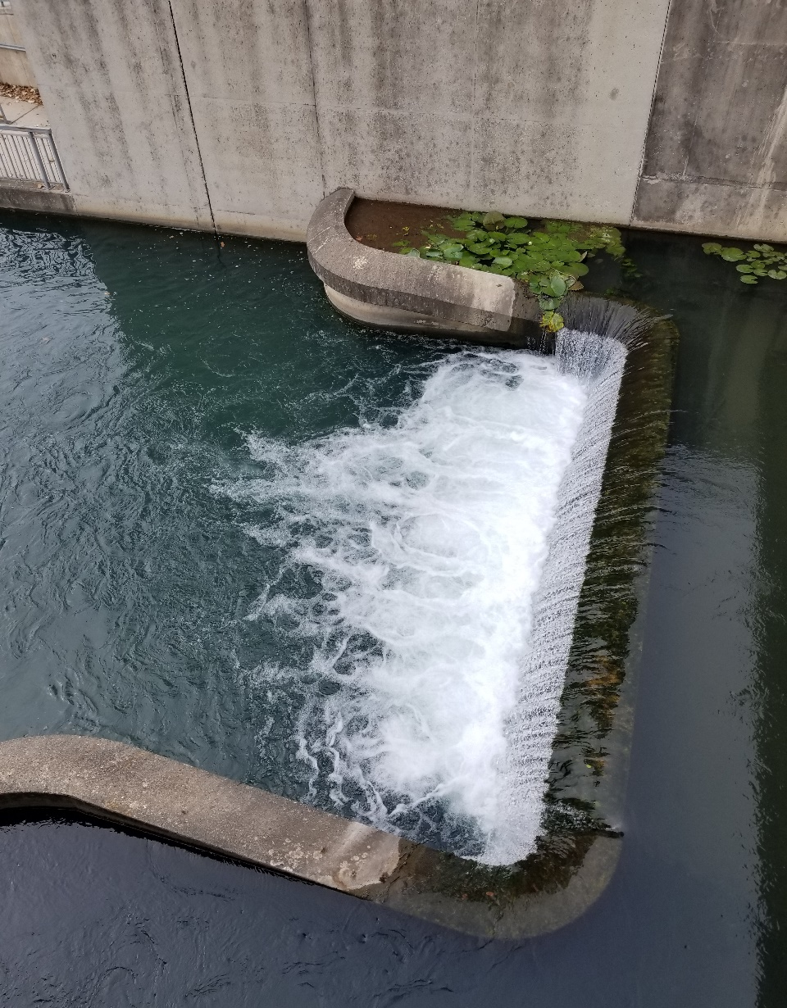
Notes:
Summary: Continuous Monitoring
Field Parameters
Instream Stormwater Sampling
40 Lab Parameters
Hydrograph
Sub-watershed Sampling

Slide 16
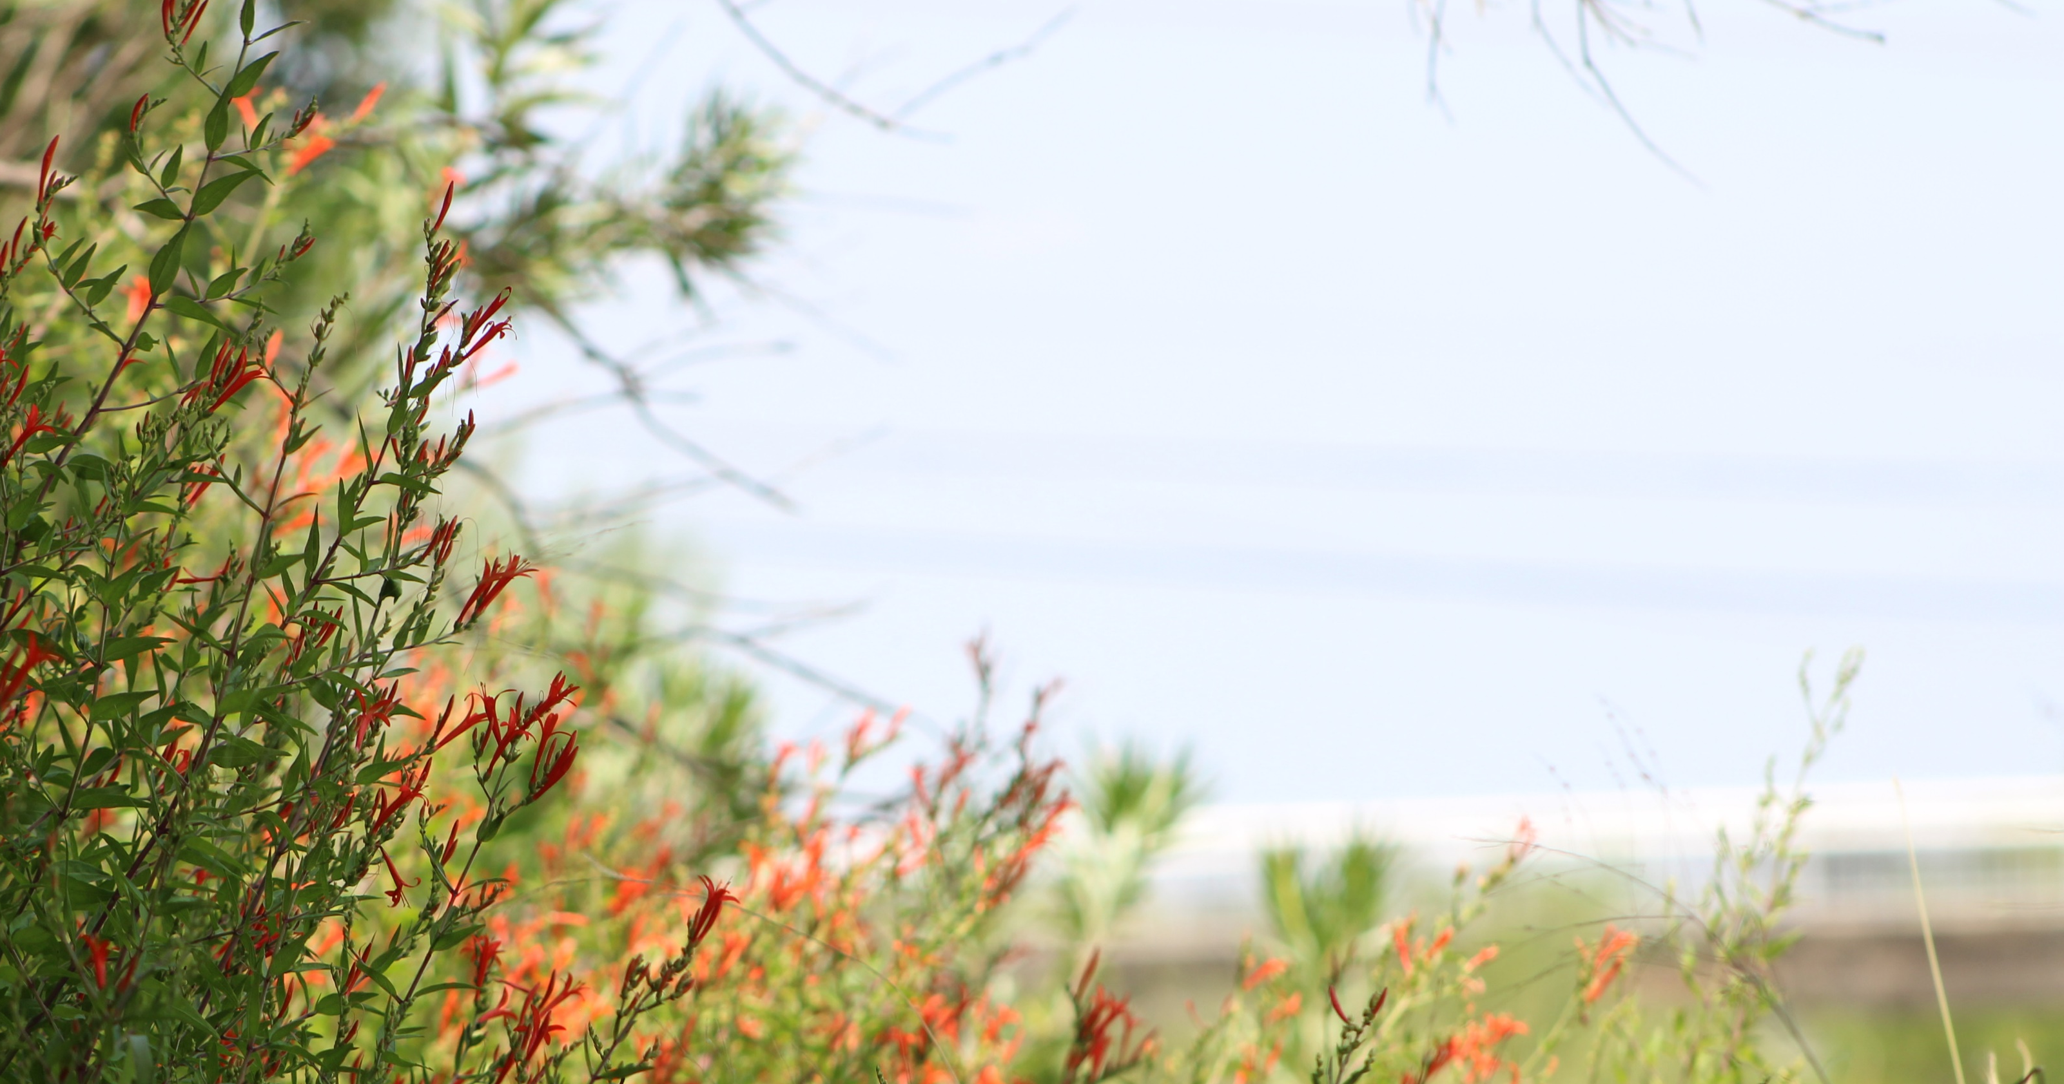
Questions?
Alicia Ramsey
aramsey@SARiverAuthority.org
302-3203

