Slide 1
THE SAN ANTONIO RIVER AUTHORITY FRESHWATER MUSSEL PROGRAM

Slide 2
Freshwater Mussel Program
Adult Survivability
Mission Reach Intensive Nekton Survey
Juvenile Propagation
Habitat Suitability

Slide 3
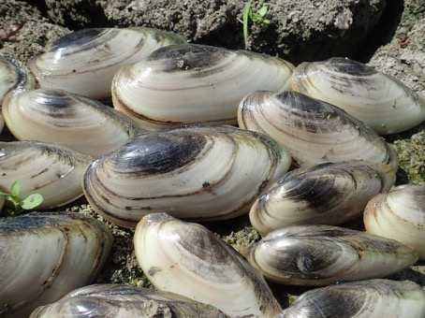
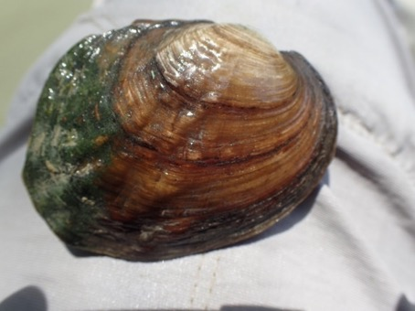
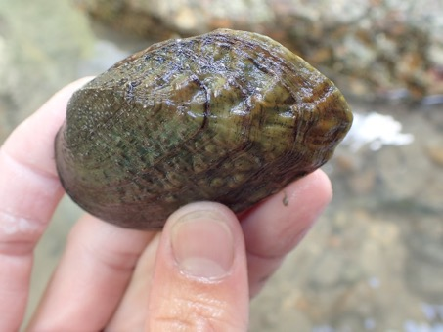
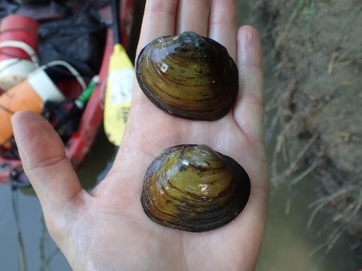
Species of Interest
Yellow Sandshell
Threeridge
Pistolgrip
Pimpleback
Notes:
Four most common species with the largest range in river miles.

Slide 4
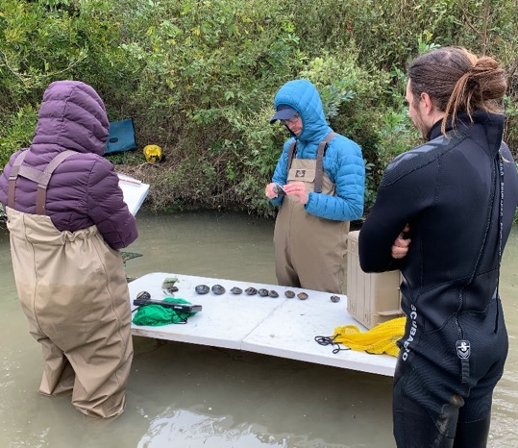
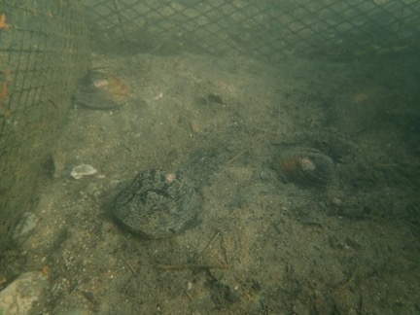
Mission Reach Mussel Survivability Study
Analyzed adult mussel survival and growth
Two experimental sites in the Mission Reach
One control site in Goliad County in the Lower San Antonio River

Slide 5
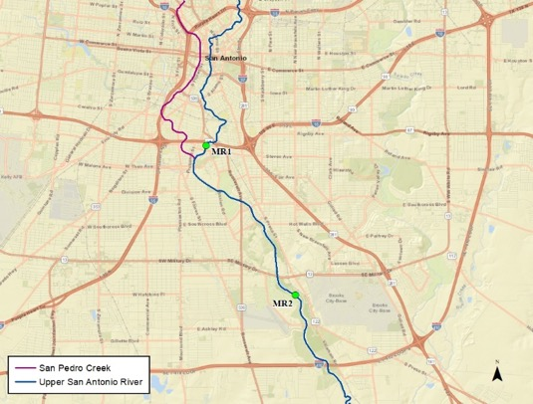
Mission Reach Mussel Survivability Study
Mission Reach sites
83% average survival
MR 2 grew significantly better
than control
Control site
High survival
Lower rate of growth
A
Site | % Survival
Control | 93.8
MR1 | 78.0
MR2 | 87.5
B
B
n = 8
n = 12
n = 14

Slide 6
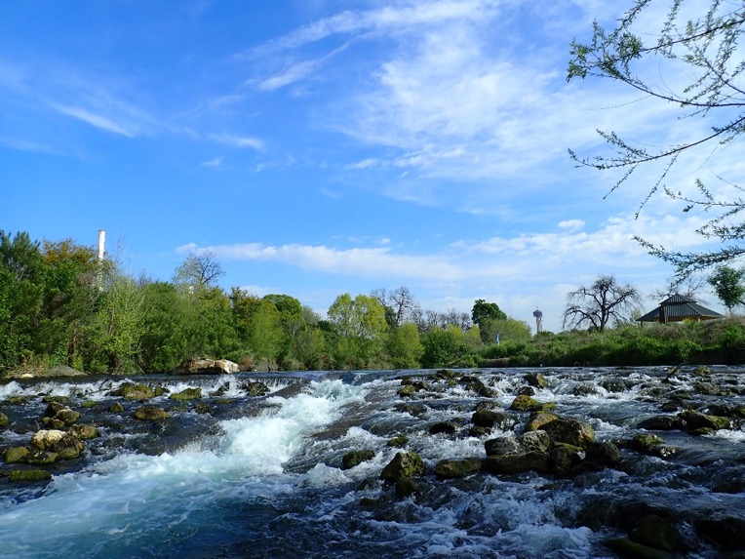
Mission Reach Intensive Nekton Survey
Establish species diversity and abundance
Analyze age/size structure
Presence/absence of host fish for species of interest

Slide 7
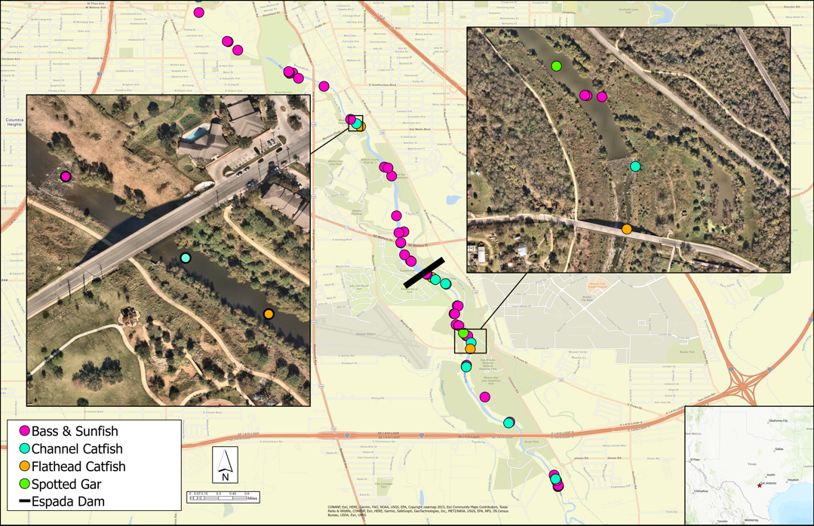
Mission Reach Intensive Nekton Survey

Slide 8
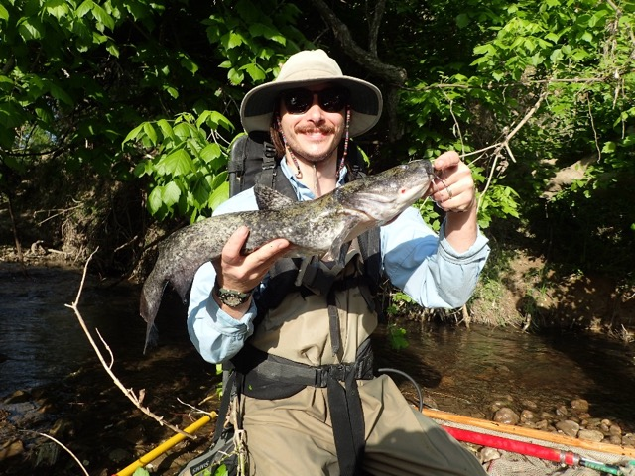
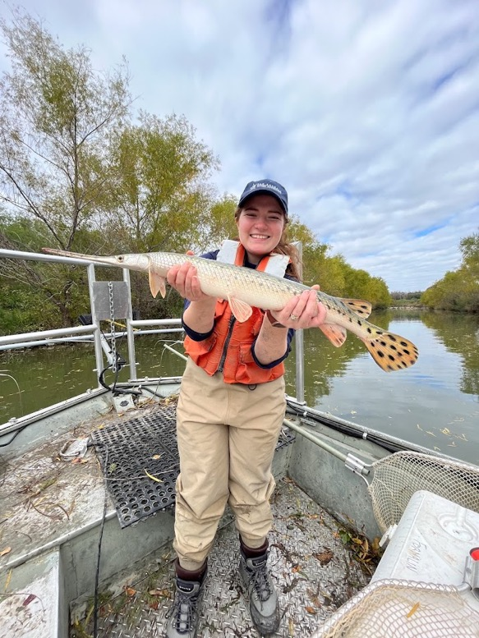
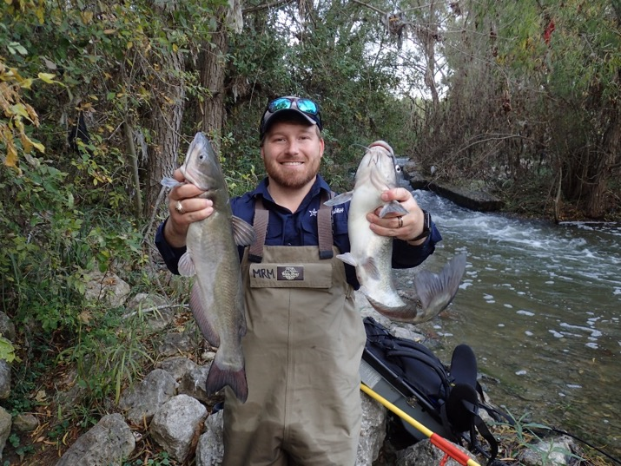
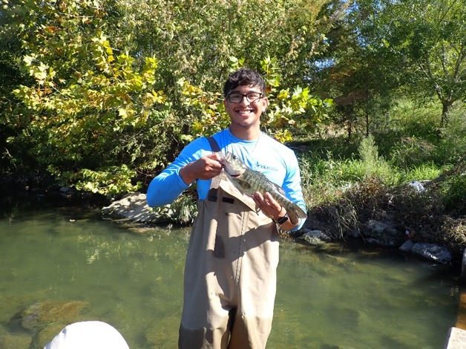

Slide 9
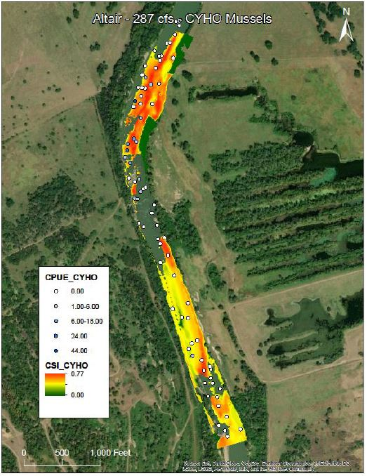
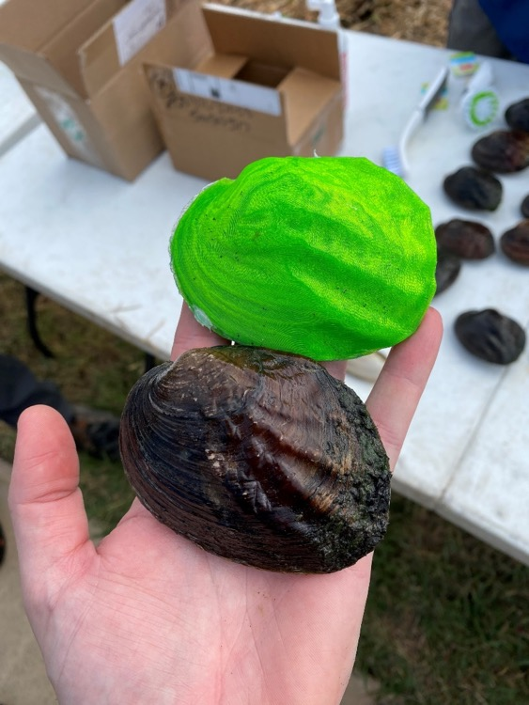
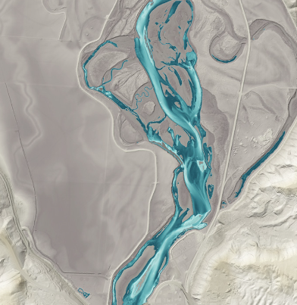
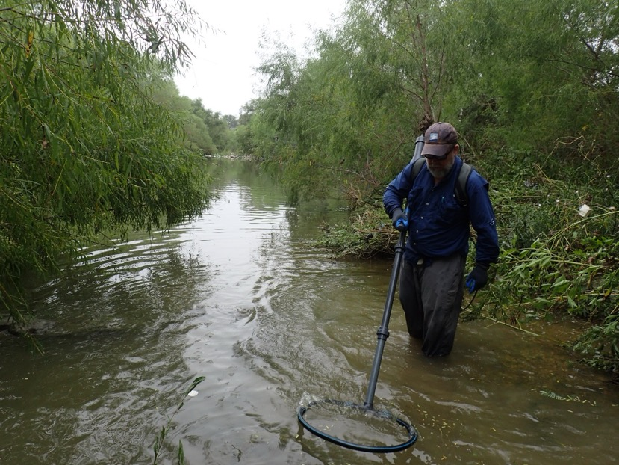
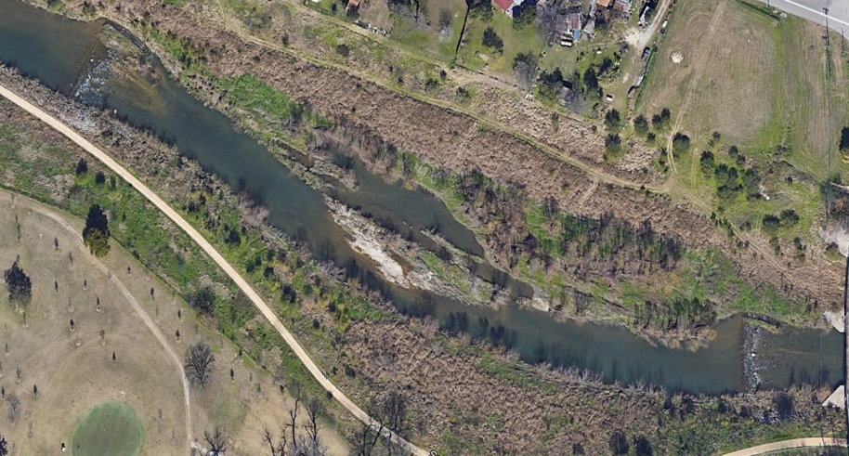
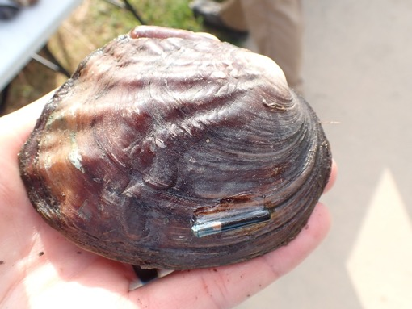
Habitat Suitability Modeling
Working with outside partners to develop habitat suitability models
Strategically selected 5 priority areas within MR

Slide 10
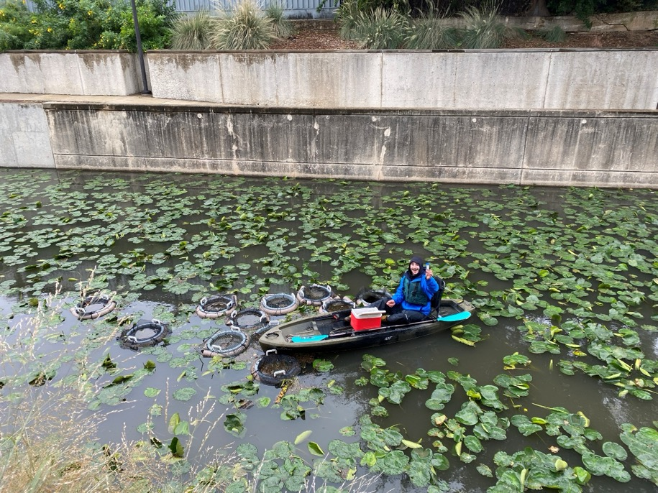
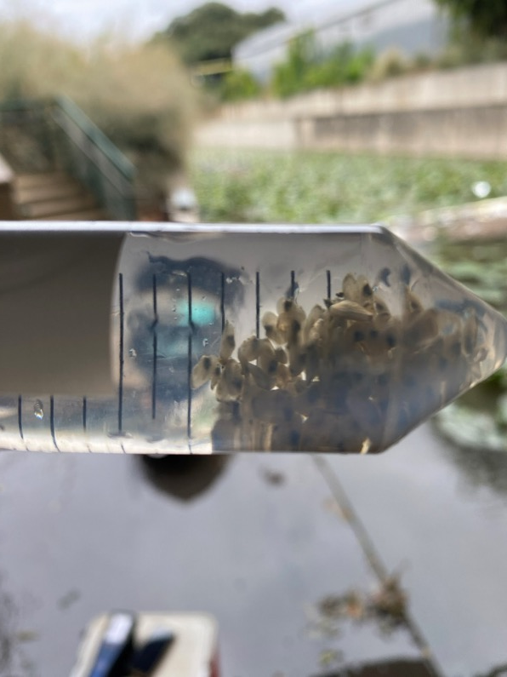
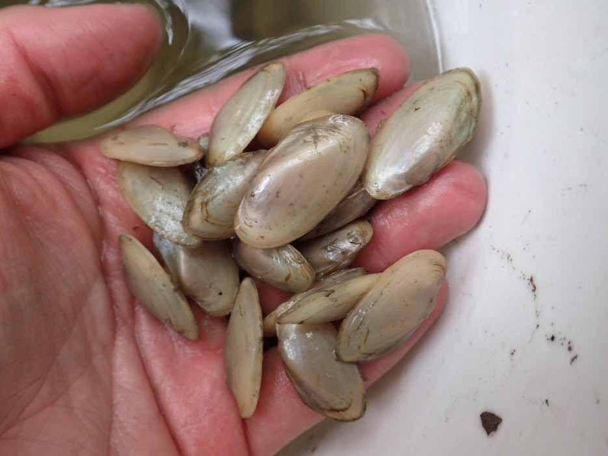
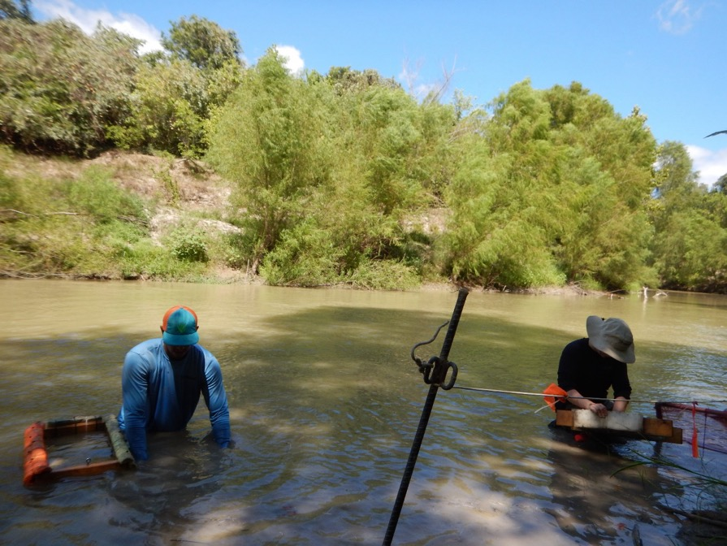
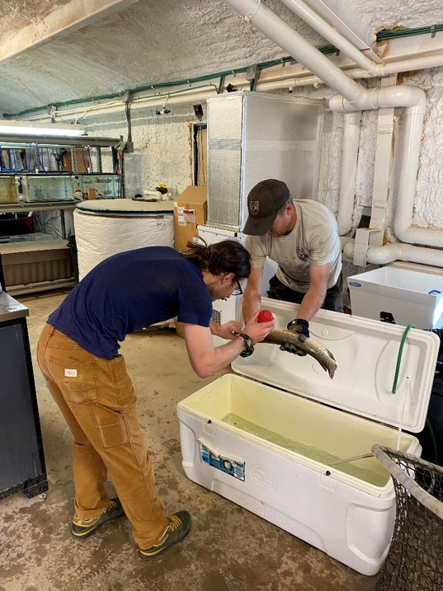
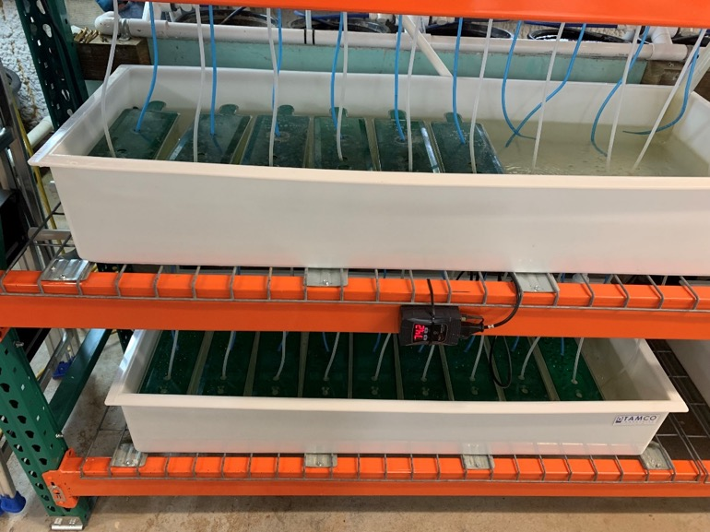
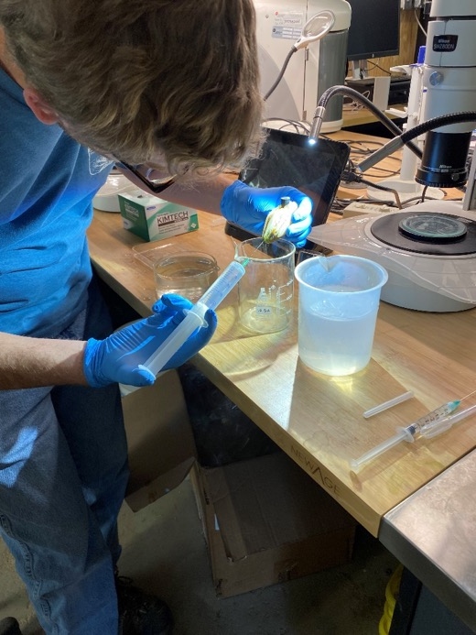
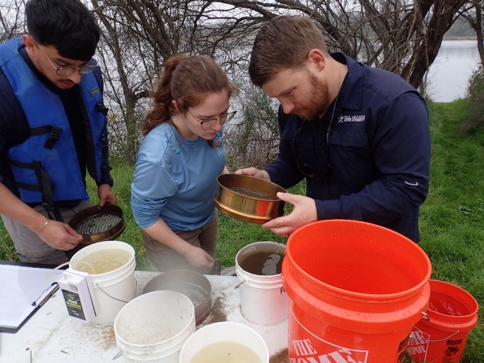
Juvenile Propagation

Slide 11
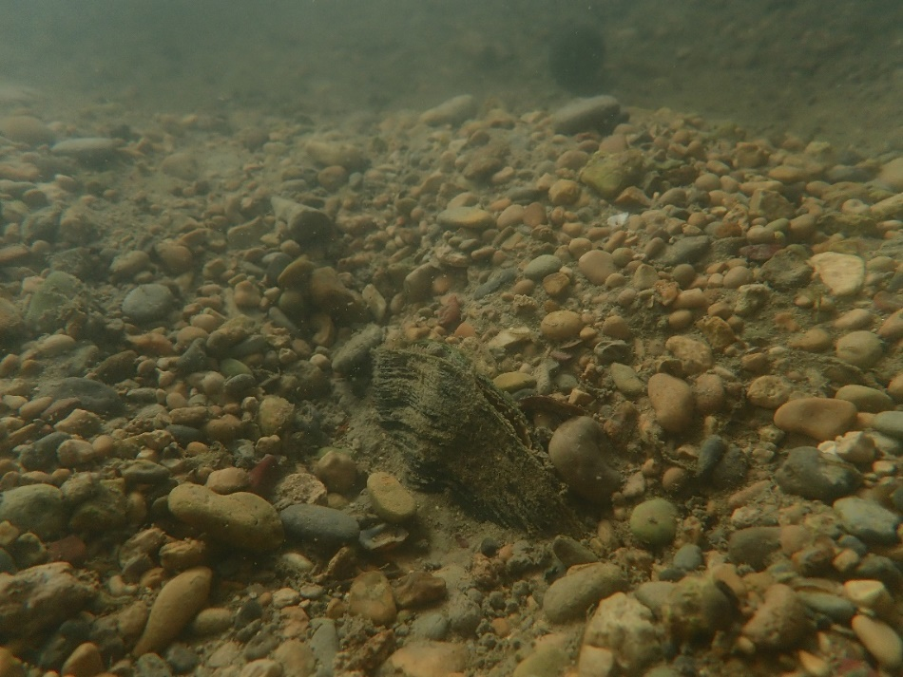
Austin Davis
210-302-3221
adavis@sariverauthority.org
Questions?

