Slide 1
2024 Coordinating Monitoring Meeting
March 15th, 2024

Slide 2
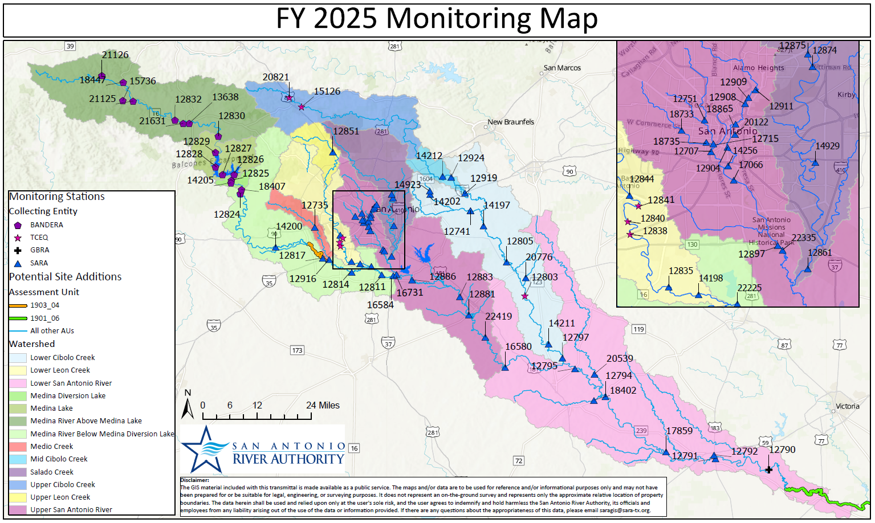

Slide 3
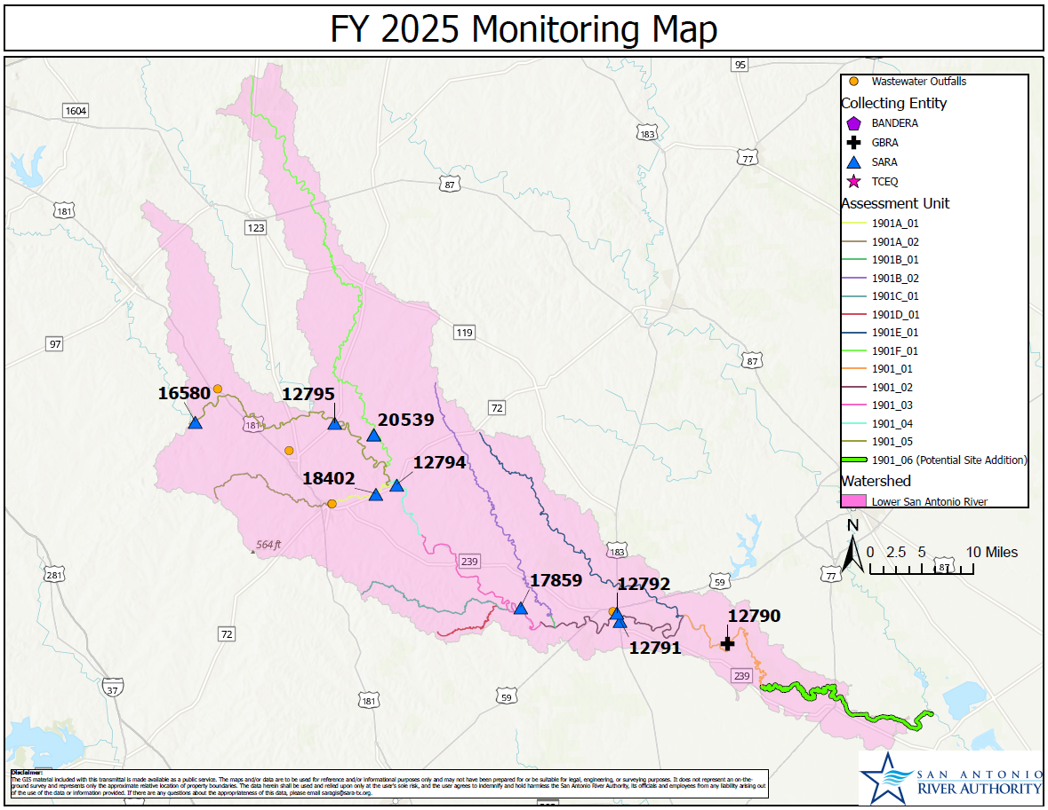
Lower San Antonio River
TCEQ_12789: SAR at US 77
Drop RT WQ
1901_06
Recon new site
TCEQ_12792: SAR at SPRR
Method Change
SAR at US 77 on Refugio-Victoria County Line
Potential new site
Notes:
1901_06 TCEQ_12789 - San Antonio River at US 77 on Refugio-Victoria County Line RT WQ Drop site Unsafe conditions for staff and poor sample quality. Search for a different location in this section of the basin.
1901_06 TCEQ_##### - San Antonio River RT WQ Add site - All parameters from 12789 - Add Chlorophyll a and Pheophytin Unsafe conditions at previous site. Potential substitution within the AU includes Mr Edward Love's property downstream. Recon of a site on the Love property scheduled for April/2024. Overall, promising.
1901_02 TCEQ_12792 - San Antonio River at Southern Pacific RR Bridge in Goliad BS Method Change Change doppler to USGS gage 08188500.

Slide 4
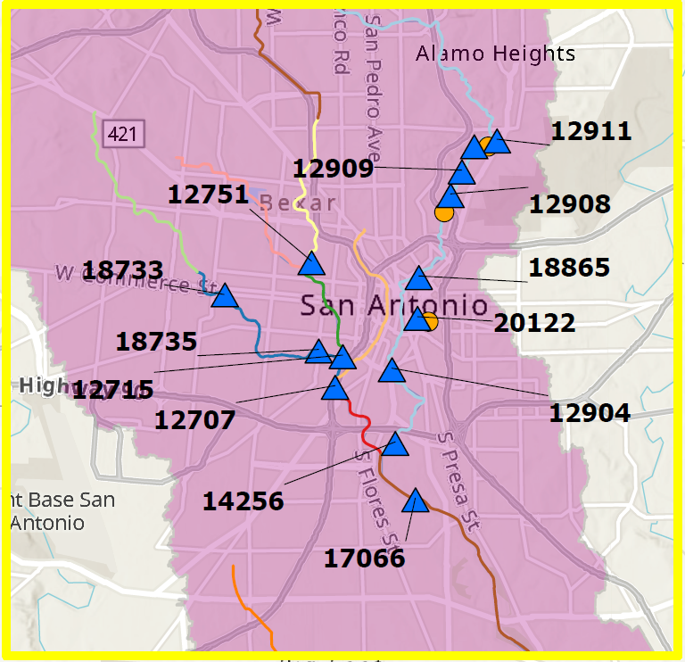
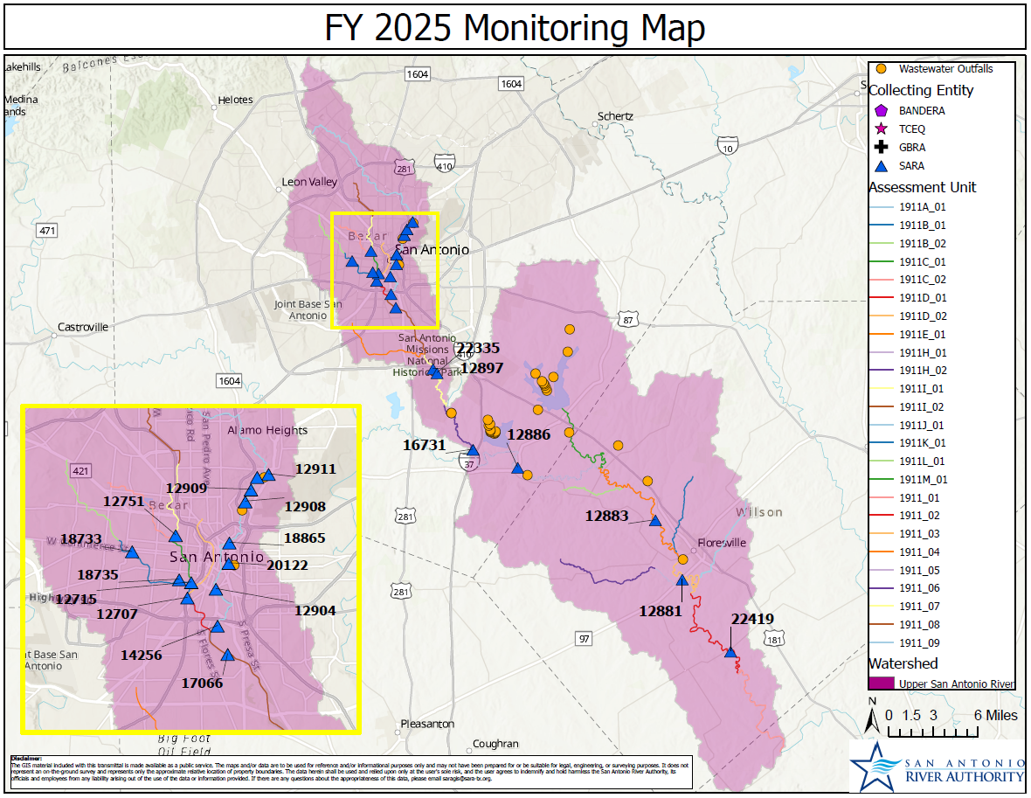
Upper San Antonio River
Continue existing 24 HR DO monitoring in same AU
TCEQ_18865: SAR at Lexington
Drop 24 HR DO
Maintain water quality, remove 24 HR DO
Notes:
1911_09 TCEQ_18865 - San Antonio River 57 meters upstream of Lexington Street Bridge and approximately 1.3 kilometers downstream of IH 35 BS Drop 24 HR DO 24 hr DO fully supported in 2022 IR, existing monitoring at Woodlawn/Mulberry in same AU will continue in support of the biological sampling.

Slide 5
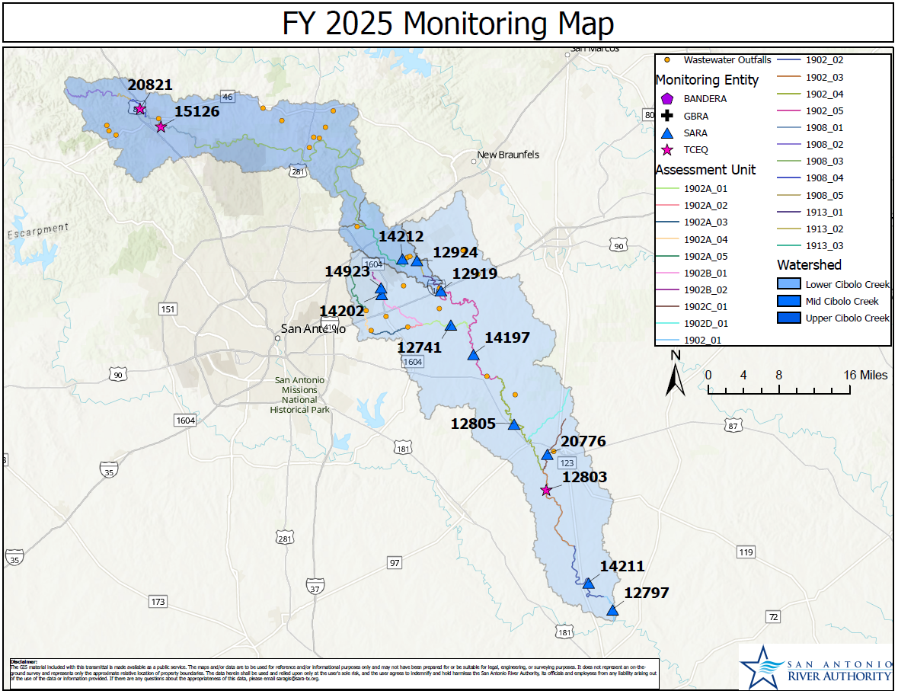
Cibolo Watershed
Santa Clara Ck nw New Berlin
Upper Cibolo upstream of Dam at River Road Park
TCEQ_20823: Upper Cibolo Creek at River Road Dam
Drop RT WQ
TCEQ_12802
Drop BS
TCEQ_12741: Martinez Creek at North Gable Rd
Drop 24 HR DO
TCEQ_12784: Santa Clara Ck nw New Berlin
Drop RT WQ
Martinez Ck on North Gable Rd
Cibolo Ck at FM 541
Notes:
UPPER CIBOLO
1908_01 TCEQ_20823 - Upper Cibolo Creek North Shore 30 meters upstream of Dam at River Road Park in Boerne Drop site Site is under construction with lack of water, difficulty coordinating, and AU is monitored downstream by TCEQ.
MID CIB – NO CHANGES
LOWER CIBOLO
1902_03 TCEQ_12802 - Cibolo Creek at FM 541 West of Kosciusko BS Potential drop site Increasing difficulty with landowner access. There are 2 samples scheduled at this site for FY24; pending access for those events, we would consider creating a new station in this AU.
1902A_01 TCEQ_12741 - Martinez Creek on North Gable Road south of Zuehl BS Drop 24 HR DO No 24 HR dissolved oxygen concerns since 2016 IR.
NA TCEQ_12784 - Santa Clara Creek on CR 315 Santa Clara Rd northwest of New Berlin 2.19 km 1.34 mi upstream of the confluence with Cibolo Creek RT WQ Drop site Site is continuously pooled, is not on a TCEQ AU and therefore not assessed in the IR. Was previously added due to a potential WWTP build. Current data: Sampled since October 2016 (~7 years), 46 samples in LIMS. Dry 22% of the time, Pooled 28% of the time, flow ≤0.1 cfs 13% of the time (at or below 7Q2 ~63% of samples).

Slide 6
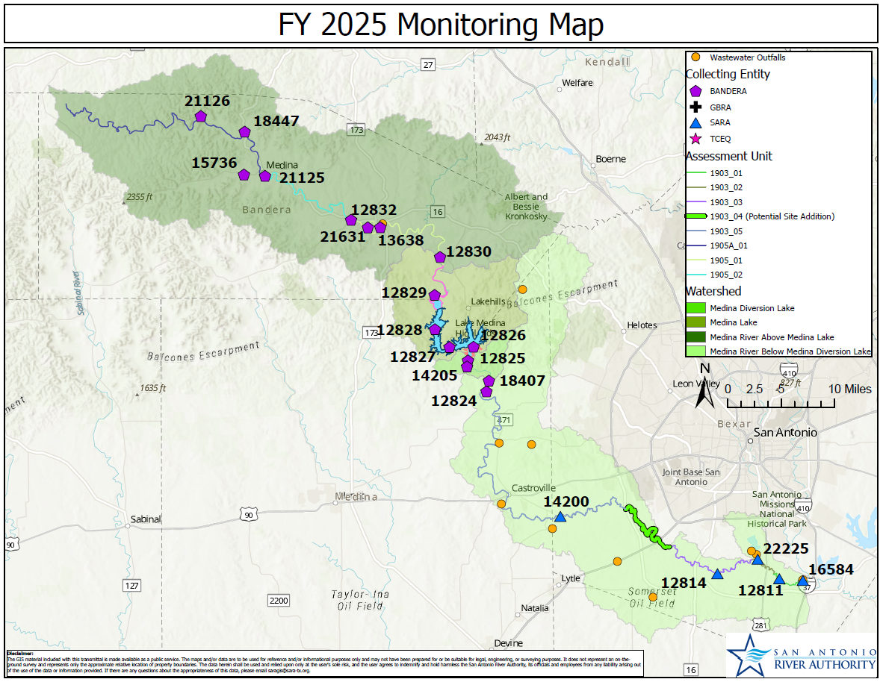
Medina Watershed
TCEQ_14200: Medina River at CR 484
Method change
1903_04
Recon historical site
Medina River at 1604
Notes:
UPPER MEDINA – No Changes
MEDINA LAKE – No Changes
DIVERSION LAKE – No Changes
LOWER MEDINA –
1903_05 TCEQ_14200 - Medina River at CR 484 RT WQ Method Change Change doppler to USGS gage 8180640.
1903_04 1903_04 RT WQ Add site - Conventionals, Field, Flow Add site in 1903_04; not currently monitored. Field parameter data is dropping off IR, was monitored for 2 years ~9 years ago CS for nitrate (fertilizers, eutrophication; agriculture in the area) May be able to provide data support for Lower Medina WPP Recon Medina @ 1604 and @ Von Ormy (I-35)

Slide 7
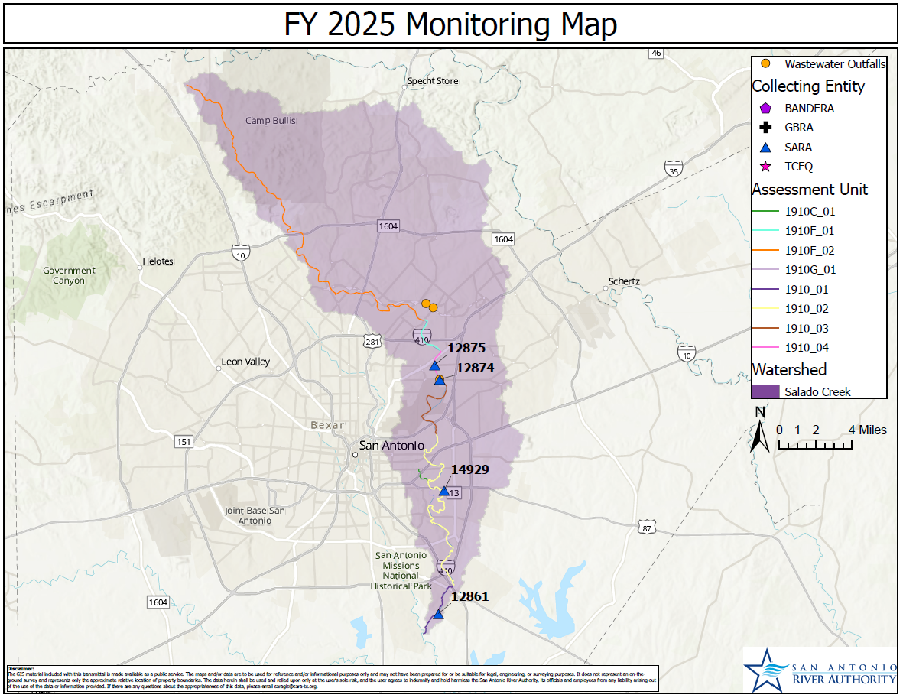
Salado Creek
TCEQ_12870: Salado Creek at Gembler Rd
Drop RT/BS
TCEQ_12698/12690/ 12693: Salado Creek tributaries
Drop RT WQ
TCEQ_14929: Salado Creek at Comanche Park
Increase biological monitoring
Walzem Creek at Holbrook Rd
Menger Creek at Coliseum Rd
Salado Creek at Gembler Rd
Rosillo Creek at WW White Rd
Notes:
1910_02 TCEQ_12870 - Salado Creek at Gembler Road RT WQ + BS Drop site Difficulty with site access and holding times post-KOA. Drop site and continue RT monitoring at 14929 Comanche Park (same AU). Drop BS monitoring and add to 14929 Comanche Park.
1910_02 TCEQ_14929 - Salado Creek at Comanche Park BS Add (AqHab, Nekton, Benthics, 24 HR DO) x1 Take on biological monitoring from Salado Creek at Gembler Road. Maintain RT WQ, total of 2 BS events per year.
1910A_01 TCEQ_12698 - Walzem Creek at Holbrook Road RT WQ Drop site Drop site - Salado creek is monitored in every main 1910 AU that these tributaries feed into and is monitored downstream of this tributary at TCEQ_12874 and upstream at TCEQ_12875 for RT WQ and 24 HR DO. Bacteria impairment in 1910 and this tributary is not expected to change. Should the impairment in the main creek change, monitoring should resume in the tributary.
1910B_01 TCEQ_12690 - Rosillo Creek at W.W. White Road in San Antonio RT WQ Drop site Drop site - Salado creek is monitored in every main 1910 AU and is monitored downstream of this tributary at TCEQ_12861 for RT WQ and all BS. Bacteria impairment in 1910 and this tributary is not expected to change. Should the impairment in the main creek change, monitoring should resume in the tributary.
1910D_01 TCEQ_12693 - Menger Creek Immediately upstream of Coliseum Road RT WQ Drop site Drop site - Salado creek is monitored in every main 1910 AU and is monitored downstream of this tributary at TCEQ_14929 for RT WQ and all BS and upstream at TCEQ_12874 for RT WQ and 24 HR DO. Bacteria impairment in 1910 and this tributary is not expected to change. Should the impairment in the main creek change, monitoring should resume in the tributary.

Slide 8
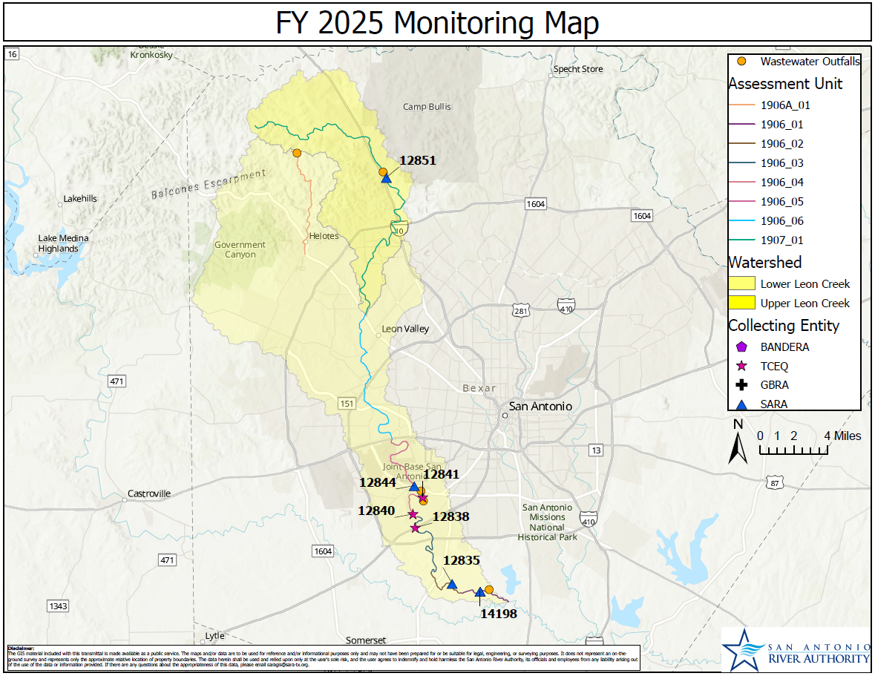
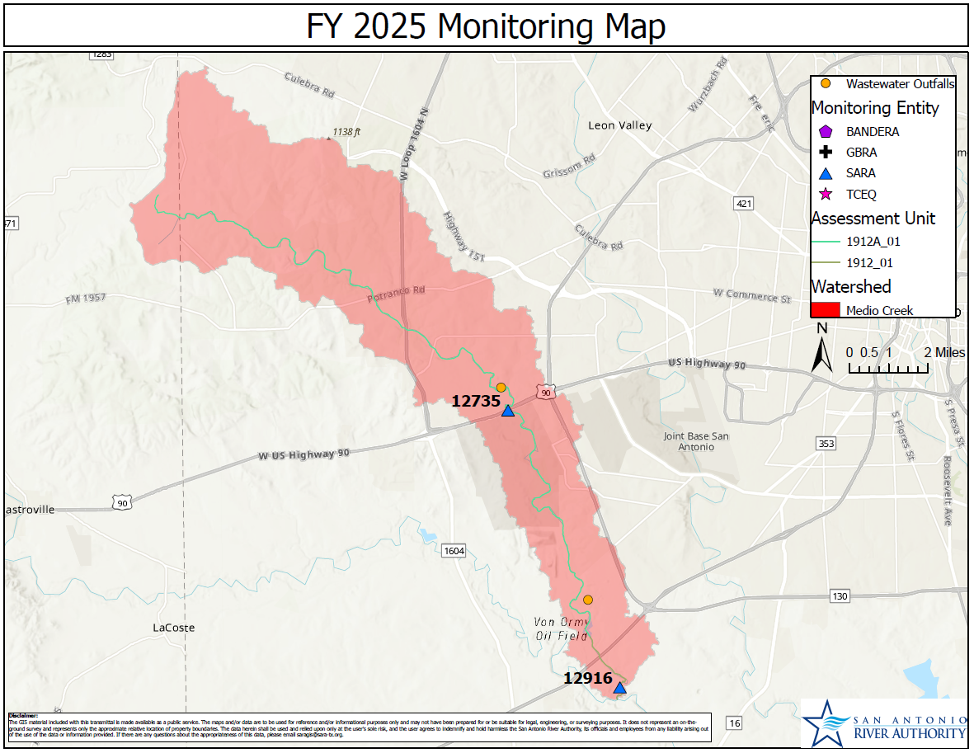
Leon Watershed
Medio Creek
Notes:
No changes.

Slide 9
Monitoring Removals
Lower San Antonio River
TCEQ_12789: SAR at US 77
Routine water quality
Upper San Antonio River
TCEQ_18865: SAR at Lexington Ave
24 HR DO
Lower Cibolo Creek
TCEQ_12802: Cibolo Creek at FM 541
Biological monitoring
Upper Cibolo Creek
TCEQ_20823: Upper Cibolo Creek at River Road Dam
Routine water quality
Salado Creek
TCEQ_12870: Salado Creek at Gembler Rd
Routine water quality, biological monitoring
TCEQ_12690/12693/12698: Salado Creek tributaries
Routine water quality
Notes:
LSAR
TCEQ_12789 – San Antonio River at US 77 on Refugio-Victoria County Line (RT WQ) – Unsafe conditions for staff and poor sample quality. USAR
TCEQ_18865 – Drop 24 HR DO – maintain WQ. 24 HR DO fully supported in the 2022 IR, and existing monitoring at Woodlawn and Mulberry in the same AU will continue in support of biological sampling.
LCIB
TCEQ_12802 – Cibolo Creek at FM 541 West of Kosciusko – Drop BS, no WQ, WQ monitored in AU by TCEQ. Declining landowner access, and after recon have determined there is not another appropriate site for biological monitoring in this AU.
TCEQ_12741 – Martinez Creek on North Gable Rd south of Zuehl – Drop BS 24 HR DO monitoring, there have been no concerns for DO in this AU since the 2016 IR. Maintain RT WQ including DO grabs.
TCEQ_12784 – Santa Clara Ck on CR 315 nw of New Berlin – Drop RT WQ – site is continuously pooled or extremely low flow – sampled for approximately 7 years, during which it has been dry 22% of the time, pooled 28% of the time, and flow at less than or equal 0.1 cfs 13% of the time, for a total of 63% of samples at or below 0.1 cfs.
UCIB
TCEQ_20823 – Site has not been able to be sampled due to construction over the past year, and the AU is already monitored downstream by TCEQ.
SALADO
TCEQ_12870 – Salado Creek at Gembler Road – drop RT and BS – Difficult site access over time and WQ hold time concerns. In the same AU as 14929, so we will increase BS monitoring at that site.
TCEQ_12698/12690/12693 – Walzem, Rosillo, Menger – Drop WQ, Salado Creek mainstem is monitored in every AU and downstream of each of these tributaries. Bacteria impairments in these AU’s are not expected to change, so if there is a change in the mainstem, we would then plan to resume monitoring in these tributaries to detect changes here.

Slide 10
Monitoring Adjustments
Monitoring Additions
Lower San Antonio River
TCEQ_12792: SAR at Southern Pacific RR Bridge in Goliad
Manual flow to USGS gage
Lower Medina River
TCEQ_14200: Medina River at CR 484
Manual flow to USGS gage
Lower San Antonio River
1901_06 – Add all parameters from TCEQ_12789 + Chlorophyll a and Pheophytin
Lower Medina
1903_04 – Add all conventionals + Chlorophyll a and Pheophytin
Salado Creek
TCEQ_14929 – Increase biological monitoring
Notes:
LSAR
TCEQ_##### - 1901_06 – Add all parameters from 12789 + Chlorophyll a and pheophytin (Unsafe conditions at previous site in this AU, recon scheduled for potential new site.
LMEDINA
TCEQ_12819 – 1903_04 – Add RT WQ monitoring here, AU not currently monitored. Field parameter data is dropping off IR. CS for nitrate (fertilizers, agriculture in the area). May be able to provide data support for Lower Medina Watershed Protection Plan.
SALADO
TCEQ_14929 – Increase BS monitoring at this site to maintain monitoring in the AU after dropping TCEQ_12870

Slide 11
Monitoring Frequency
6
4
Bimonthly to quarterly
2 fewer samples per year

