Slide 1
2024 Clean Rivers Program
CRP Stakeholder Meeting
March 15, 2024

Slide 2
Overview of the Clean Rivers Program
Courtesy of J. Robins

Slide 3
Overview
The Texas Clean Rivers Program is statewide program to conduct monitoring, assessments and have stakeholder participation
Administered by the Texas Commission on Environmental Quality (TCEQ)

Slide 4
The San Antonio River Authority
As part of the CRP, SARA staff work with our partners to monitor the entire basin:
Bandera County River Authority and Groundwater District
City of Boerne (have not sampled this year due to construction on HWY 46).

Slide 6
FY 24Clean Rivers Program
Routine Monitoring
San Antonio River Authority | 57 Sites
Bandera River Authority and Groundwater District | 16 Sites
City of Boerne | 1 Site
TCEQ (Local Office) | 6 Sites
Guadalupe-Blanco River Authority | 1 Site
Notes:
Last year 59 sites were monitored by SARA. Two sites were dropped:
17862 (SAR at US 181) dropped due to safety (1901)
16992 (Cabeza Creek ) dropped due to dry conditions (1901)
20539 (Ecleto Creek) added to replace Cabeza (1901)
12880 (SAR at FM 541) Unsafe Conditions (1911)

Slide 7
Clean Rivers Program Routine Monitoring
Nitrate nitrogen
Nitrite nitrogen
Total phosphorus
Total kjeldahl nitrogen
Ammonia nitrogen
Chlorophyll-a
Pheophytin
E. coli bacteria
Sulfate
Chloride
BOD*
TSS
Total metals in water*
Dissolved metals in water*
Hardness*
Notes:
* Limited stations

Slide 8
Clean Rivers Program Field Monitoring
Flow
Temperature
Specific conductivity
Dissolved oxygen
pH
Secchi depth
Field observations
Water color
Water odor
Present weather
Days since last precipitation

Slide 9
Clean Rivers Program
Seasonal (Biological) Sampling
Fish | 15 sites | 26 events
Benthic macro-invertebrates | 7 sites | 12 events
Aquatic habitat | 15 sites | 26 events
24 Hr. dissolved oxygen, pH, conductivity, temperature | 20 sites | 35 events
Notes:
Fish: No change
Benthic: : No change
Habitat: No change
24 hour DO: was 19 sites with 33 events

Slide 10
Coordinated Monitoring Schedule https://cms.lcra.org/default.aspx

Slide 11
Texas Clean Rivers Program
Provides quality assured data for use in decision making.
Data:
TCEQ: https://www80.tceq.texas.gov/SwqmisPublic/index.htm
SARA website: www.sariverauthority.org
River Health
San Antonio River Watershed Water Quality Viewer

Slide 12
TCEQ

Slide 13
TCEQ

Slide 14
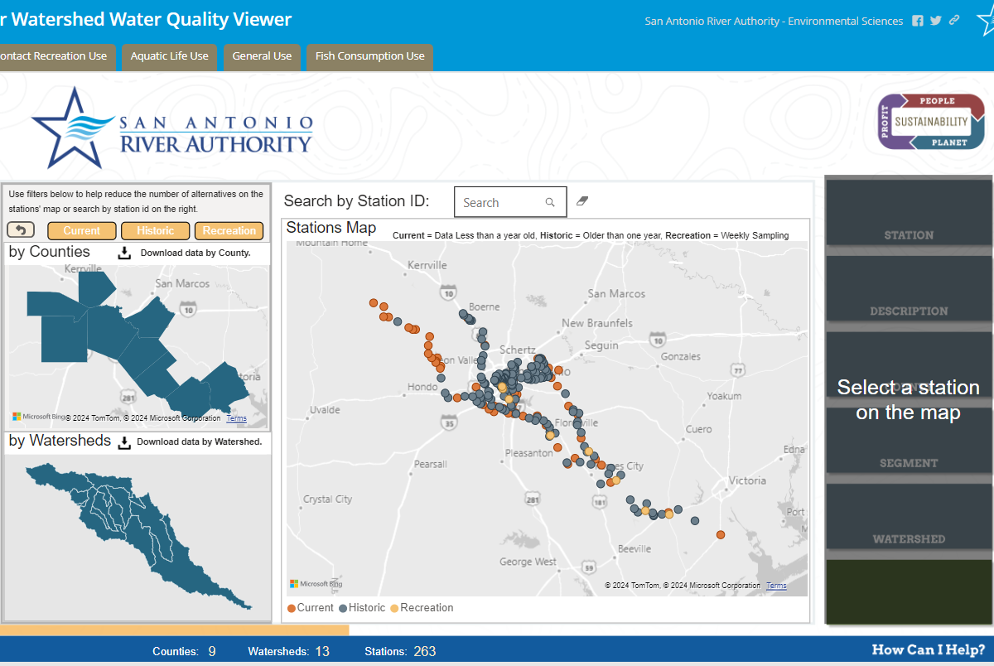
SARA

Slide 16
CRP Data
The CRP data is used by TCEQ to generate the Texas Integrated Report every two years.
This report is sent to EPA as required by the Federal Clean Water Act Sections 305(b) and 303(d).

Slide 17
Water Quality Objectives and Priorities

Slide 18
CRP Goal
Maintain and improve the quality of water within each river basin in Texas through an ongoing partnership involving the TCEQ, river authorities, other agencies, regional entities, local and state governments, industry, and citizens.

Slide 19
CRP Objectives
Provide quality-assured data
Identify and evaluate water quality issues
Promote cooperative watershed planning
Recommend management strategies
Inform and engage stakeholders
Maintain efficient use of public funds

Slide 20
SARA’s Priority
To provide timely, relevant and defensible data to decision makers and the public to support actions that improve and protect the water quality and ecology of the riverine environment.

Slide 21
Basin Specific Priorities?
Special studies?
Parameters of concern?
Sampling locations?

Slide 22
Work Plan and Allocation of Resources
Courtesy of C. Nelson

Slide 23
Workplan
Task 1 - Project administration
Task 2 - Quality assurance
Task 3 - Water quality monitoring
Task 4 - Data management
Task 5 - Data analysis and reporting
Task 6 - Stakeholder participation and public outreach
Notes:
Task 3 - Identified a minimum of 50 samples, but we anticipate approximately the same number of samples. But the decision on exactly how many samples and what type will be decided in the coordinated monitoring meeting.
Task 4 - Only major change is in the second year of the contract, they are asking for the data deliverable on February 1st, not March 1st so the TCEQ can get started on evaluating the data for the integrated report.
Task 5 – Year 1 – Basin Highlights Report – Program Update – Select several watershed and characterize it. Hydrology, Water quality, land use , natural characteristics, Potential causes of Water Quality issues, Potential Stakeholders, Recommended Actions, Maps, Ongoing projects, Major Watershed Images.
Year 2 – Basin Highlights Report - Watershed Characterization
Task 6 – Public Outreach is generally done outside the Clean Rivers Program, but SARA is committed to public outreach, ESD scientists routinely participate in public outreach, and SARA has Public Affairs Department that has two teams communications team and the education and engagement teams. Also, Watershed and Parks Operations host public events at our parks.

Slide 24
CRP Funding
The program is funded by fees assessed on wastewater discharge permittees and water rights holders, TCEQ’s own state appropriations and San Antonio River Authority.

Slide 25
Funding FY24-25
BUDGET CATEGORIES | FY 24 | FY 25 | Total
 | 9/1/23 - 8/31/24 | 9/1/24 – 8/31/25
Personnel/Salary | $153,816.04 | $153,816.04 | $307,632.08
Fringe Benefits (38% Salary) | $59,988.26 | $59,988.26 | $119,976.51
Travel | $300.00 | $300.00 | $600.00
Supplies | $5,599.10 | $5,599.10 | $11,198.20
Equipment | - | - | -
Contractual | - | - | -
Other | $400.00 | $400.00 | $800.00
Total Direct Costs | $220,103.40 | $220,103.40 | $440,206.79
Indirect costs (10% Salary ) | $15,381.60 | $15,381.60 | $30,763.21
Total Reimbursable Costs | $235,485.00 | $235,485.00 | $470,970.00

Slide 26
Draft 2024 Basin Highlight Report
Notes:
Late Spring - Review and Comment
Once TCEQ sends back the first draft, we will forward this to you for review and comments. It is only 40 Pages
First Draft: Feb 15, 2024
Final Due: May 15th

Slide 27
Outreach
Warriors
Trash pickup
Apple snails
Citizen scientists
Community events
Presentations
Media outreach

Slide 28
Outreach
Hazardous waste pickup in lower basin
Support STEM programs
Park programs
Notes:
ESD staff
Judge science fairs
Participate in community events
Assist Universities
Park programs –
What would worms do
Night Hike
Walk on the wild side (using I naturalist)
Tracks and Scat

Slide 29
Outreach www.sariverauthority.org

Slide 30
Thank You
Notes:
EAC
Additional Steering Committee
Partners
Bandera County River Authority and Groundwater District
City of Boerne
Staff:
Aquatic Biologists
Laboratory Analysts
Quality Assurance Scientists
Data Scientists
Ecologists
Minna
Brian
TCEQ
Project Manager – Grant
All the volunteers who give up their free time to help the environment

Slide 31
Questionnaires
Stream restoration
Watershed protection plans
Non-point source pollution issues
Illegal dumping
Invasive species
Fish and benthic communities in the San Antonio River Basin
Lower basin water pollution
Environmental flows

Slide 32
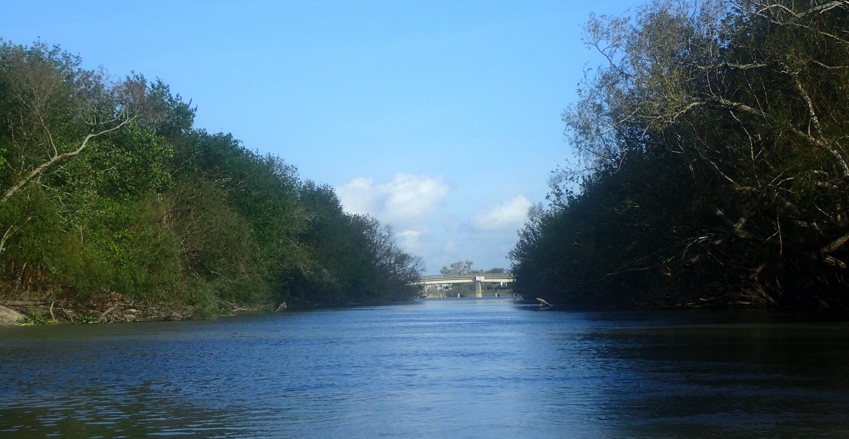
Rebecca Reeves Senior Quality Assurance and Monitoring Scientist rreeves@sariverauthority.org
Questions?

Slide 34
Sampling Plan
Data Collection
Assessment
(TCEQ IR)
TMDL
I plan
Implement
Coordinated monitoring plan
Quality assurance project plan
Collecting the sample
Laboratory analysis
Quality assurance
Data management
Notes:
A TMDL is a study that calculates of the maximum amount of a pollutant that a waterbody can accept and still meet the state's Water Quality Standards for public health and healthy ecosystems.

